Slide 1
Opt-in or out of Video Recording During Alerts
Solo Mobile

Slide 2

[DISCLAIMER]
This presentation document has been prepared by Damstra Technology Limited (“Damstra") and is intended for off line demonstration, presentation and educational purposes.
The information is not version controlled and as such is subject to change without notice.
Damstra does not accept any responsibility or obligation to inform users of this presentation of such changes.
This includes any copies of this presentation taken and modified outside of the Damstra domain.

Slide 3
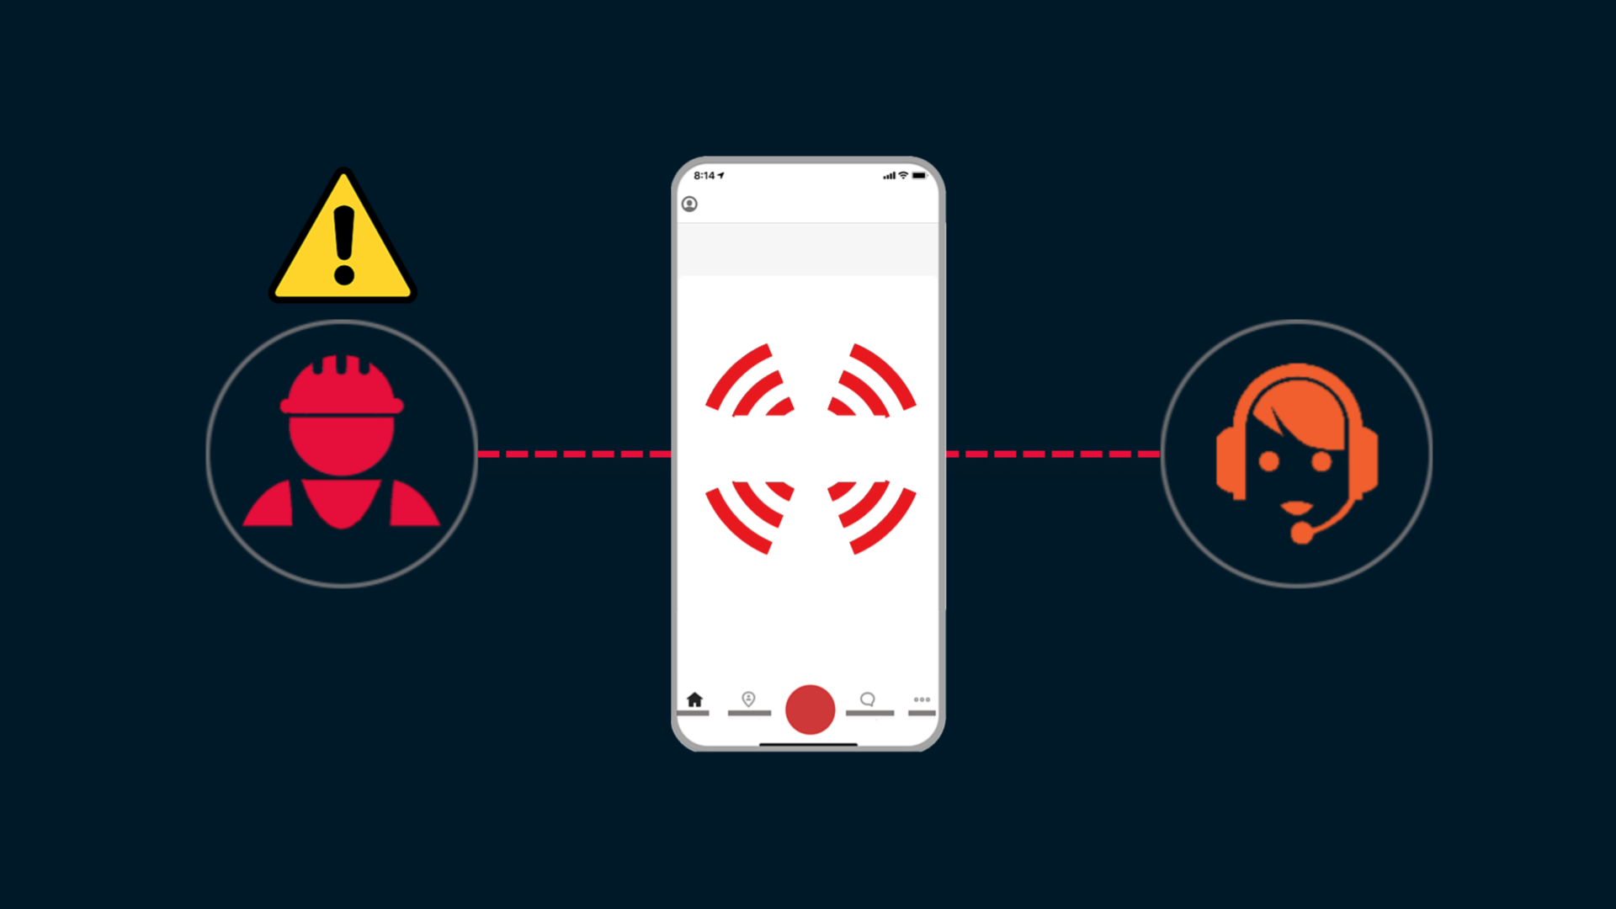
Opt-in or Out of Video Recording
Introduction
Damstra Solo offers an optional Video Recording During Alerts feature which, when enabled, allows video and audio to be recorded via your mobile device in the event of a raised alert.
Enabling this feature can provide crucial situational awareness to first responders attending to your alert event.
This is an optional feature, and in this video we will explain eligibility criteria and how to opt-in or out.

Slide 4
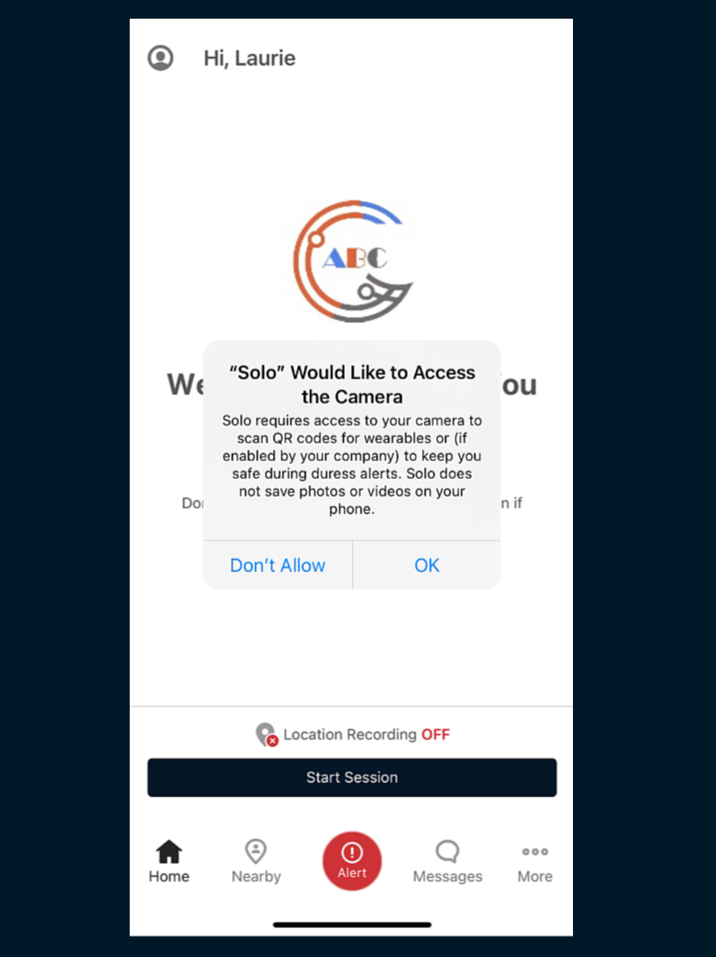
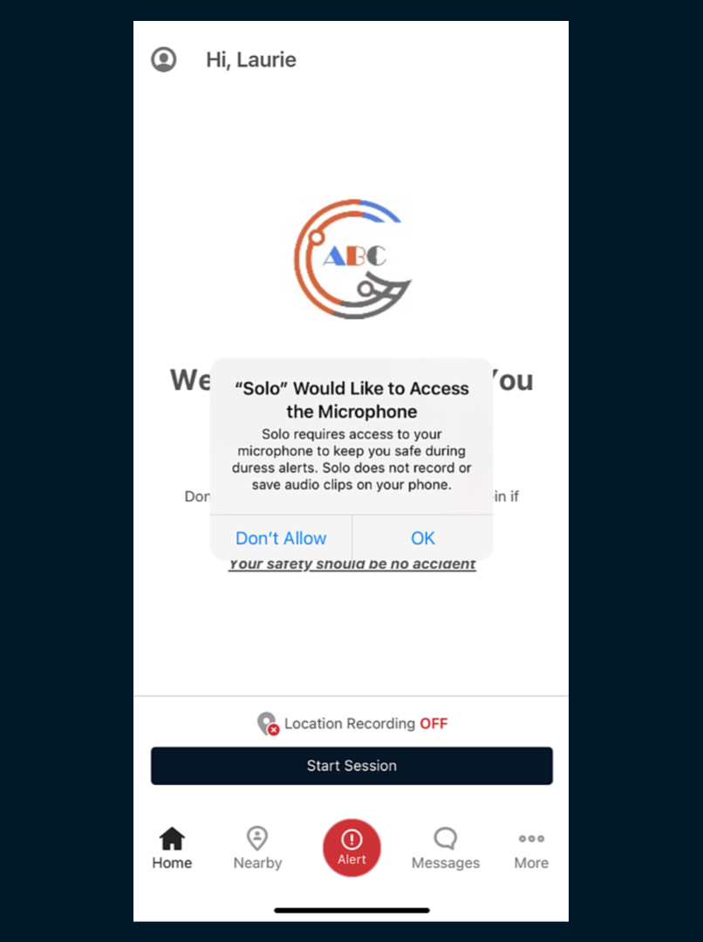
Opt-in or Out of Video Recording
Eligibility
In terms of eligibility, this feature will only be available on your phone if both you and your Organisation permit it.
First, your Organisation must opt-in to the feature.
You’ll know if this is the case as Solo will ask you for permission to utilise your Camera and Microphone during setup.

Slide 5
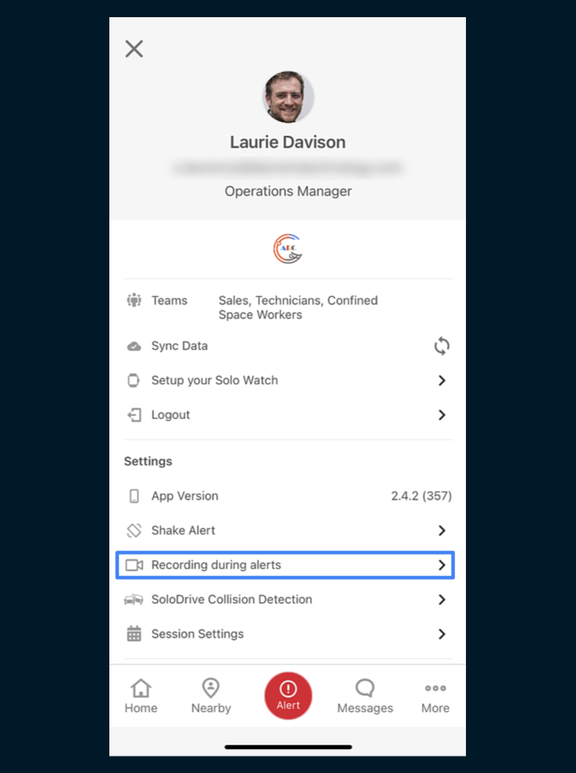
Opt-in or Out of Video Recording
Eligibility (cont)
Additionally, you’ll see a 'Recording during Alerts' section in Solo Settings. If this option is not visible in your Settings menu, your Organisation has not opted-in to the feature and you will not be able to enable it on your device.

Slide 6
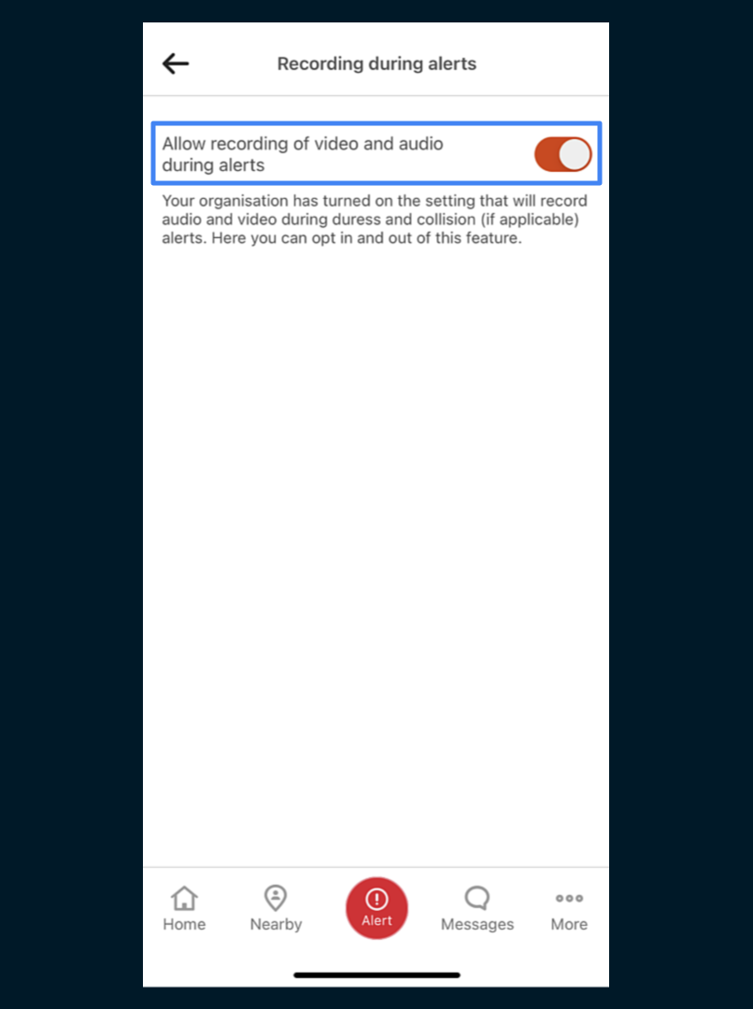
Opt-in or Out of Video Recording
Opting-in
Once your Organisation has opted-in, the choice of whether to opt-in or out of the feature on your device is yours.
To opt-in, allow permissions for Solo to access your Camera and Microphone when prompted.
In addition, ensure that in the ‘Recording During Alerts’ section, ‘Allow recording of video and audio during alerts’ is enabled.

Slide 7
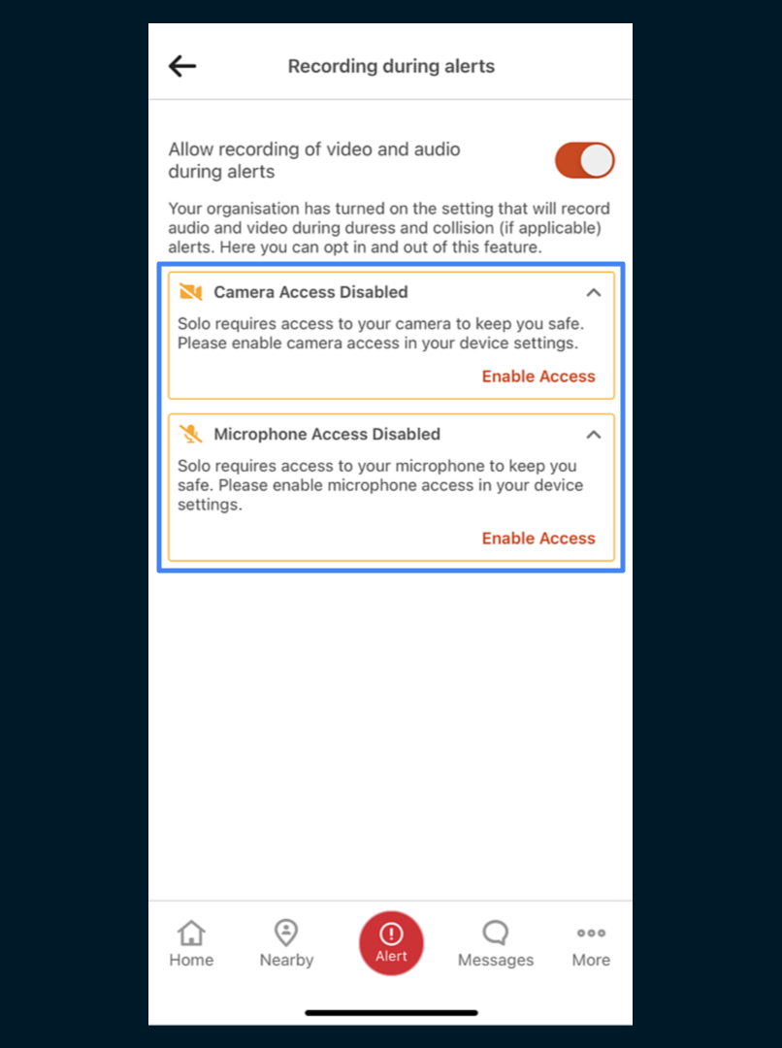
Opt-in or Out of Video Recording
Opting-in (cont)
If the feature is enabled but either of the camera or microphone permissions are not correctly set, you’ll be prompted to enable them.
No recording will take place unless the ‘Recording During Alert’ option is enabled and both permissions are granted.

Slide 8
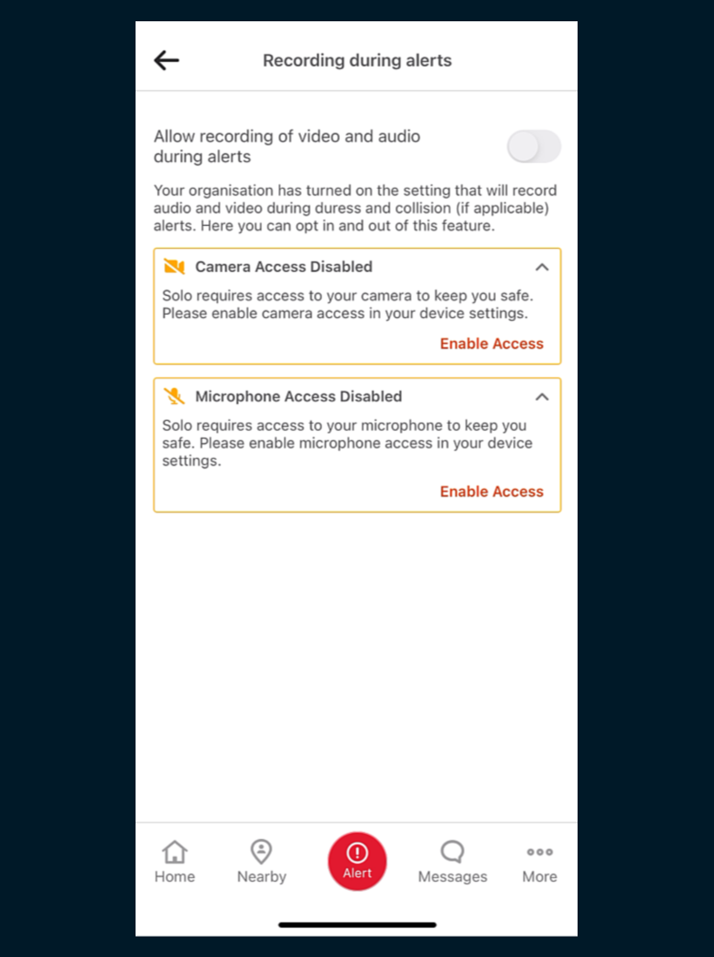
Opt-in or Out of Video Recording
Opting-out
To opt-out of this feature on your device, ensure that ‘Allow recording of video and audio during alerts’ is disabled.
Note that you may opt-in or out at any time.

