Slide 1
View Session History
Solo Mobile

Slide 2

[DISCLAIMER]
This presentation document has been prepared by Damstra Technology Limited (“Damstra") and is intended for off line demonstration, presentation and educational purposes.
The information is not version controlled and as such is subject to change without notice.
Damstra does not accept any responsibility or obligation to inform users of this presentation of such changes.
This includes any copies of this presentation taken and modified outside of the Damstra domain.

Slide 3
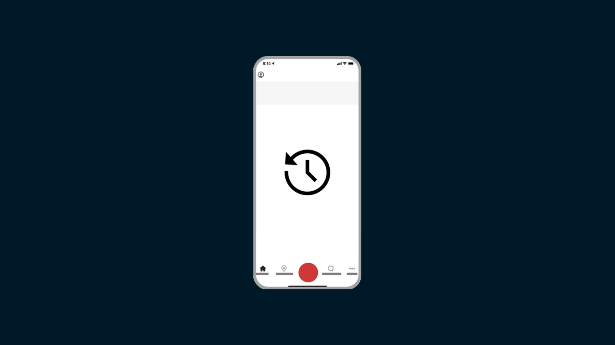
View Session History
Introduction
The Solo Mobile app keeps a record of your previous Solo Sessions, including any recorded location data where GPS tracking was enabled. This can be a handy way of retracing your steps and allows you to view any available video recorded during alerts, if your Organisation uses this feature and you have opted-in to using it.

Slide 4
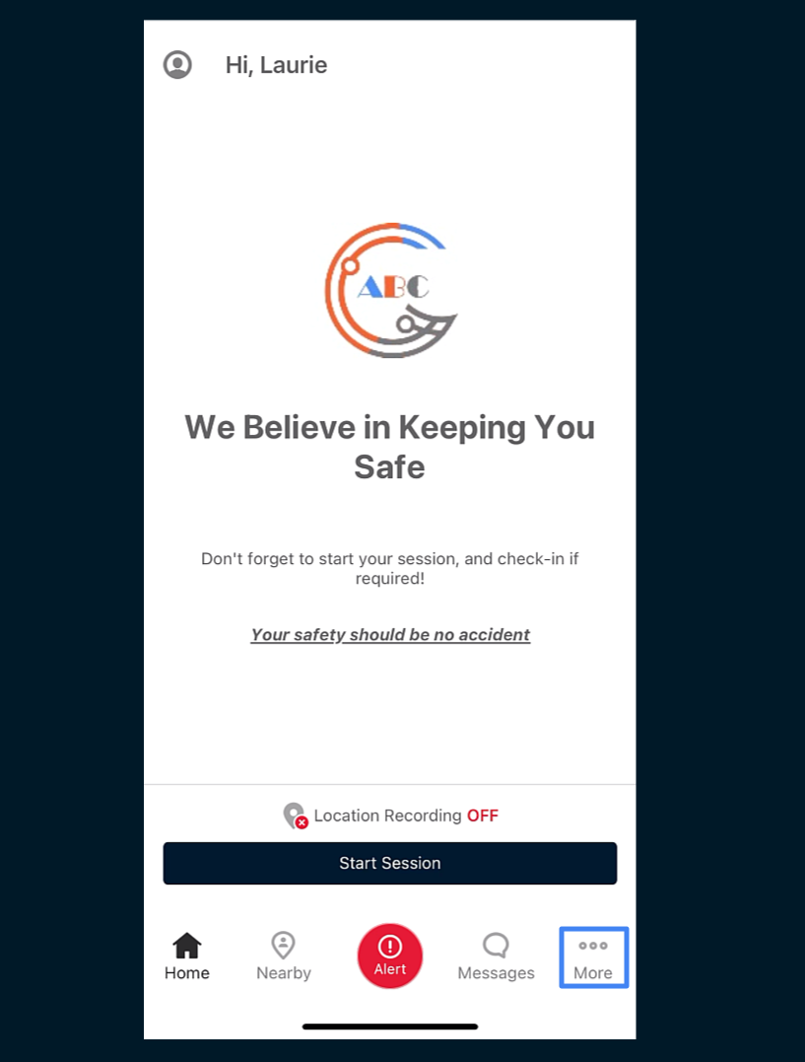
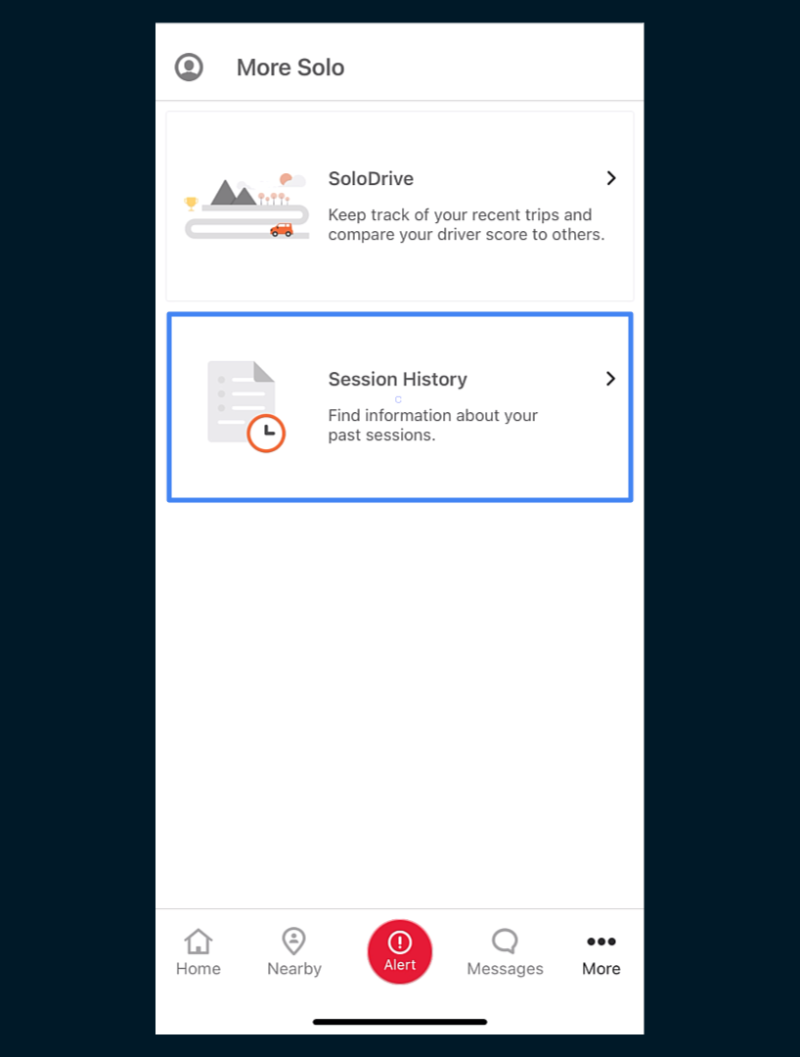
View Session History
Accessing Session History
To view your Session History, tap the ‘More’ button toward the bottom of the screen, and tap ‘Session History’.

Slide 5
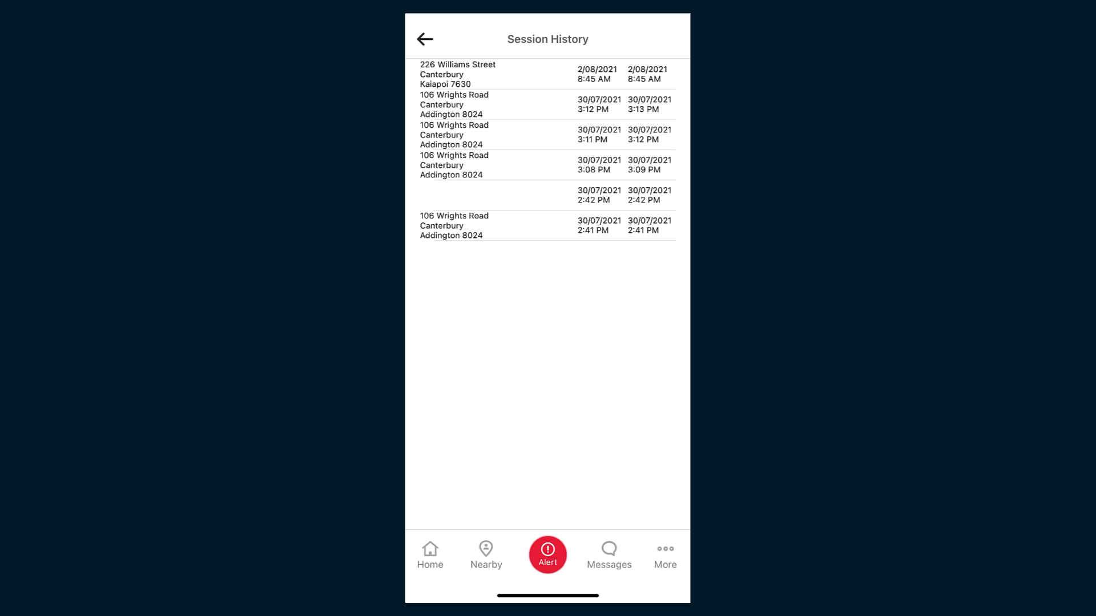
View Session History
Session History Screen
All available historical sessions are displayed with the most recent at the top. Note that only sessions that have taken place since you last installed the app are available.
If GPS tracking was enabled for a session, Solo displays the starting location along with the date and time information for both the start and end of the session.
If GPS tracking was not enabled for a session, only the start and end times will be displayed.
To view additional session information, tap the required session.

Slide 6
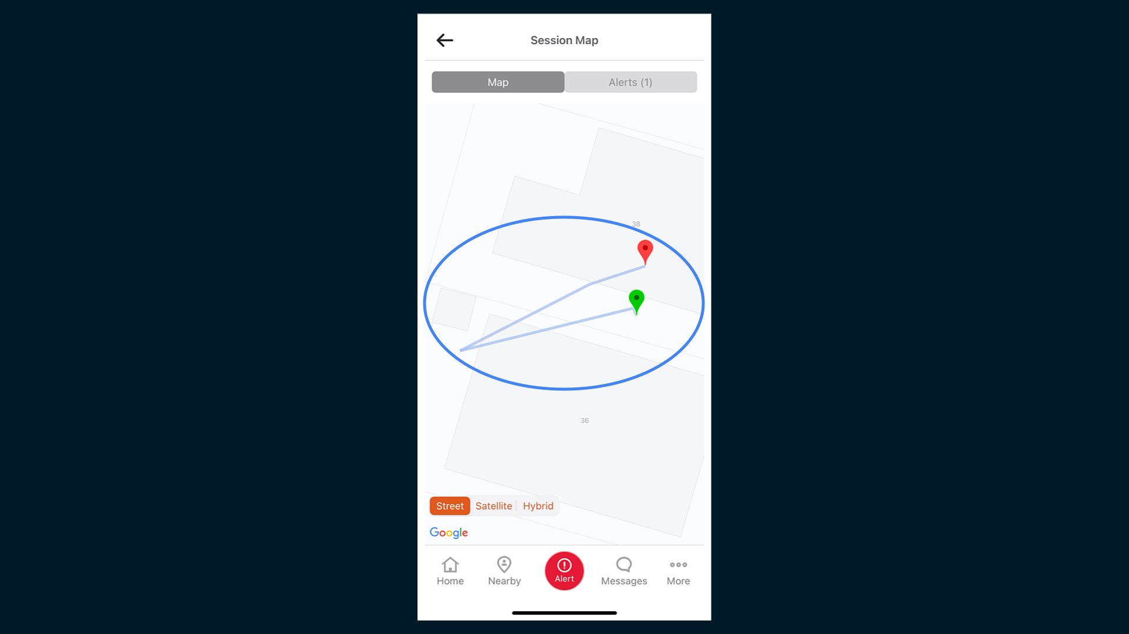
View Session History
Accessing Session History
If GPS tracking was enabled, the location data may be viewed on the ‘Map’ tab. Normal Google Maps functionality is available to zoom, pan and switch between map modes.
The recorded route is shown in blue, with markers designating the captured start and end points.

Slide 7
View Session History
Location Data
If GPS tracking was enabled, the location data may be viewed on the ‘Map’ tab. Normal Google Maps functionality is available to zoom, pan and switch between map modes.
The recorded route is shown in blue, with markers designating the captured start and end points.

Slide 8
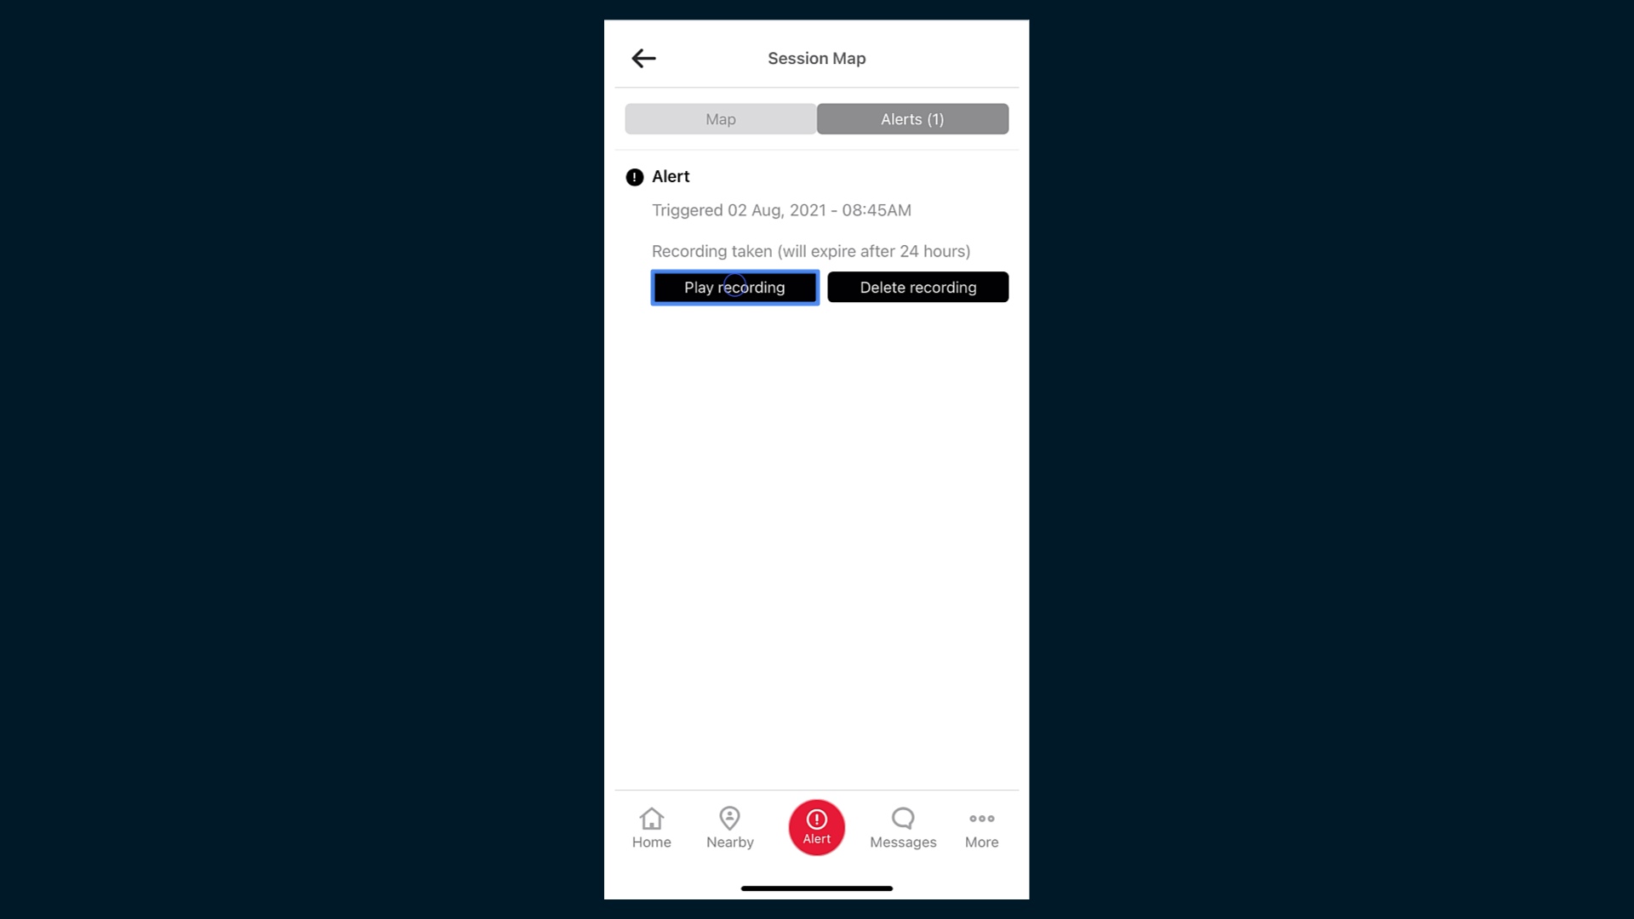
View Session History
Alert Data
If an Alert was raised during the session, these details are available on the ‘Alerts’ tab.
If a video recording was made, controls for playing and deleting the recording are shown.
Tapping the ‘Play Recording’ button will open a link to the recording.

Slide 9
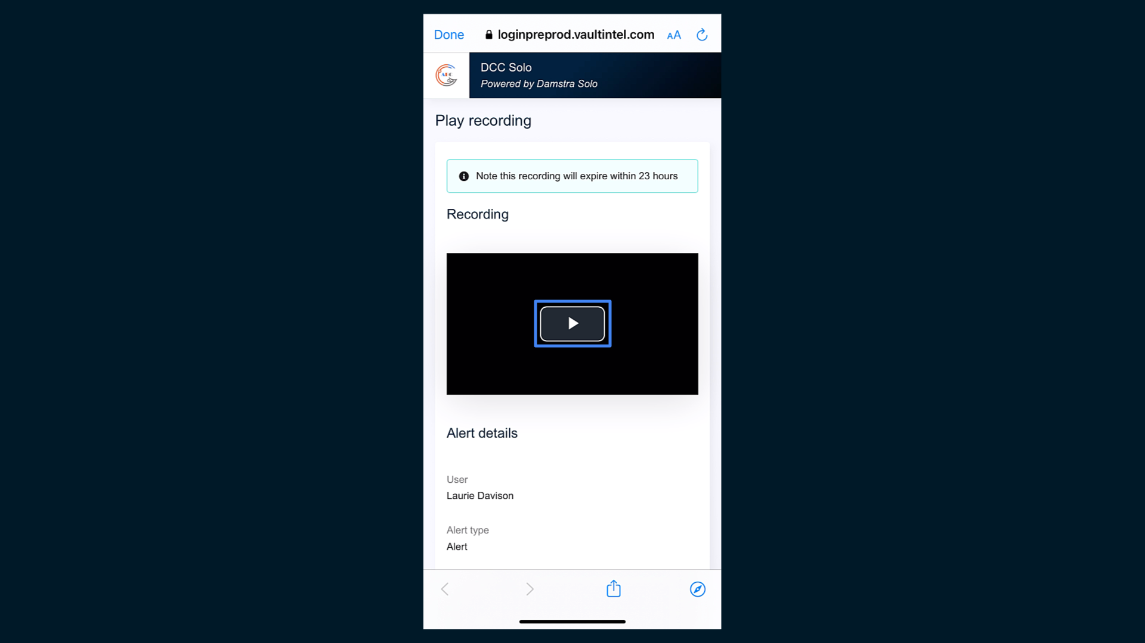
View Session History
Playing Video Recordings
Tap the ‘play’ button to play the video, and tap ‘Done’ to return to the Alerts tab.
Note that these videos are stored in Solo’s secure cloud server and do not take up space on your device.

Slide 10
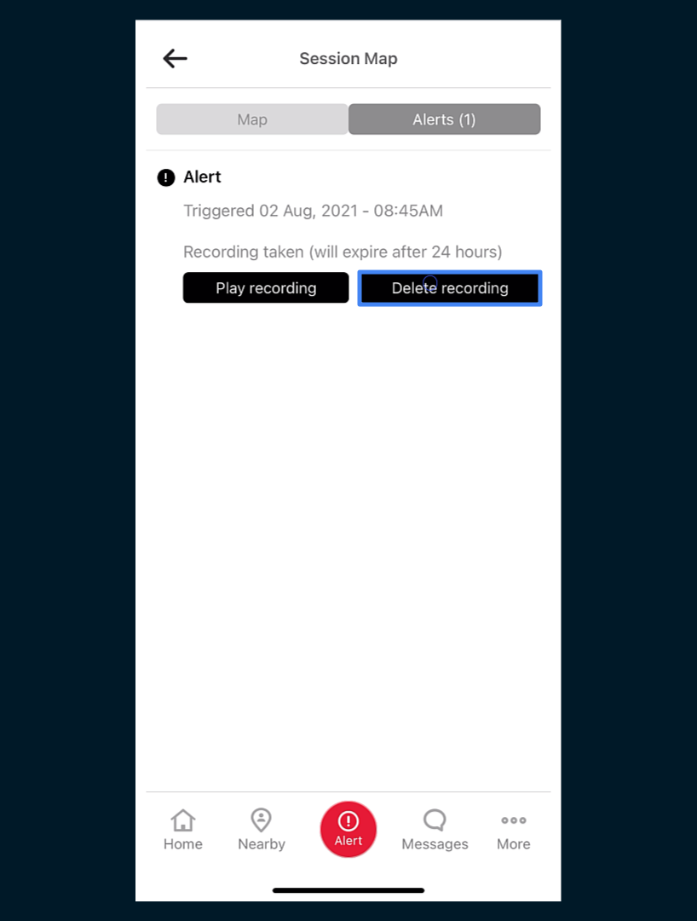
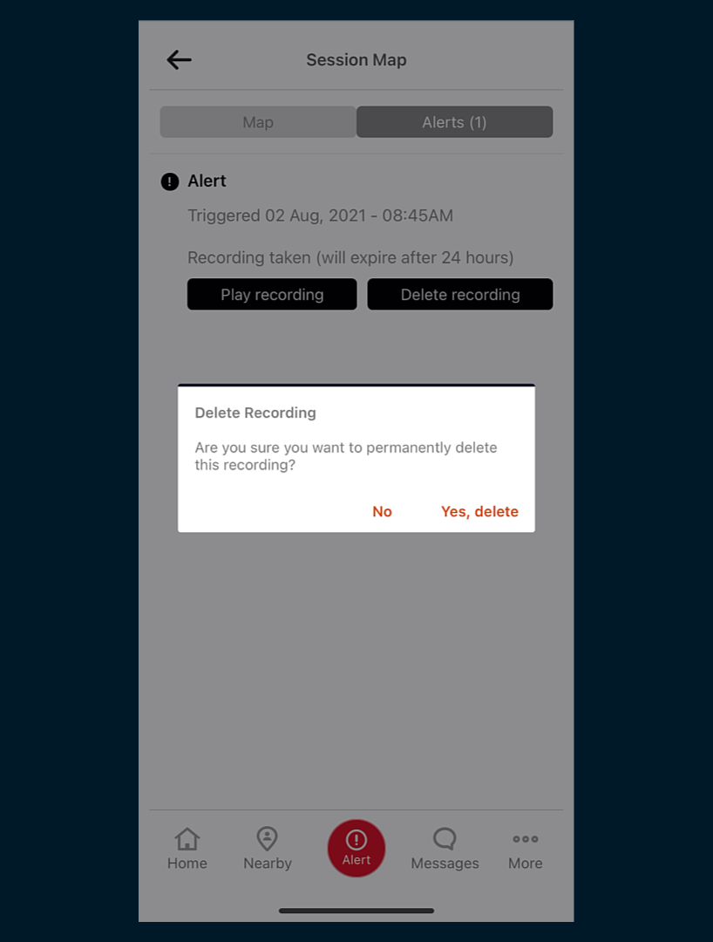
View Session History
Deleting Video Recordings
Deleting a video deletes it for all Users who currently have access.
Video recordings are automatically deleted after 24 hours.
Help with opting-in to video recording is available separately in the Support Portal.

