Slide 1
Pause / Resume Session
Solo Mobile App

Slide 3
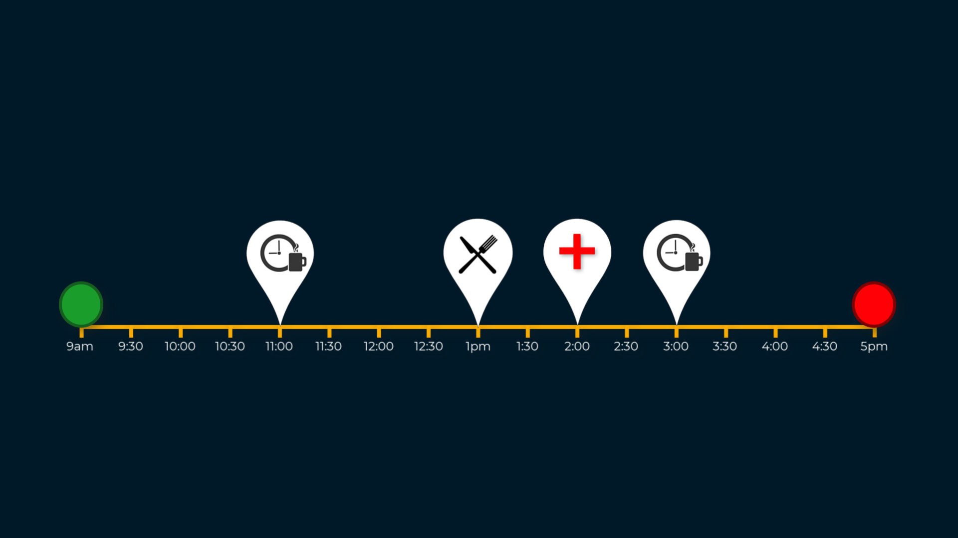
Pause / Resume Session
Introduction
Because our Working days are often punctuated by things like breaks and private appointments, Solo provides the ability to Pause, and later resume a session.
While a session in paused, Solo will not share your location with your Organisation, and will not expect to receive any check-ins until the session is manually resumed.

Slide 4
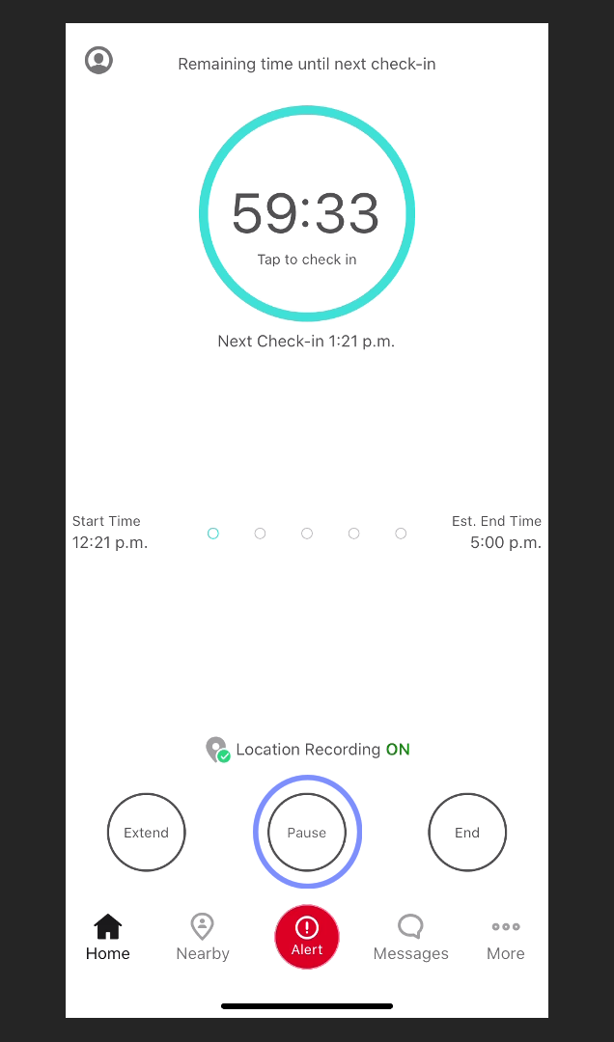
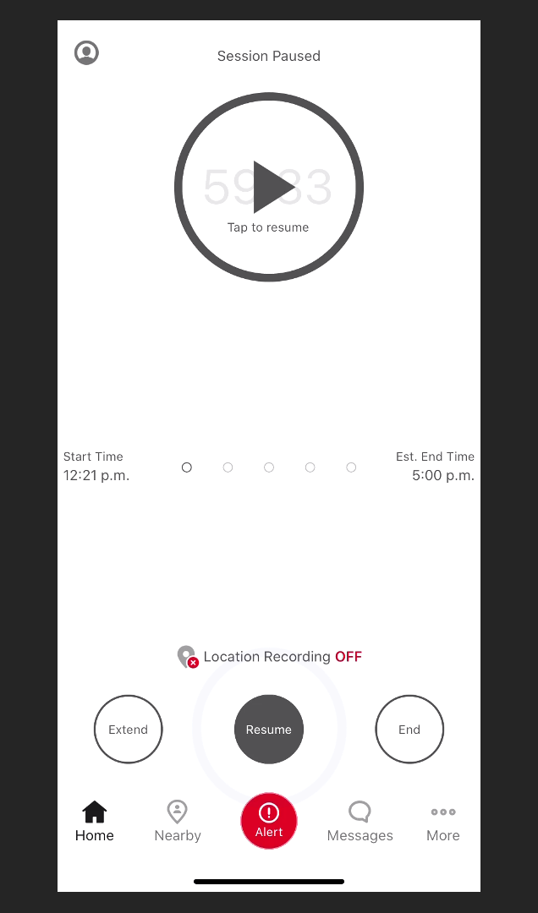
Pause / Resume Session
Pause Session
From your current active session, tap Pause.
The countdown timer will now pause, and location recording will stop.

Slide 5
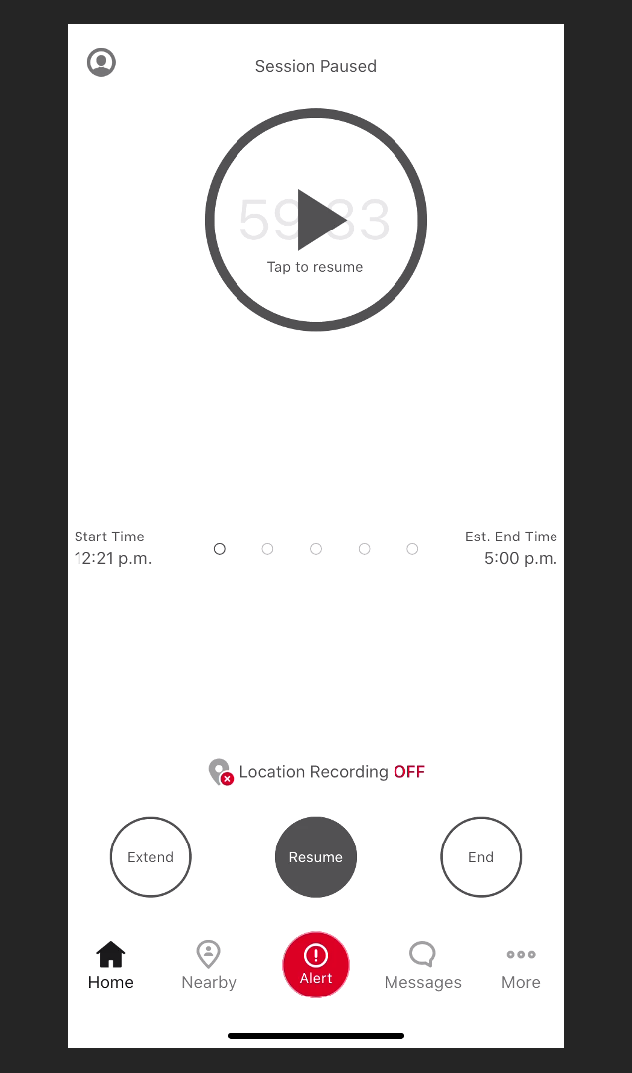
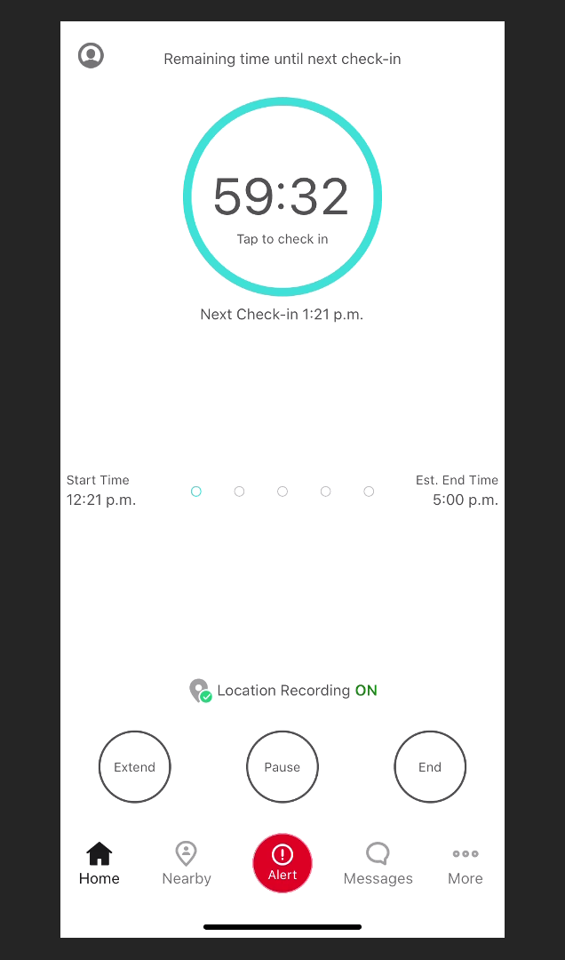
Pause / Resume Session
Resume Session
To resume the session, simply tap Resume.
The Countdown timer will now resume from where it was paused, and your location will once again be shared with your Organisation.

