Slide 1
Extend a Session
Solo Mobile App

Slide 3
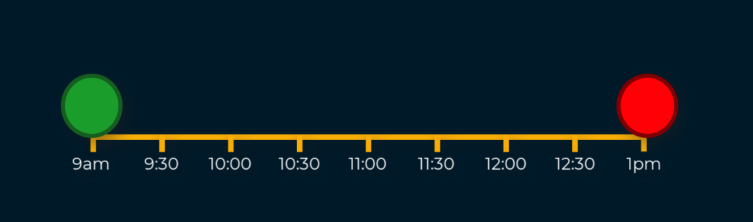
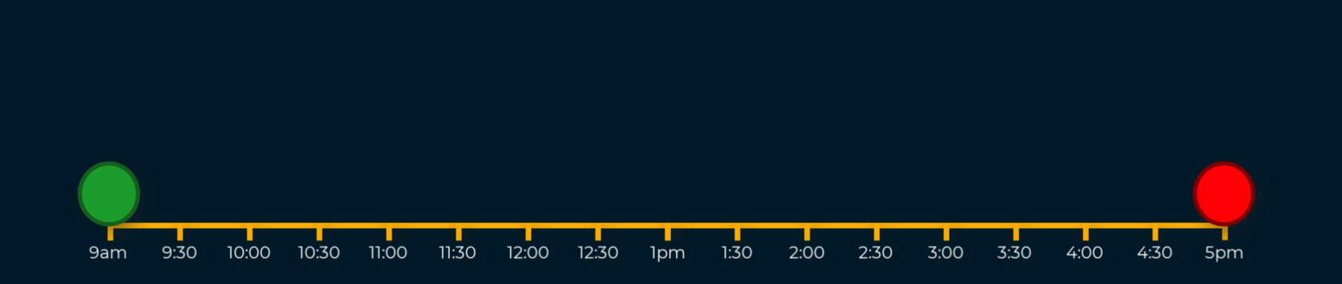
Extend a Session
Introduction
Once a session had been started, the estimated end time of that session can be adjusted at any time, even if no finish time was stipulated at the start of the session.
This guide shows how this is done.

Slide 4
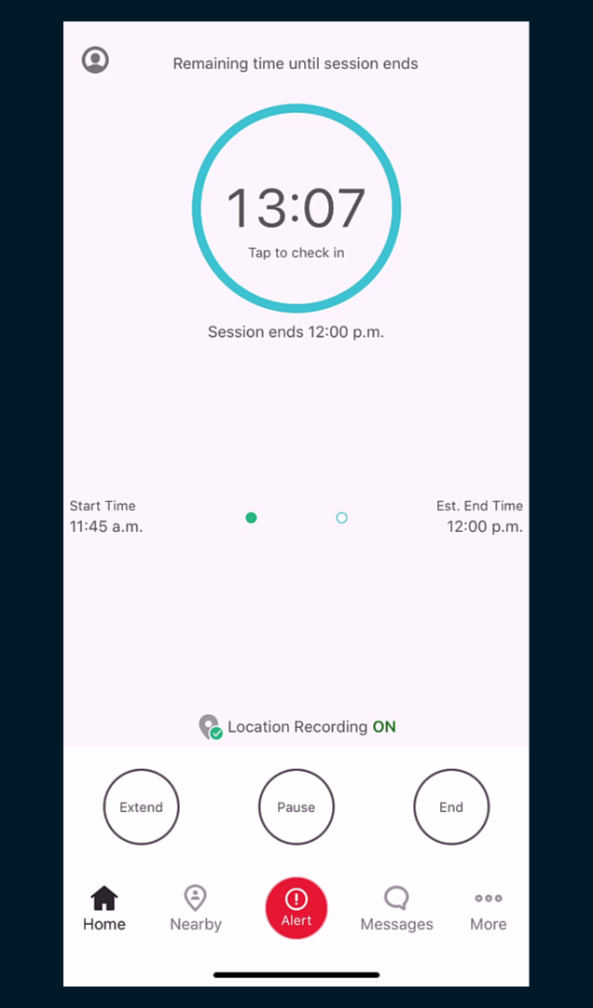
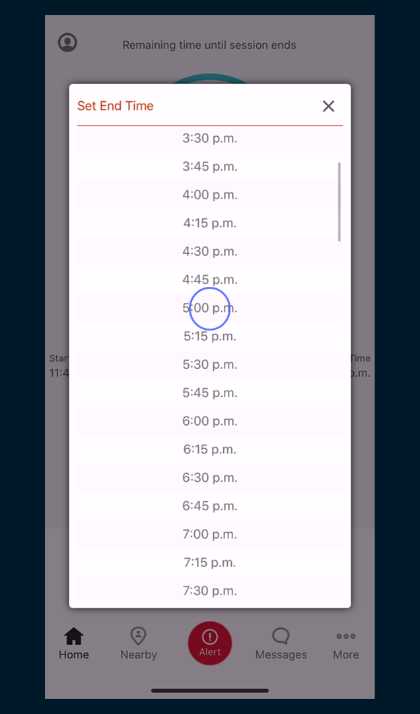
Extend a Session
Extending a Session
From your current active session, tap Extend and select the new finish time for the session.

Slide 5
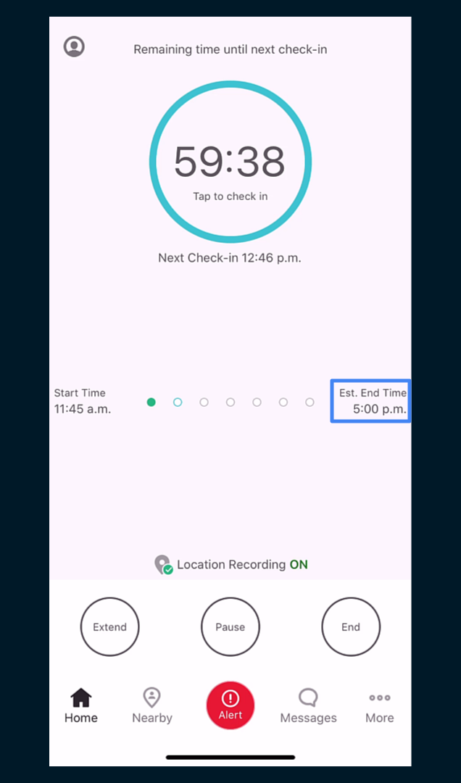
Extend a Session
Extending a Session cont.
The current session will redisplay with the new finish time.
The required number of check-ins will also be recalculated and loaded against the session.
Once the new finish time is reached, you will be prompted to end the session.

