Slide 1
Using Solo
Damstra SoloWatch

Slide 2

[DISCLAIMER]
This presentation document has been prepared by Damstra Technology Limited (“Damstra") and is intended for off line demonstration, presentation and educational purposes.
The information is not version controlled and as such is subject to change without notice.
Damstra does not accept any responsibility or obligation to inform users of this presentation of such changes.
This includes any copies of this presentation taken and modified outside of the Damstra domain.

Slide 3
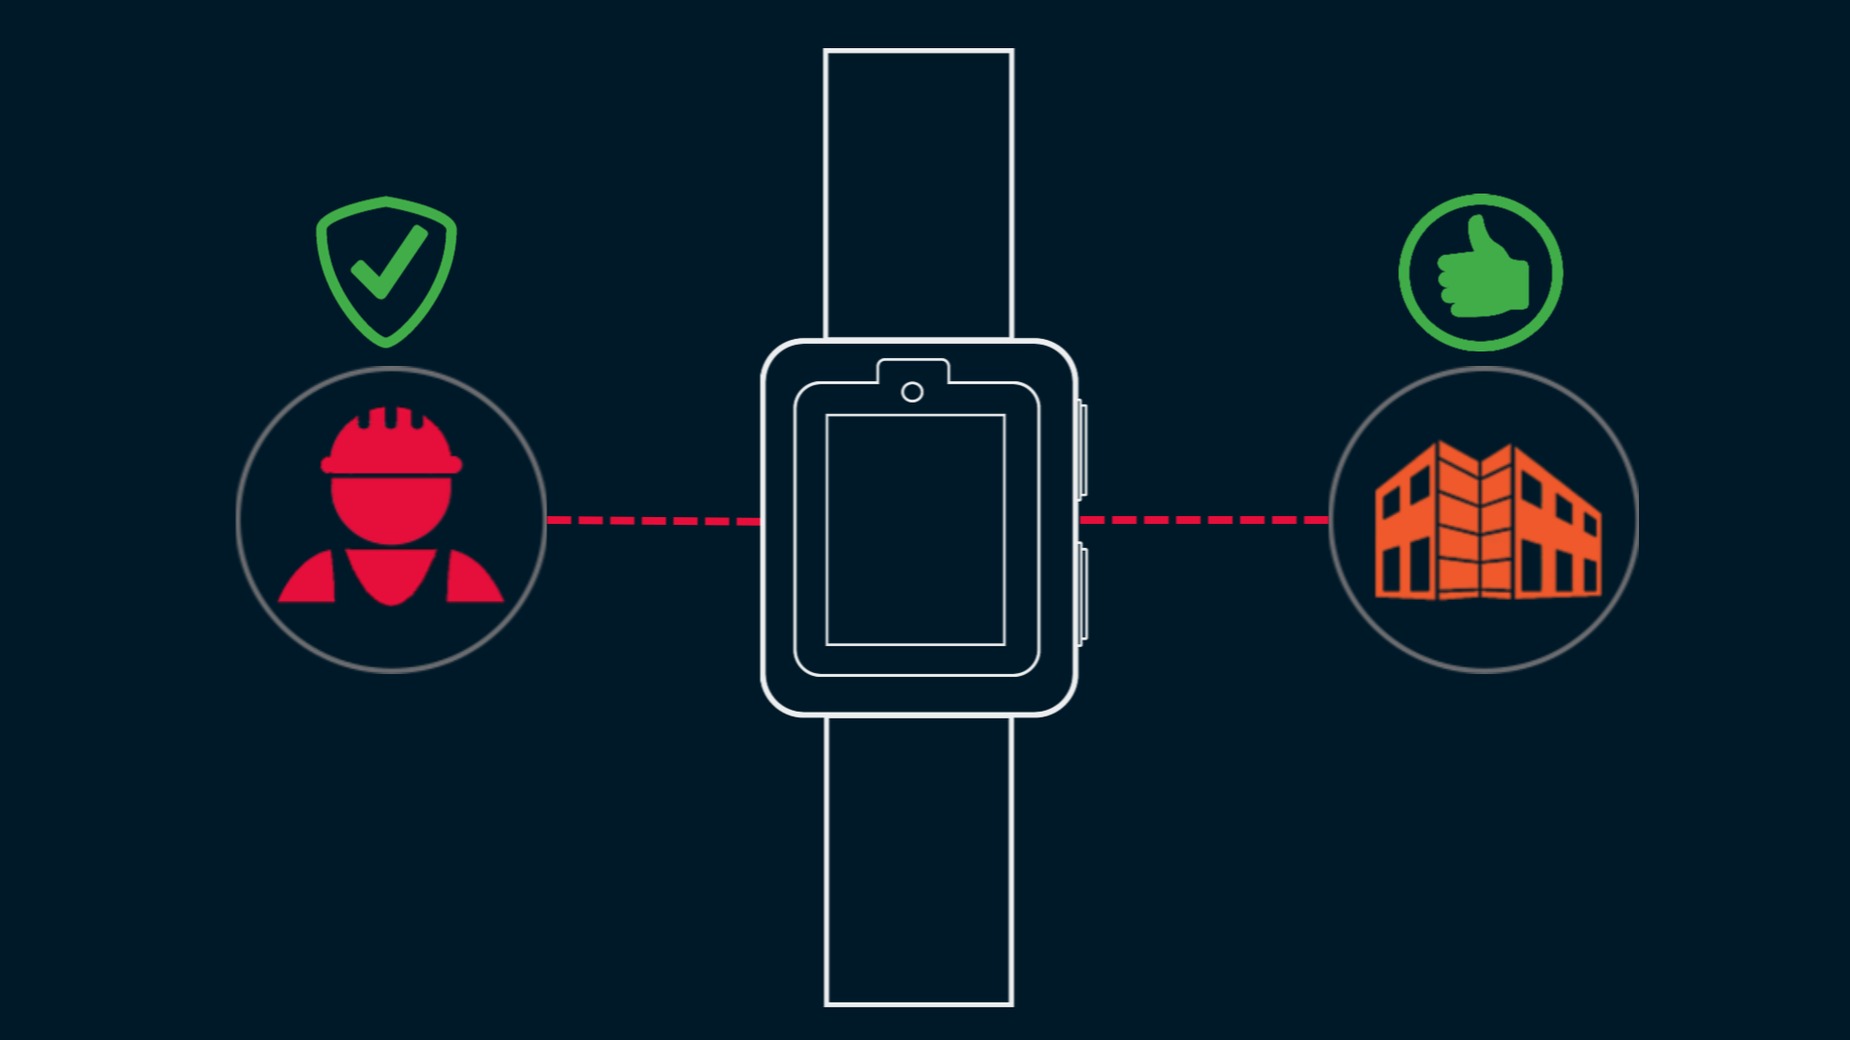
Using Solo for SoloWatch
Introduction
The Damstra Solo Watch is designed to help keep you safe and connected to your Organisation as you go about your daily tasks.
In this video, we’ll show how you might use Solo as you go about a typical workday.

Slide 4
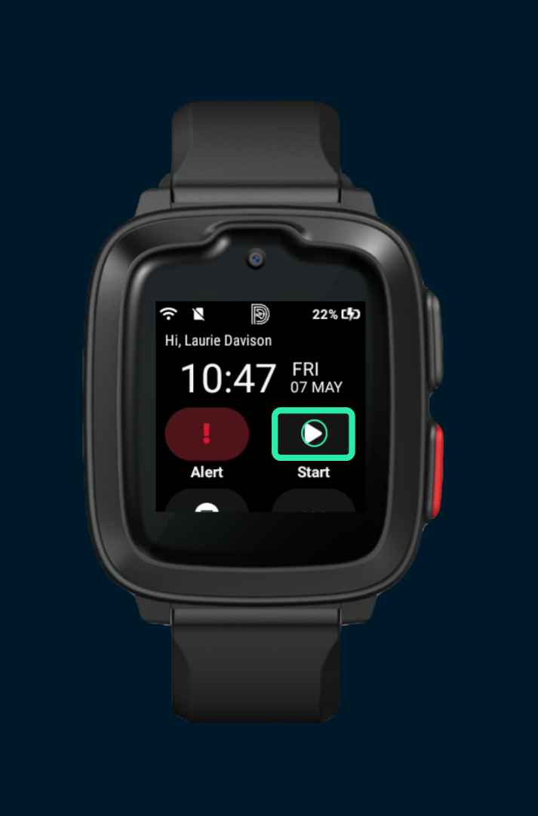
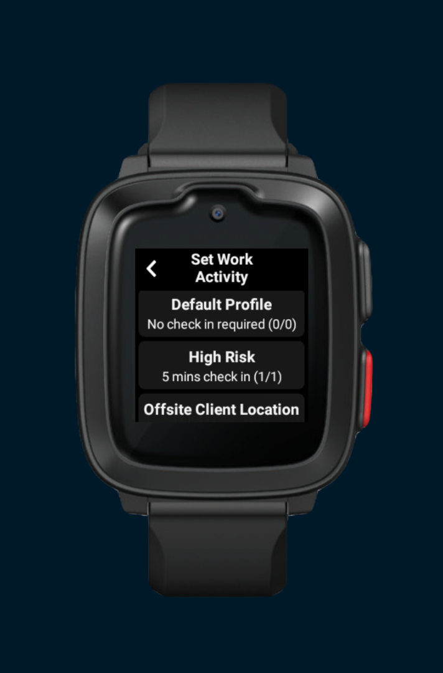
Using Solo for SoloWatch
Starting a Session
When you start work, let your Employer know that you’re safe by starting a new Solo session.
Tap the ‘Start’ button and, when presented, select a profile from the list.
If you’re not sure which one to pick, contact your manager or your systems administrator for advice.
Once started, your Organisation will be able to see your current status, heart rate, and, if enabled within the selected profile, your location.

Slide 5
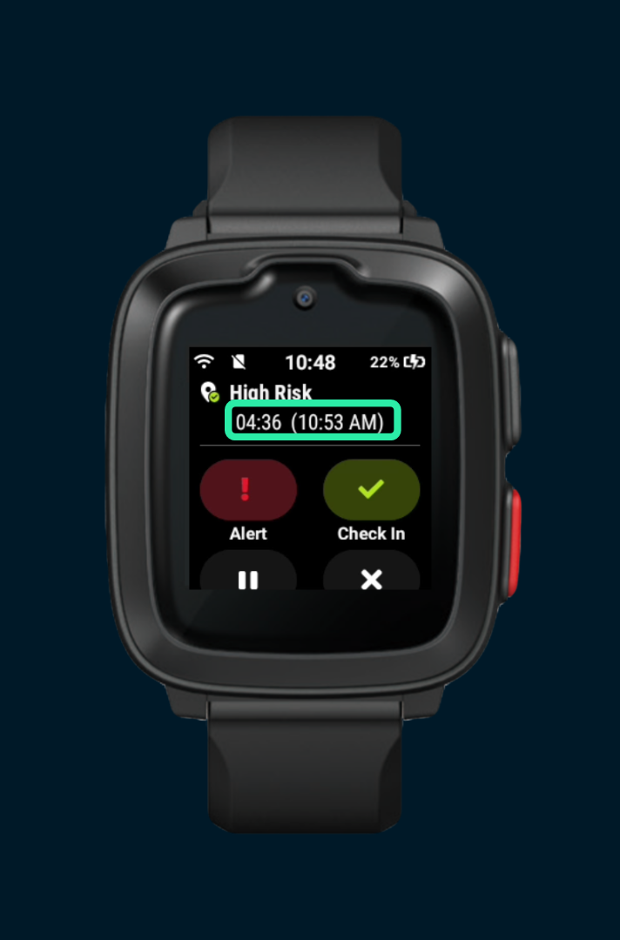
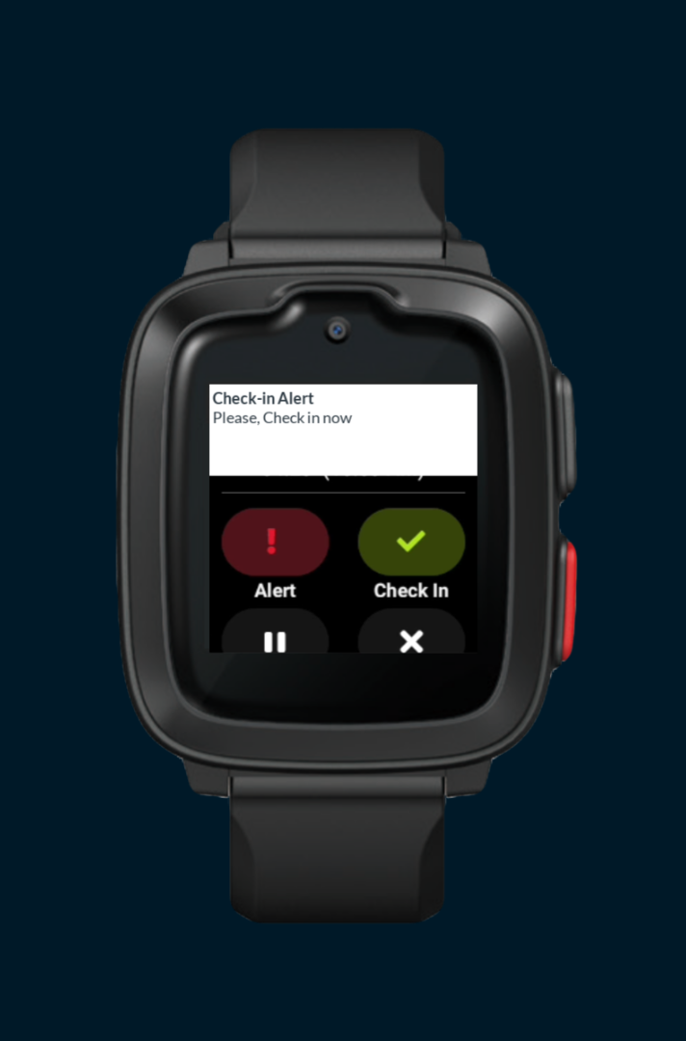
Using Solo for SoloWatch
Checking-in
Your employer might require you to ‘check-in’ at regular intervals throughout your Session to let them know that you’re safe. If this is the case, you’ll see a countdown timer which indicates the time remaining until the next check-in is due.
When the check-in time arrives, you’ll receive a notification on your watch.
Tap ‘Check-in’. Your employer now knows you’re safe.

Slide 6
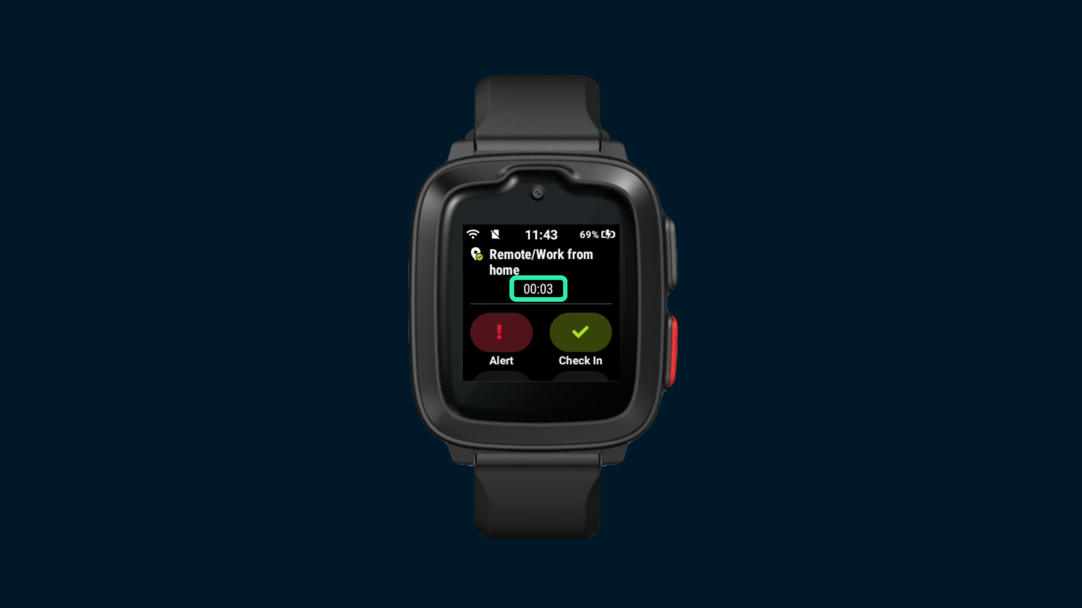
Using Solo for SoloWatch
Checking-in (cont.)
If you see a timer counting up from the point when the Session was started, rather than counting down, you don’t need to check-in.

Slide 7
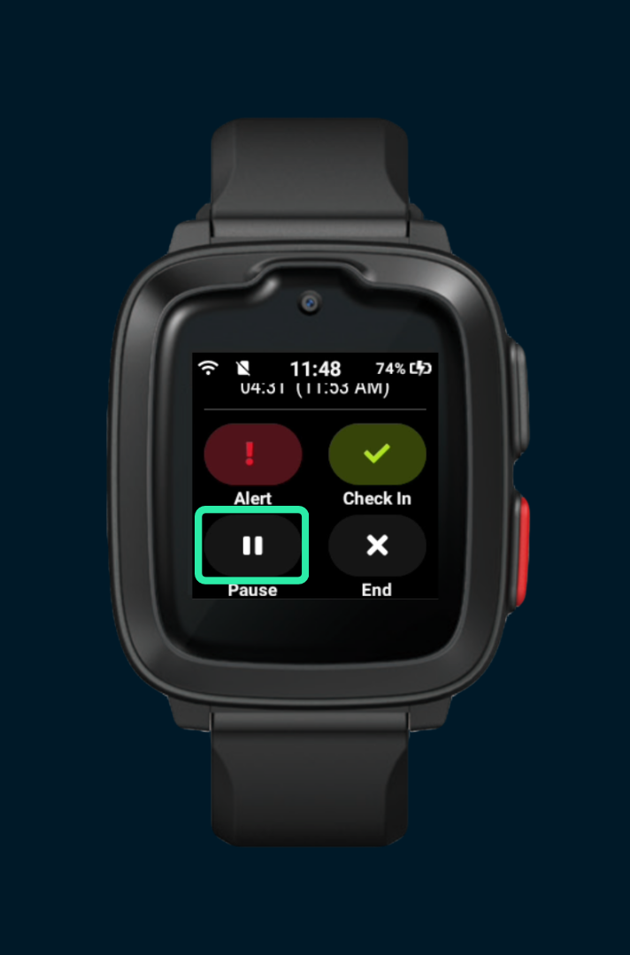
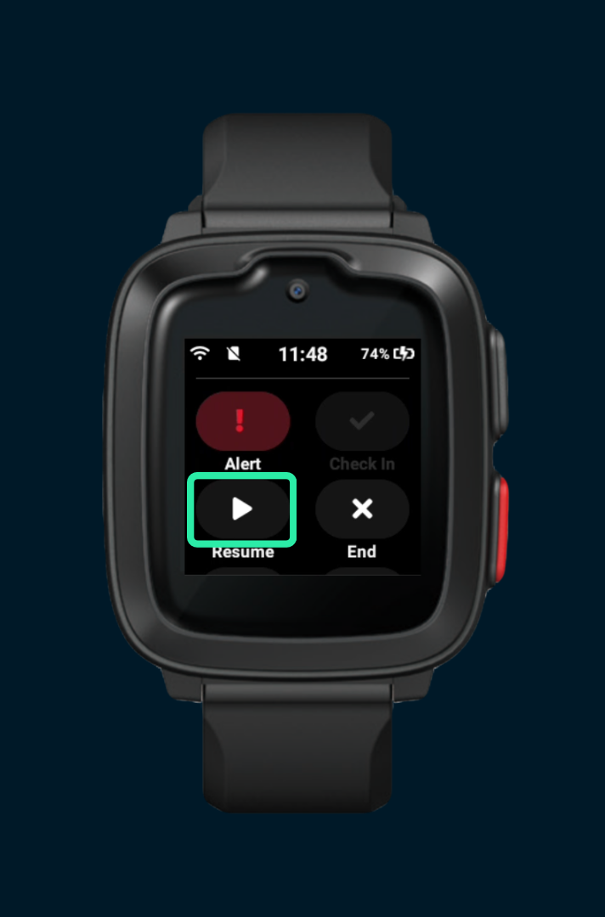
Using Solo for SoloWatch
Pausing a Session
For privacy during personal appointments or breaks, your Solo session can be paused whenever you like. Simply tap the ‘Pause’ icon.
While paused, Solo will not require any check-ins and your Organisation will not be able to view your location.
Tap the ‘Resume’ icon when you’re ready to resume the Session.

Slide 8
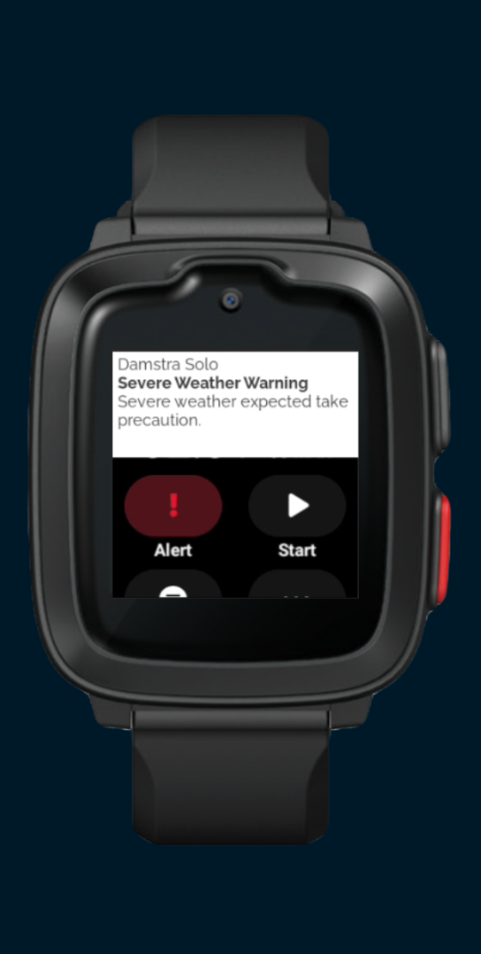
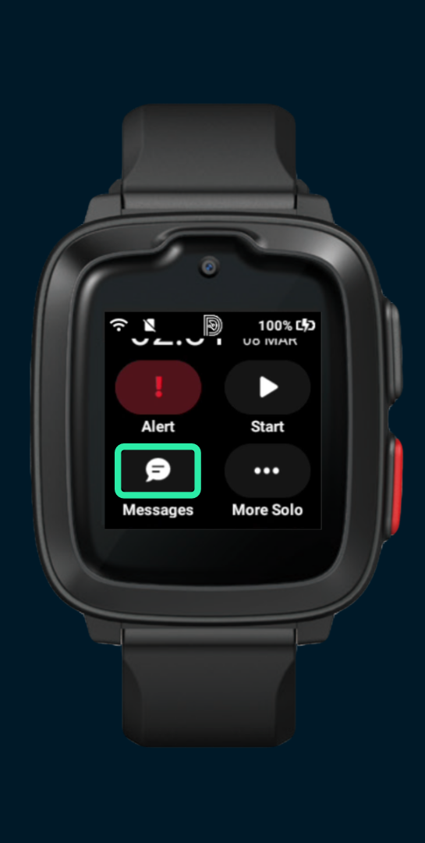
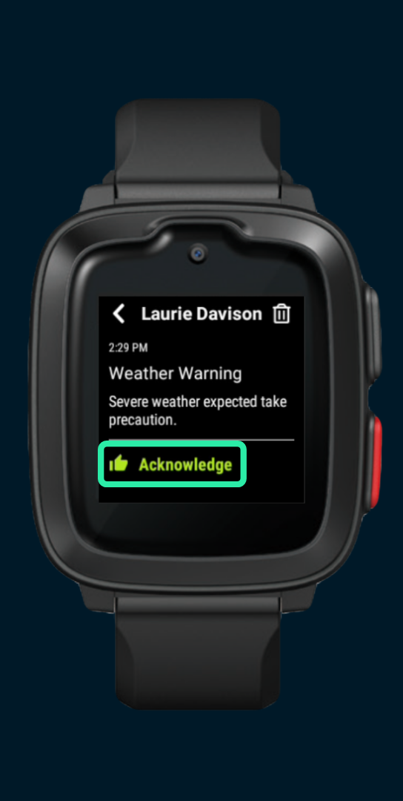
Using Solo for SoloWatch
Messages
You may receive messages from your Organisation via Solo. Your Organisation may send messages to you individually, or to you as part of a group, and may be triggered either manually by your monitoring team, or automatically based on your location.
When this happens, you will receive a push notification with a preview of the message.
You may view the entire message by tapping the ‘Messages’ icon. Once read, ensure that you ‘Acknowledge’ the message so that your Organisation knows you’ve read and understood it.

Slide 9
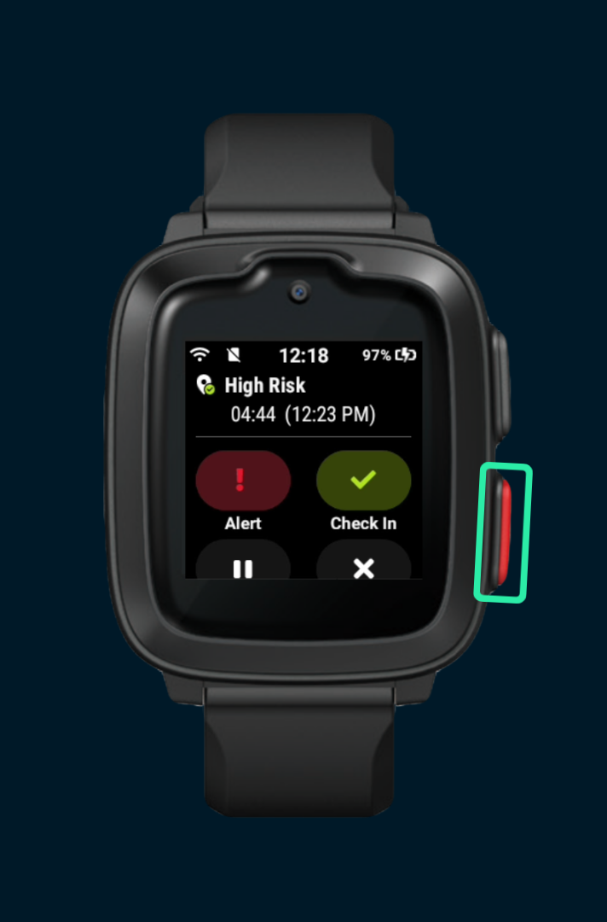
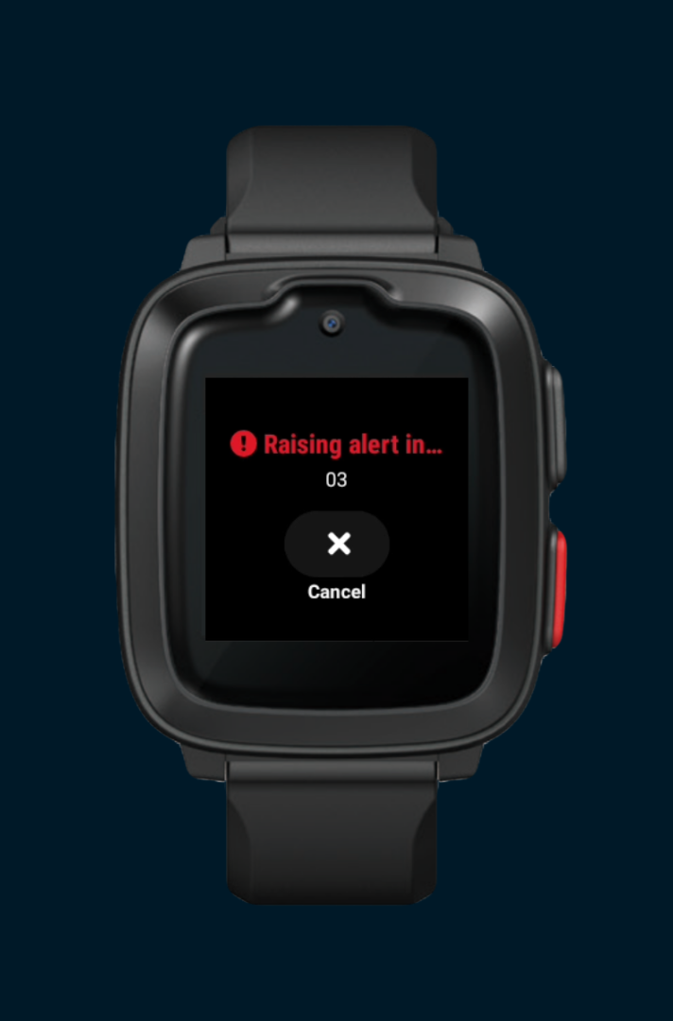
Using Solo for SoloWatch
Raising an Alert
If you’re in danger and you need help from your Organisation, either double-press the red button on the side of the watch, or tap the ‘Alert’ button on-screen. Note that if the button is greyed-out, your Organisation may have disabled the Alerts feature, either for the selected profile or across the board.
A five-second countdown will commence, allowing time to cancel if you raised the alert in error.
Once raised, your Organisation will be notified and will be provided with your current location.

Slide 10
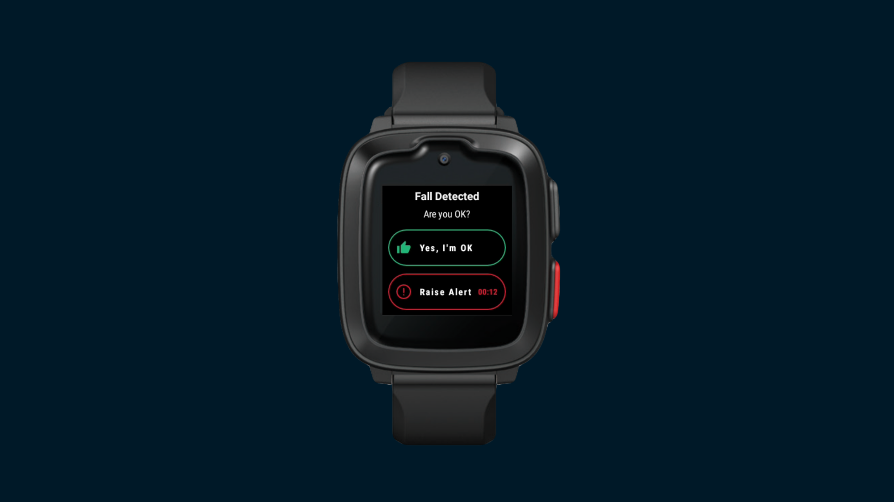
Using Solo for SoloWatch
Automatically Raised Alerts
Note that an alert will be raised automatically if you miss a required check-in.
An alert will also be raised automatically if your Damstra Solo Watch detects that you have taken a fall.
In this case, you’ll first be asked if you’re OK. If you are, simply tap the ‘thumbs-up’ icon to dismiss the alert. If you need help, tap the ‘Raise Alert’ option.
If you don’t respond within 15 seconds, the alert will be raised.

Slide 11
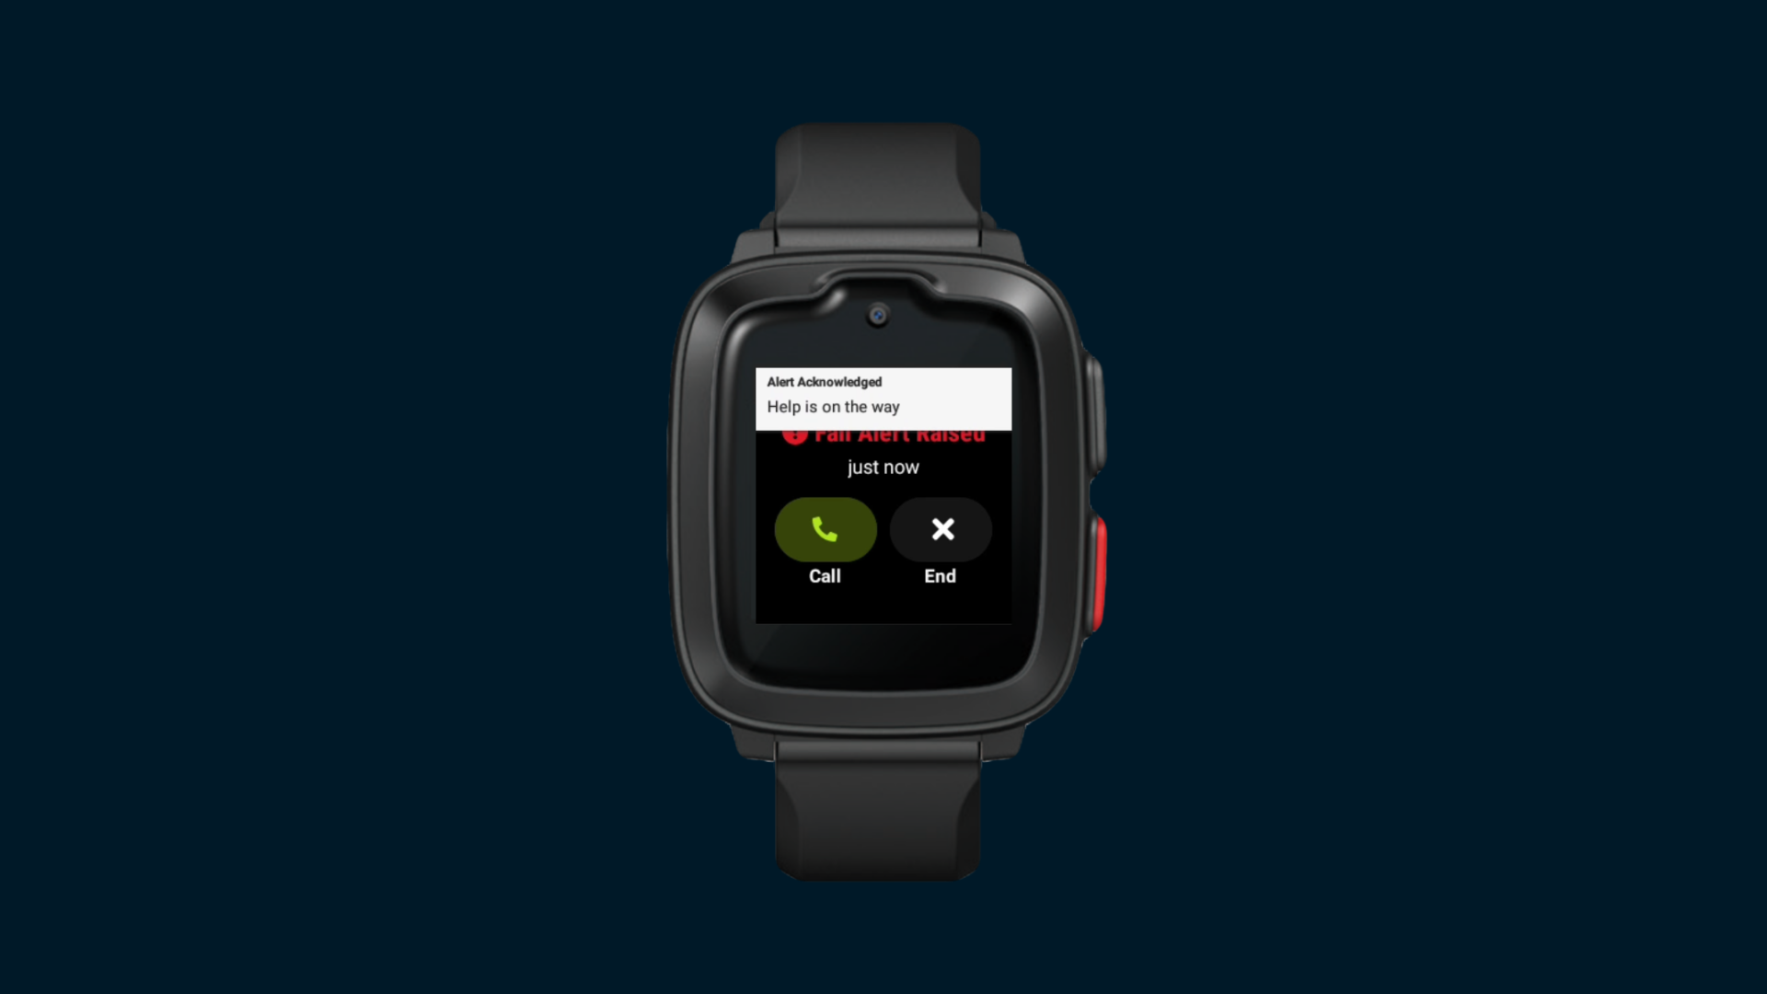
Using Solo for SoloWatch
Managing an Alert
While in the alert state, for immediate assistance, tap the ‘Call’ button to dial a predefined emergency contact.
Otherwise, you may receive an acknowledgement notification to let you know that your alert state has been noted.
When the situation has been dealt with, simply tap the ‘End Alert’ button to resume the session, or your Organisation may clear the alert on your behalf.

Slide 12
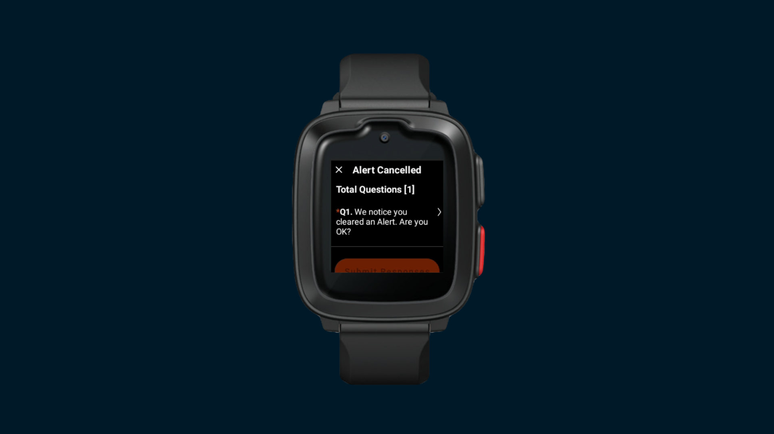
Using Solo for SoloWatch
Responding to Questions
From time-to-time, you might receive questions via Solo that you can answer right from your watch. These can be presented at various milestones.
For example, after raising and then ending an alert, your Organisation might want to understand what happened and whether you need any additional support.
When these questions present themselves, you may tap on the most appropriate response to send the answer back to your Organisation.

Slide 13
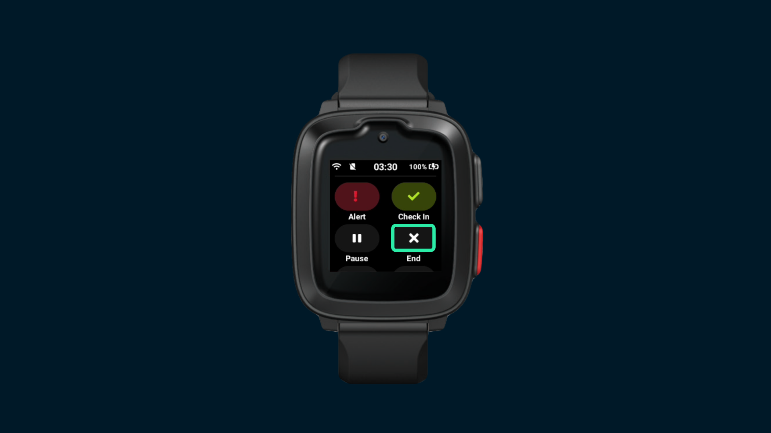
Using Solo for SoloWatch
Ending a Session
Once your work is done, end the session by tapping the ‘End’ button.
You’ll no longer be required to check-in, and your location will no longer be visible to your Organisation.
The App is ready to begin a new session the next time you start work.

