Slide 1
Starting a Session
Solo Wearable

Slide 3
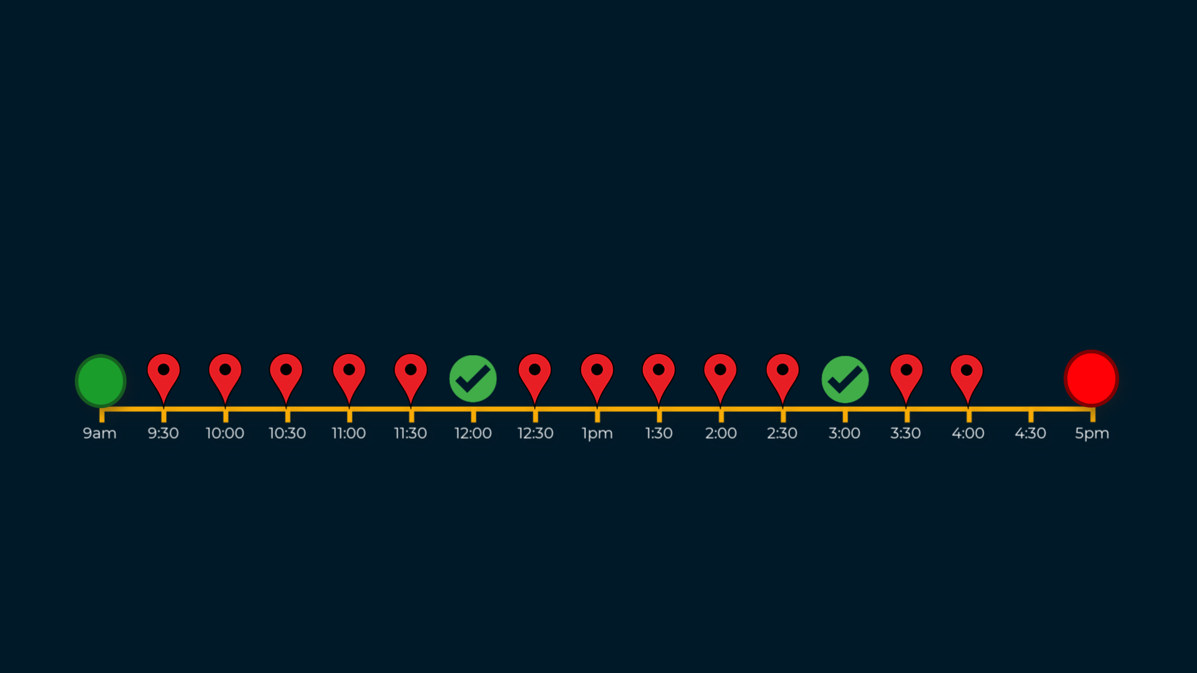
Starting a Session
Introduction
A Session is a period of time started and ended by you as the Solo Wearable user, during which Solo may share your location with your Organisation and prompt you to confirm that you’re safe - that is, Check-in.
This guide shows how to start a Session.

Slide 4
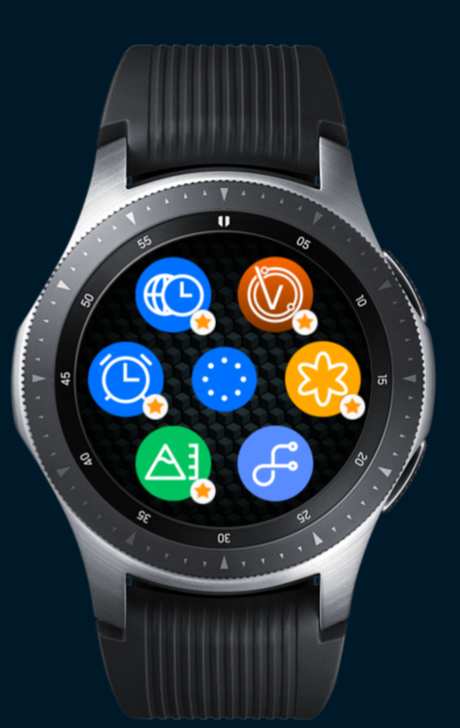
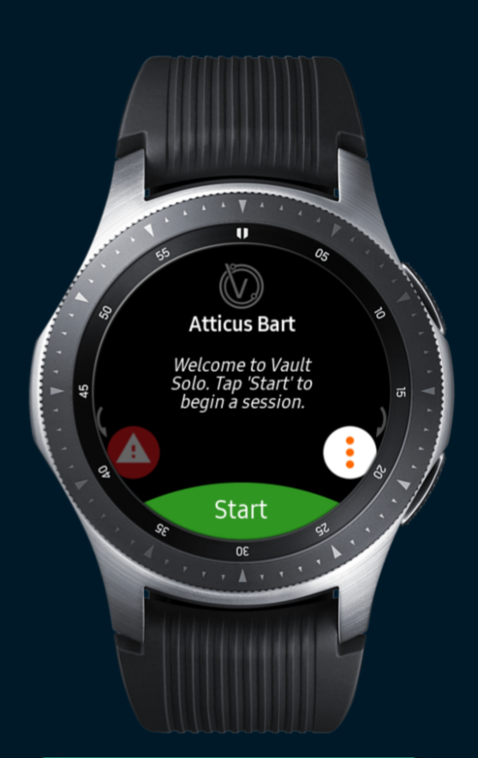
Starting a Session
Via the Solo App icon
From your wearable device, either tap the Solo app icon and Tap Start Session…

Slide 5
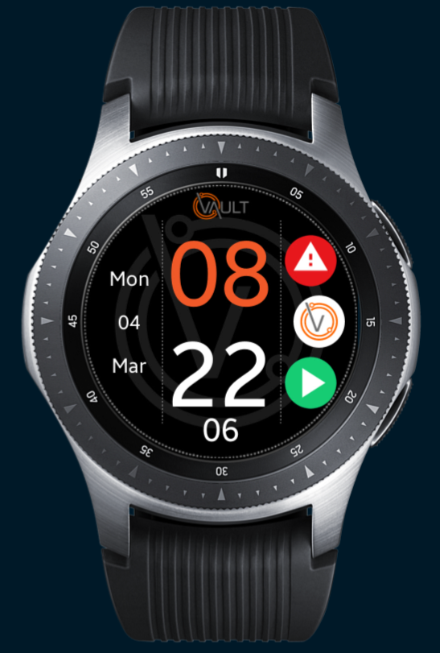
Starting a Session
Via a Solo Watch face
OR, if using a Solo Watch face, tap Start Session icon.

Slide 6
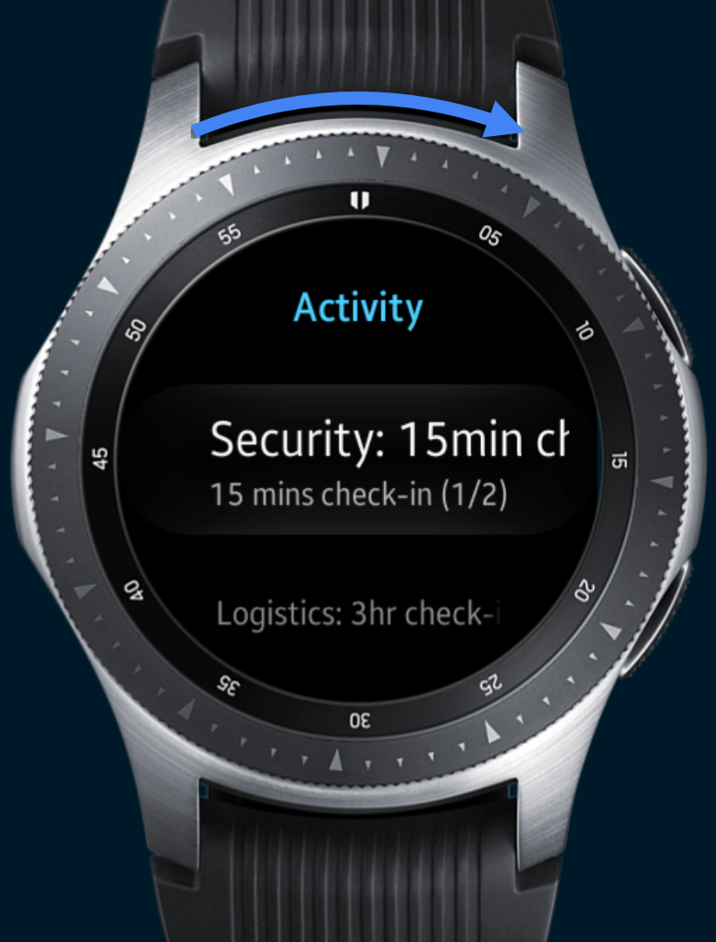
Starting a Session
Selecting a Profile
Scroll the session ‘profile list’ and tap the profile that you’d like to use.
Note: That your options will differ from the ones shown here.
Contact your system administrator if you’re unsure which profile to select.

Slide 7
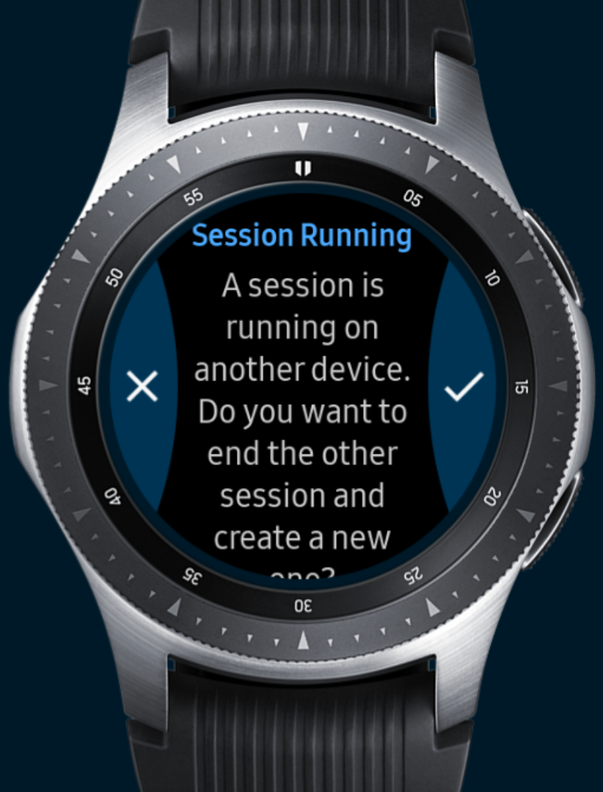
Starting a Session
Override Message
Starting a Solo Wearable session will override a Solo Mobile session if one is active.
You will be advised of an active Mobile session by the following message
To continue with the override simply tap the ‘tick’ to confirm and the new wearable session will commence.

Slide 8
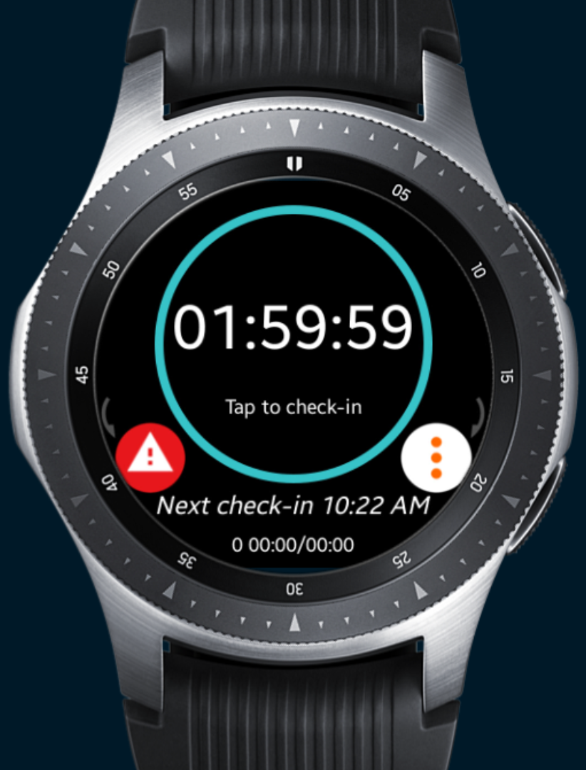
Starting a Session
Session Started
The session has now commenced and the Solo app will begin communicating your safety with your Organisation.

