Slide 1
Update Vehicle Certification
Safety

Slide 2

[DISCLAIMER]
This presentation document has been prepared by Damstra Technology Limited (“Damstra") and is intended for off line demonstration, presentation and educational purposes.
The information is not version controlled and as such is subject to change without notice.
Damstra does not accept any responsibility or obligation to inform users of this presentation of such changes.
This includes any copies of this presentation taken and modified outside of the Damstra domain.

Slide 3
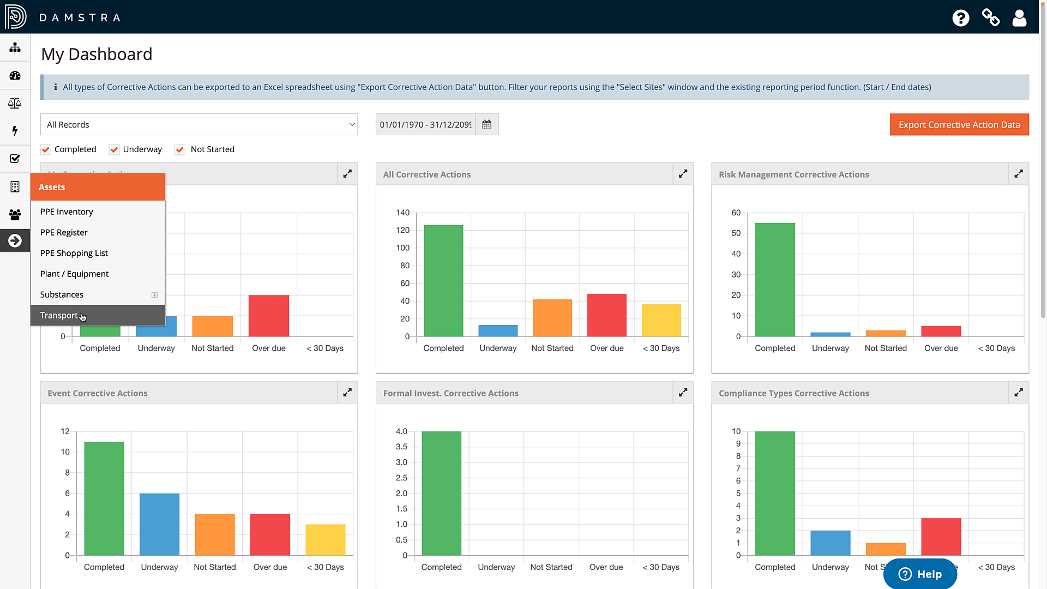
Update Vehicle Certification
Introduction
Updating the certification record for a Transport item is managed via the Vehicle’s record in the Transport Register. This is found under ‘Assets’ in the Menu Bar.

Slide 4
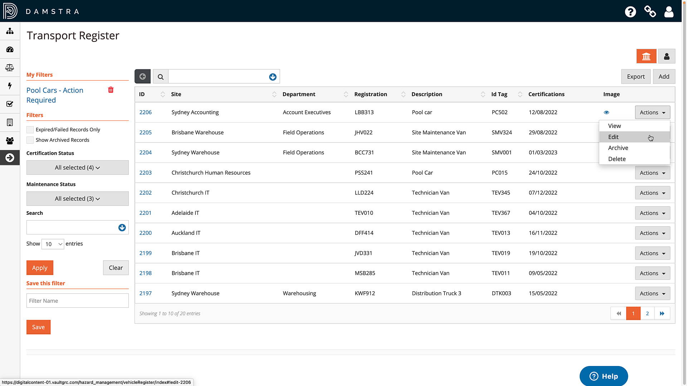
Update Vehicle Certification
Edit Transport Item
Locate the item in the Register, then click ‘Actions’, then ‘Edit’.

Slide 5
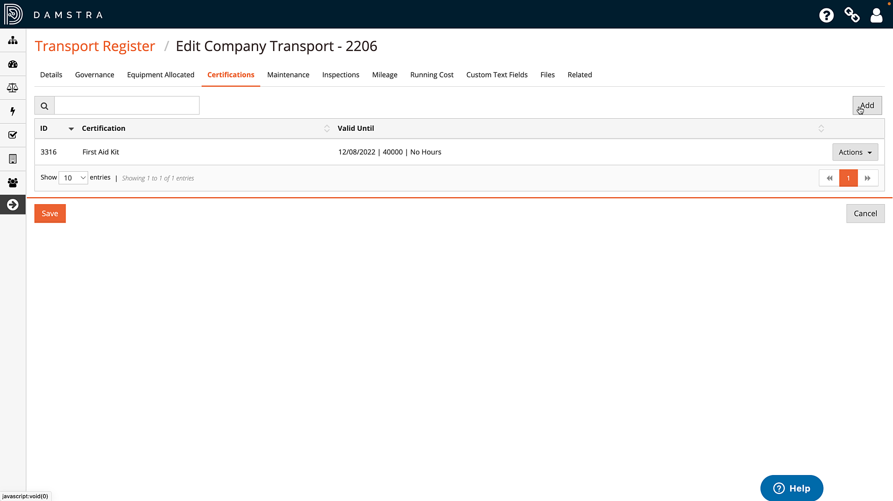
Update Vehicle Certification
Add New Certification Type
Click on the ‘Certifications’ tab.
The register displays all currently-recorded certifications, together with the details of when they expire.
To add an instance of a certification type that has not previously been recorded for this vehicle – for example, there is no previous ‘Warrant of Fitness’ record for this vehicle – click ‘Add’.

Slide 6
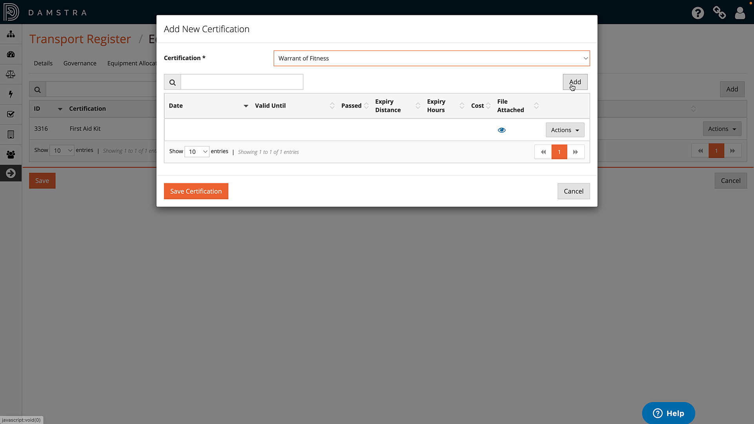
Update Vehicle Certification
Add New Certification Type (Cont)
In the pop-up form that appears, select the Certification type from the list, noting that the options available in your system are defined by your Organisation in Settings, and click ‘Add’.

Slide 7
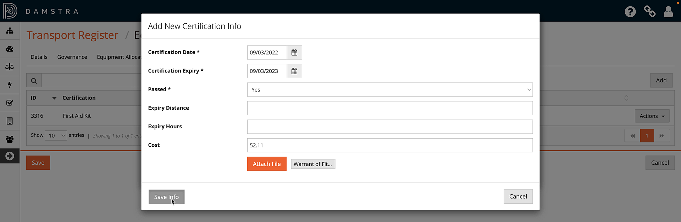
Update Vehicle Certification
Add New Certification Type (Cont)
In the pop-up form that appears, select the Certification type from the list, noting that the options available in your system are defined by your Organisation in Settings, and click ‘Add’.
Enter the mandatory and relevant certification information and attach any related files.
Then, click ‘Save Info’.

Slide 8
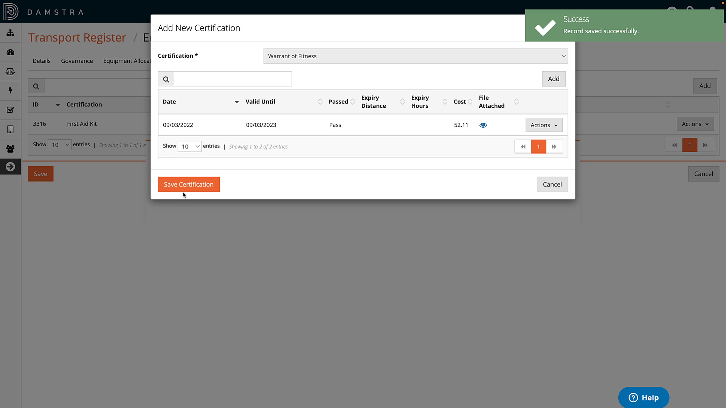
Update Vehicle Certification
Add New Certification Type (Cont)
The details appear in the register. To add another certificate of this type, click ‘Add’ again, otherwise click ‘Save Certification’ to close the pop-up form and return to the Certifications tab.

Slide 9
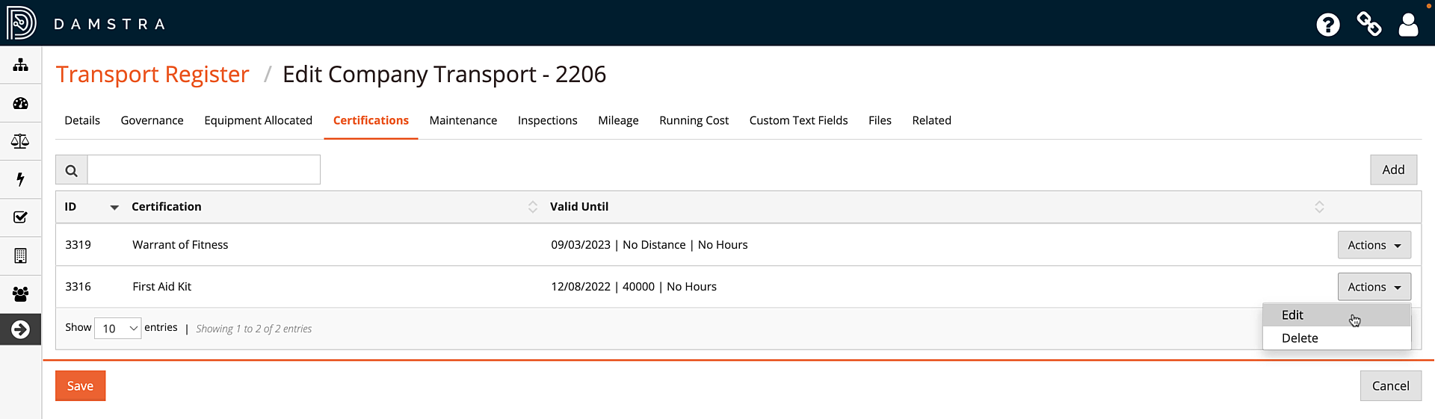
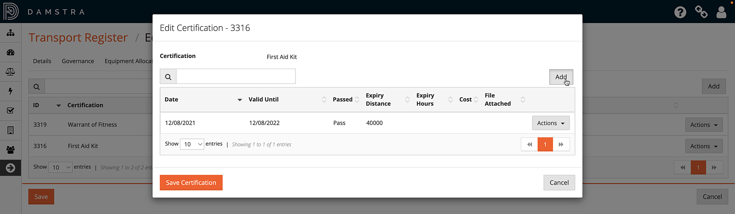
Update Vehicle Certification
Add Existing Certification Type
To add a new instance of a previously-recorded certification type, such as ‘First Aid Kit’ in this example, click ‘Actions’, then ‘Edit’, then click ‘Add’ and fill in the details just as before.

Slide 10

Update Vehicle Certification
Edit or Delete Existing Item
To edit or delete the details of an existing certificate, choose ‘Actions’, then select the appropriate option.
Once all changes have been made, click ‘Save’ to return to the Transport Register.

Slide 11
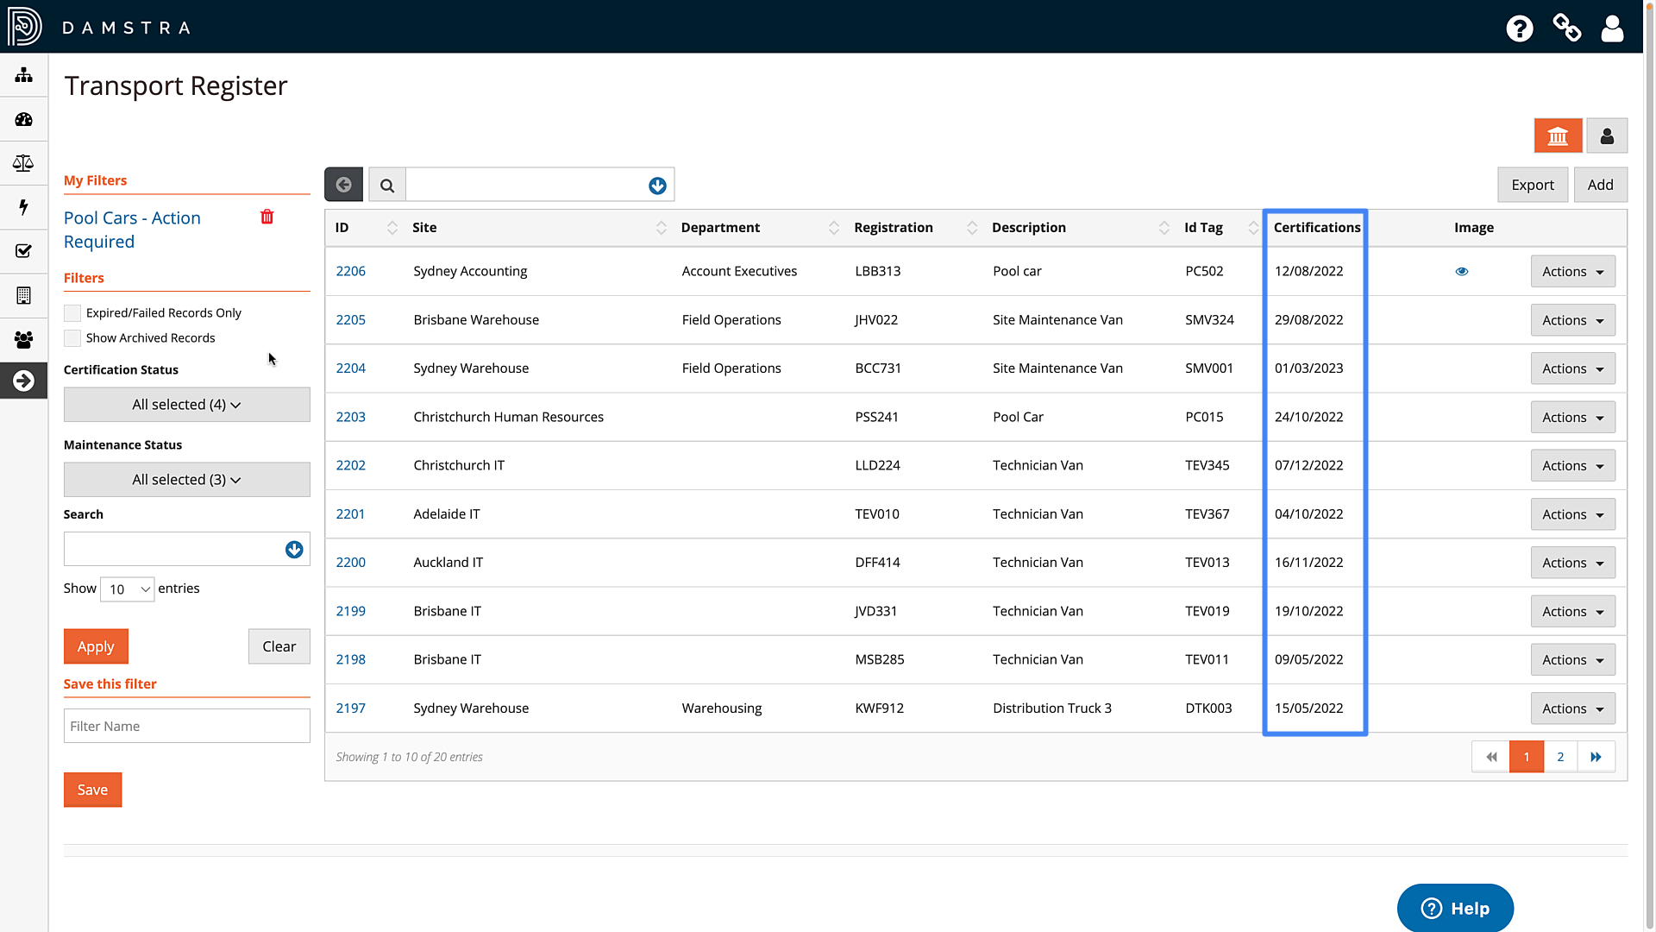
Update Vehicle Certification
Return to Transport Register
The date of the next expiring certificate will be displayed in the ‘Certifications’ column. This will be highlighted red if the certification has expired due to either date, mileage or hours, or may be highlighted yellow if a ‘warning’ range has been defined via Settings > General > Options and Preferences > Transport - Certification / Maintenance Warning.
Those responsible for certification currency will receive an escalation when the expiry nears, provided this has been enabled in Settings > General > Notifications & Escalations.

