Slide 1
Update Worker Contact Details
Safety

Slide 3
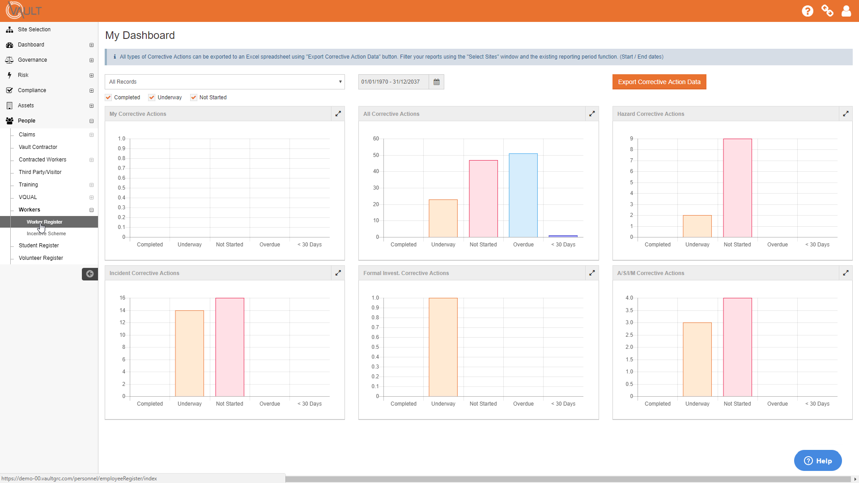
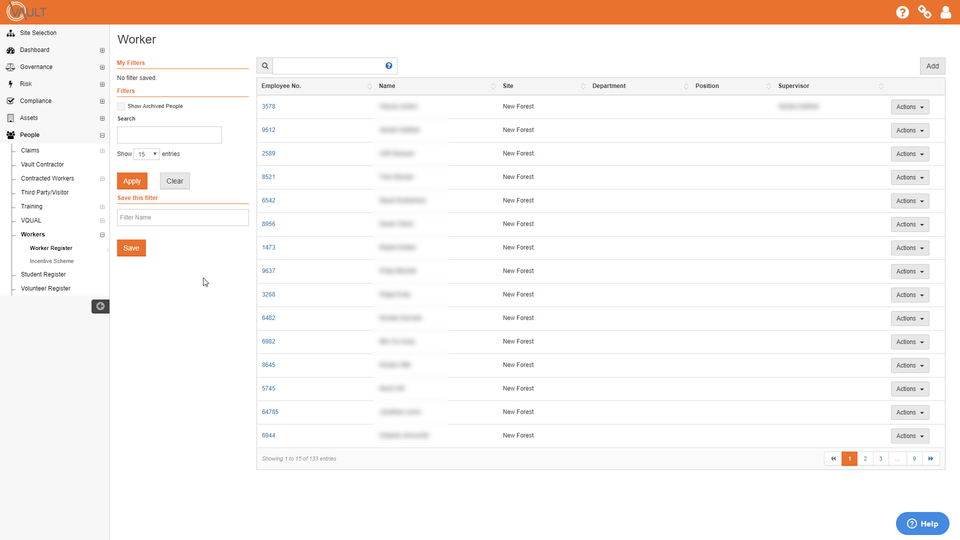
Update Worker Contact Details
Worker Register
Updating the contact details for an existing Worker is done via the Worker’s record in the Worker Register. This is found under People in the Menu bar.
‘Worker Register’

Slide 4
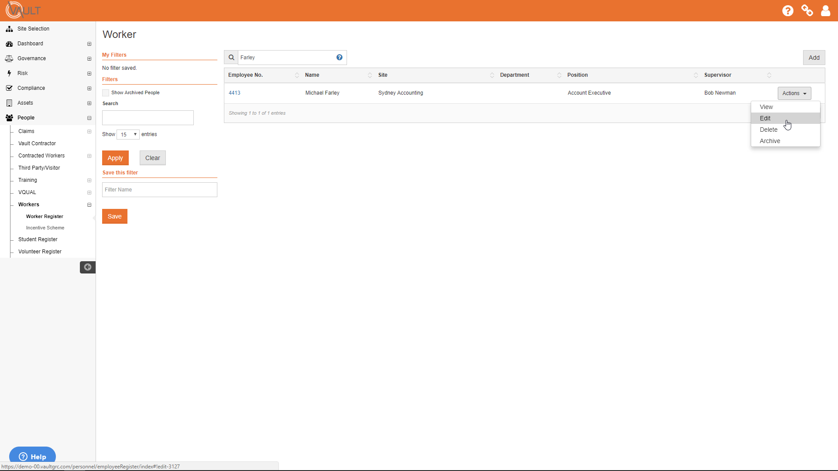
Update Worker Contact Details
Edit Worker
Locate the Worker whose contact details you wish to update.
Click ’Actions’, then ’Edit’.

Slide 5
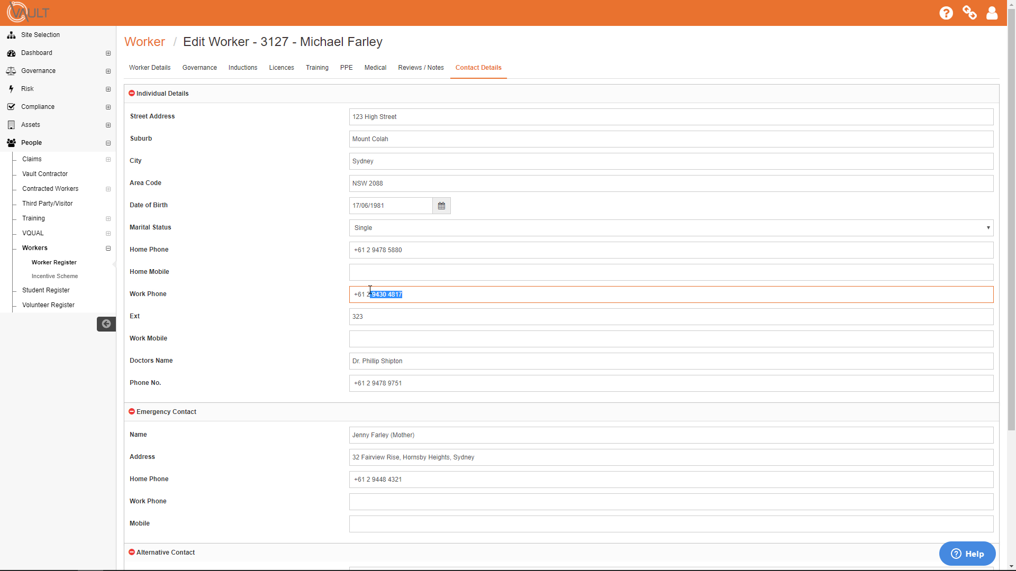
Update Worker Contact Details
Edit Details
Click the Contact Details tab.
Add the new contact details, over-typing any existing information that may already be there.

Slide 6
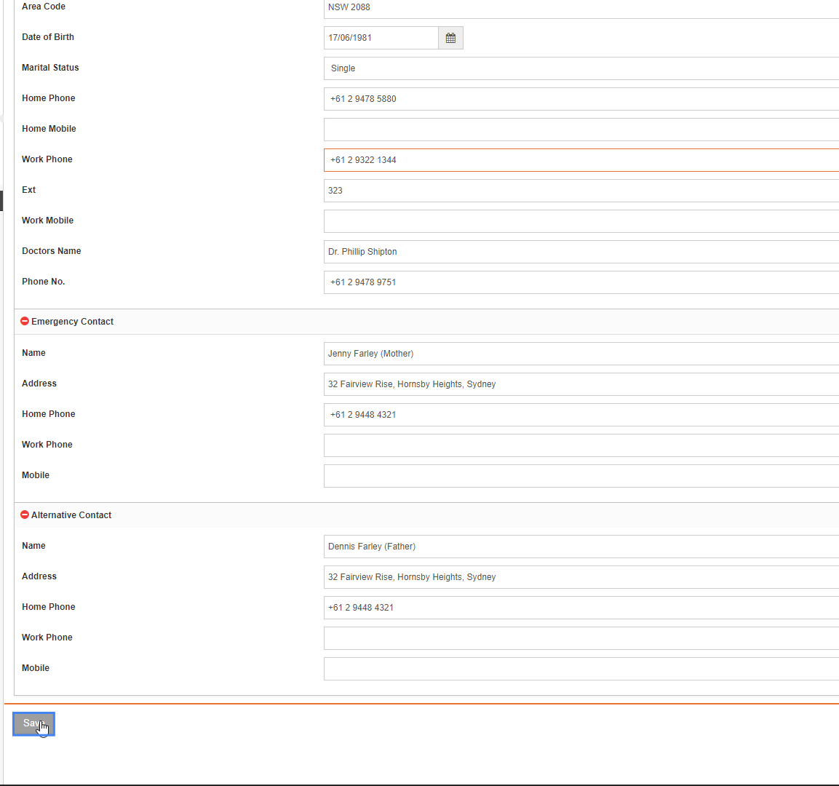
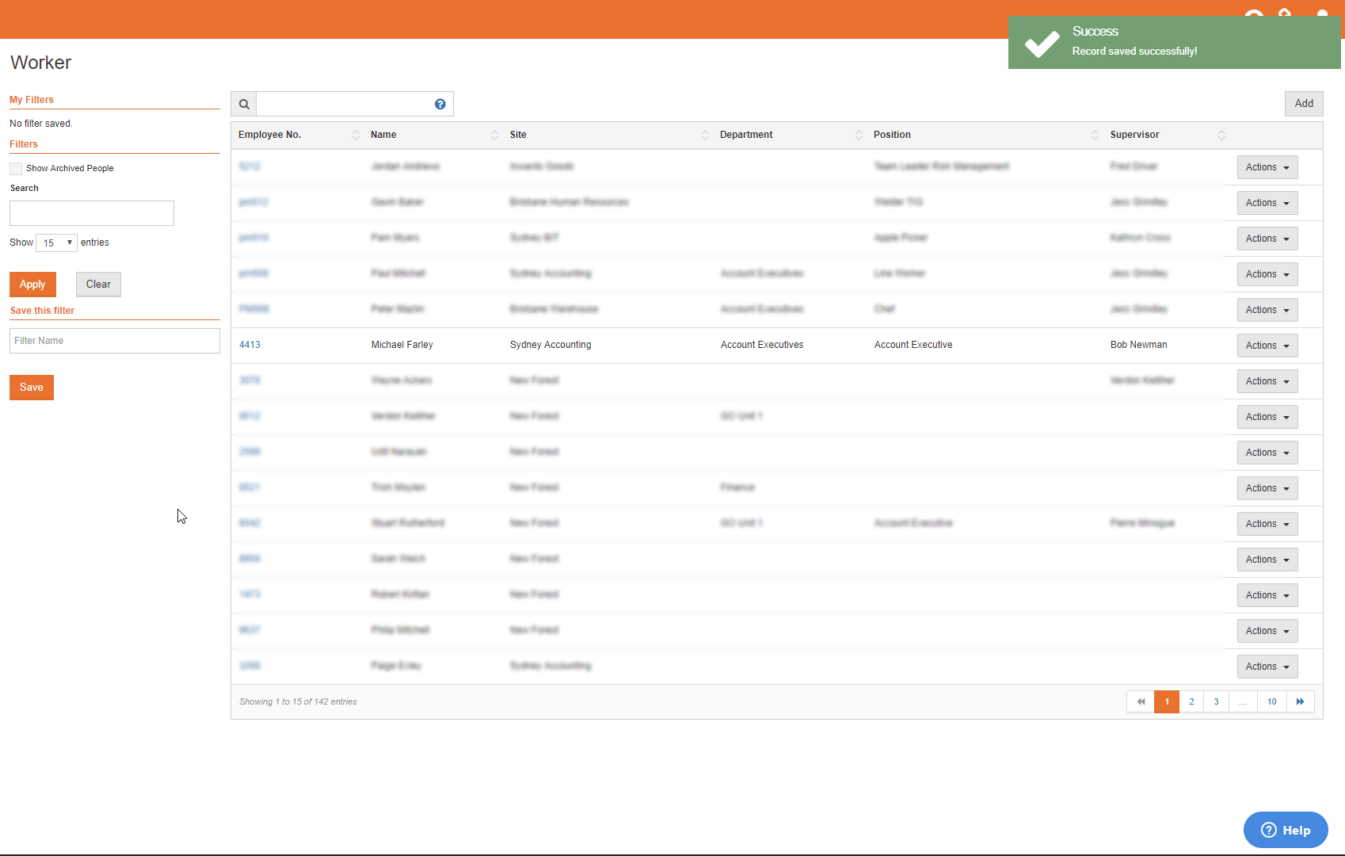
Update Worker Contact Details
Save Details
Once the required updates are made, click ’Save’ to return to the Worker Register.

