Slide 1
Customising the
Menu Bar
Safety

Slide 2

[DISCLAIMER]
This presentation document has been prepared by Damstra Technology Limited (“Damstra") and is intended for off line demonstration, presentation and educational purposes.
The information is not version controlled and as such is subject to change without notice.
Damstra does not accept any responsibility or obligation to inform users of this presentation of such changes.
This includes any copies of this presentation taken and modified outside of the Damstra domain.

Slide 3
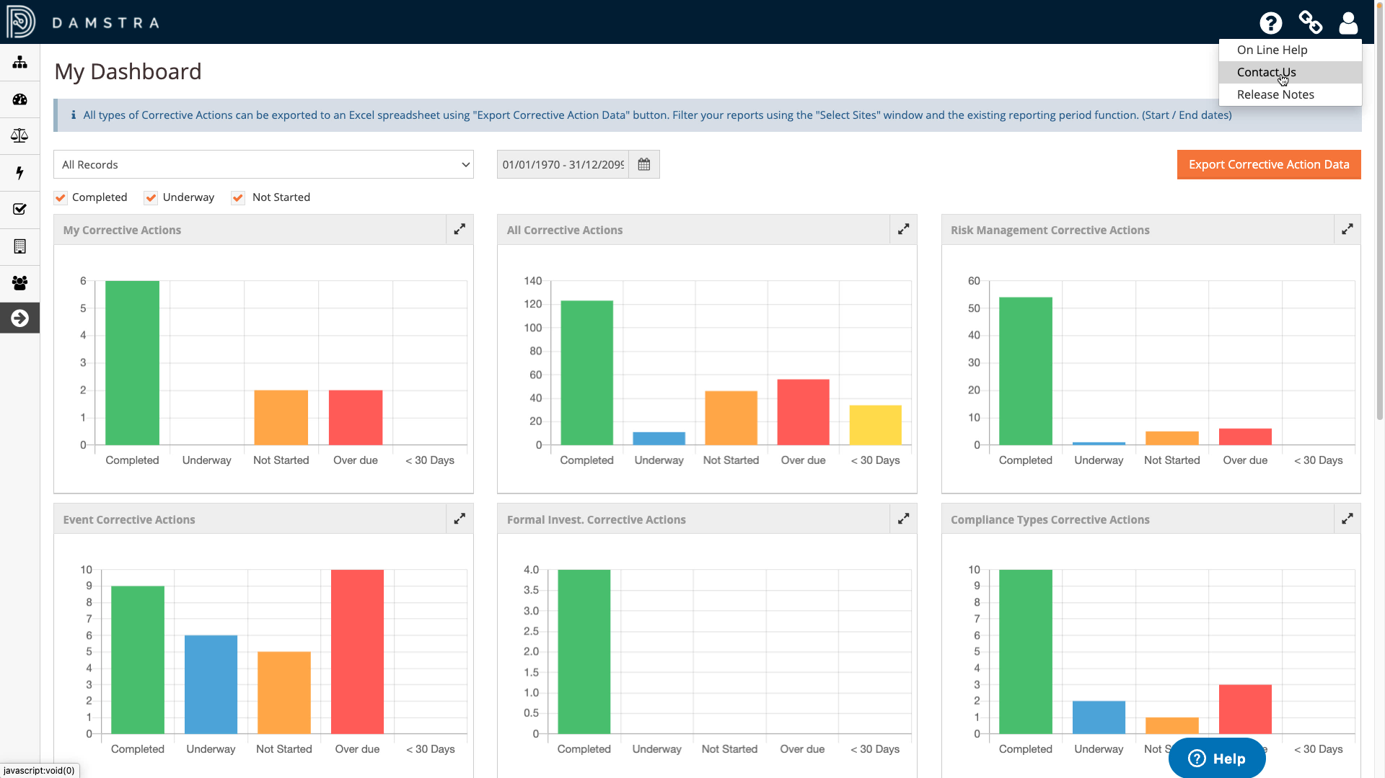
Customising the Menu Bar
Introduction
The Menu Bar of your Damstra Safety system contains customisable links that allow Users within your Organisation to contact your systems administrators for help and provides quick access to relevant internal or public web pages.

Slide 4
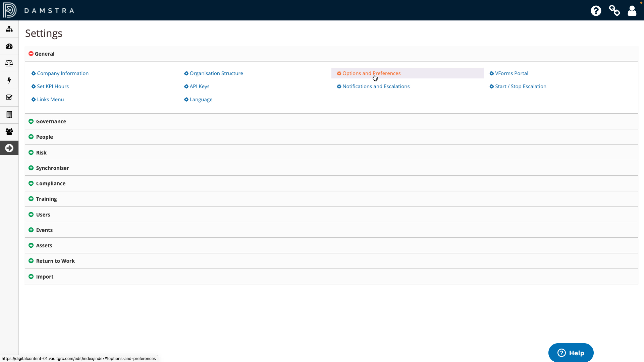
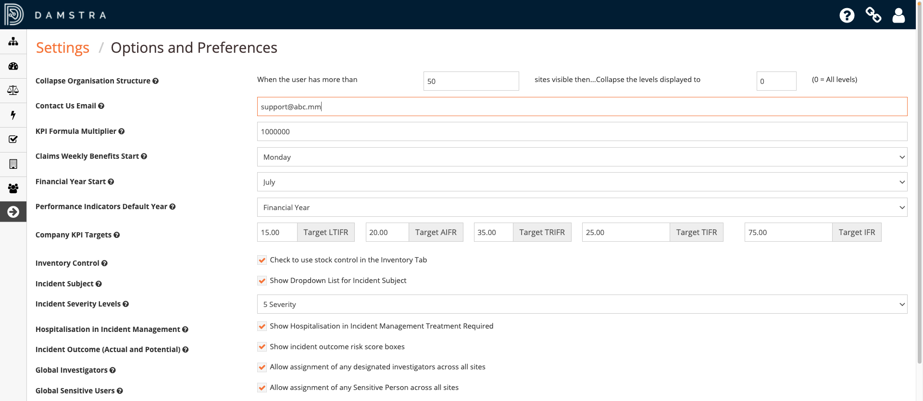
Customising the Menu Bar
‘Contact Us’ link
To customise the ‘Contact Us’ link, go to ‘Settings’, then ‘Options and Preferences’ within the ‘General’ section, and enter the email address you’d like Users to send their queries to, and save.
This will launch the User’s default mail client, beginning a new, blank email with the email address you supplied automatically entered as the recipient.

Slide 5

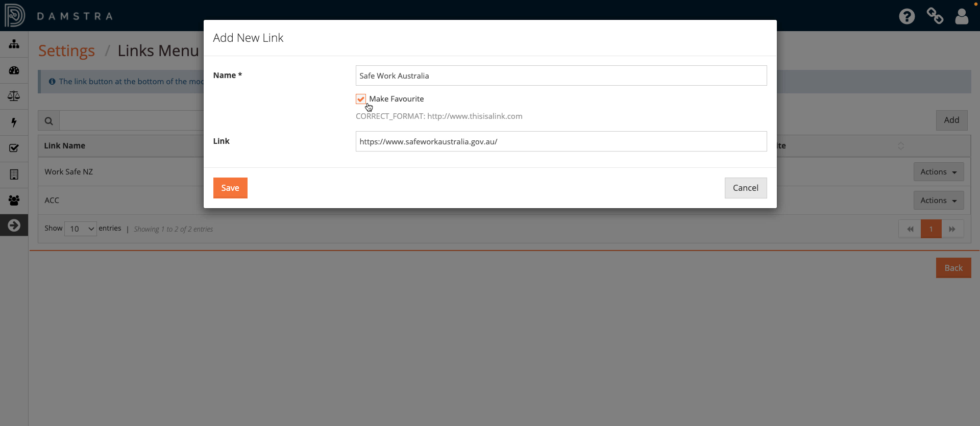
Customising the Menu Bar
Adding a new Link
To customise the links found under the ‘Links’ icon, go to Settings, then ‘Links Menu’.
Any existing links are displayed in the register. To add a new link, click the ‘Add button’, enter the name and URL of the target in the format shown, check the ‘Favourites’ box to ensure it is included in the menubar, and save.
You may need to log out and back in to your Damstra Safety in order to see the changes you have made.

Slide 6
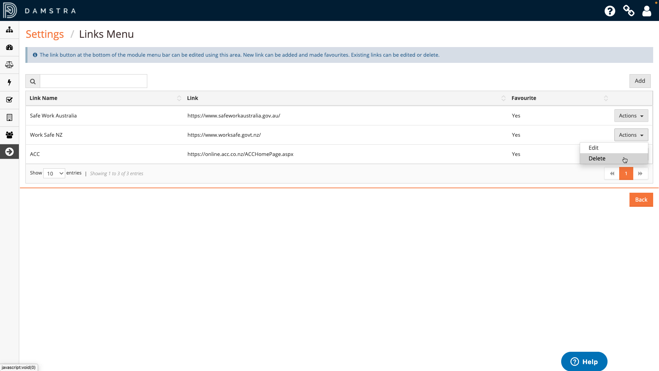
Customising the Menu Bar
Editing / Deleting Links
To edit or delete an existing link, click ‘Actions’, followed by the appropriate option.

