Slide 1
Recording Emergency Checks and Registers
Safety

Slide 2

[DISCLAIMER]
This presentation document has been prepared by Damstra Technology Limited (“Damstra") and is intended for off line demonstration, presentation and educational purposes.
The information is not version controlled and as such is subject to change without notice.
Damstra does not accept any responsibility or obligation to inform users of this presentation of such changes.
This includes any copies of this presentation taken and modified outside of the Damstra domain.

Slide 3
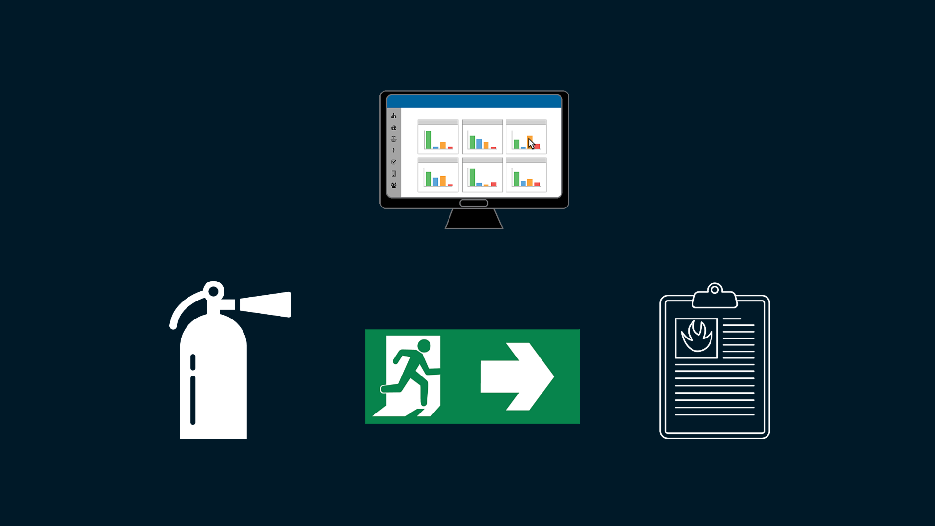
Emergency Checks and Registers
Introduction
Damstra Safety provides the ability to keep tabs on important Emergency-related information such as the availability of emergency facilities, reviews of recent site evacuations and the effectiveness of evacuation procedures.

Slide 4
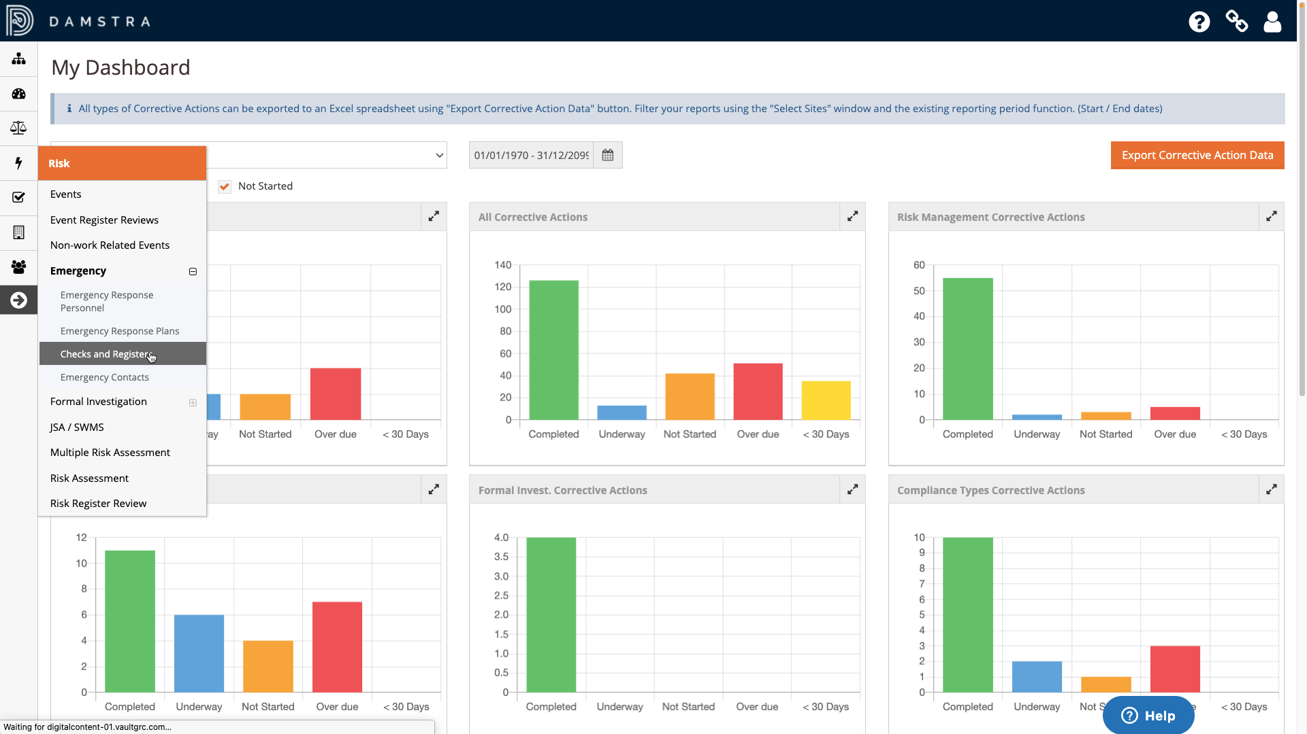
Emergency Checks and Registers
Location
This information is recorded under ‘Risk’ in the menu bar, then ‘Emergency’, then ‘Checks and Registers’.

Slide 5
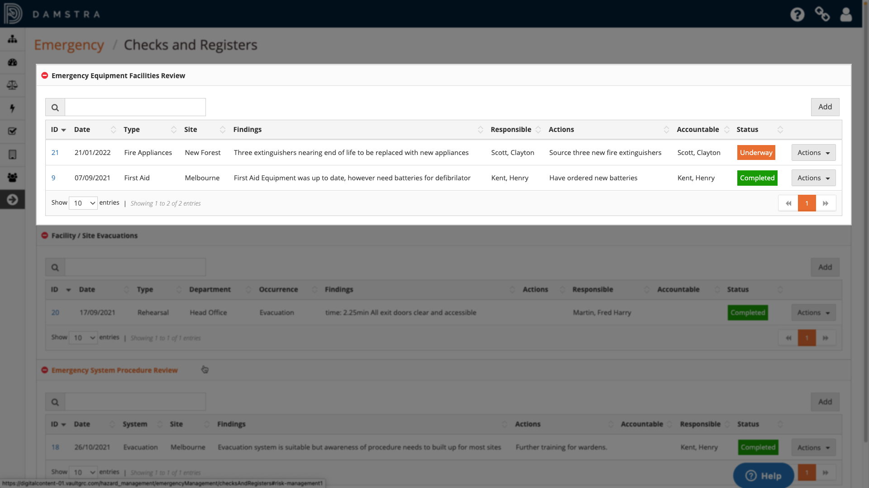
Emergency Checks and Registers
Emergency Equipment Facilities Review
The register is divided into three collapsible sections, the first being ‘Emergency Equipment Facilities Review’. Use this as a place to review the availability and effectiveness of emergency equipment such as fire extinguishers and first aid kits to the business at any level of your Org Structure.
The register shows all existing reviewed facilities with key, summary information for each displayed in the table.

Slide 6
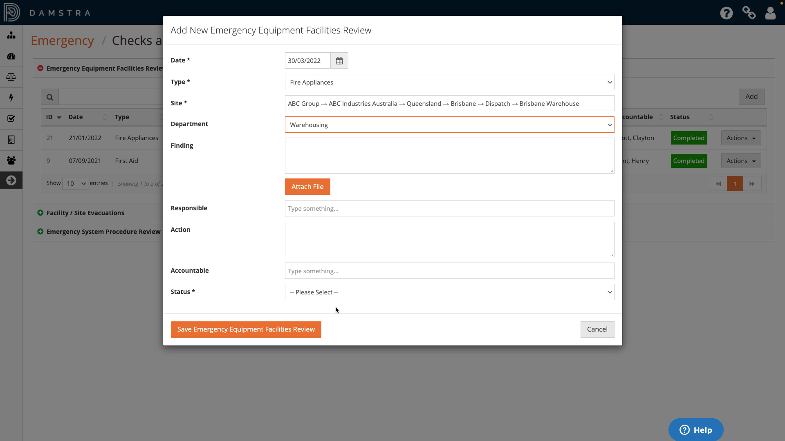
Emergency Checks and Registers
Add Emergency Equipment Facilities Review
To add a new review, click ‘Add’.
Select the date of the review and the ‘type’ of item being reviewed from the picklist. The options available in the picklist are determined by your Organisation via Settings. Help with this is available separately in the Support Portal.
Select the site that the review relates to from your Org Structure. This can be a blue or red site, or can be set to the global level if it is something that relates to the entire Organisation.
Select the department, noting that this field may not be visible in your system depending on Settings.

Slide 7
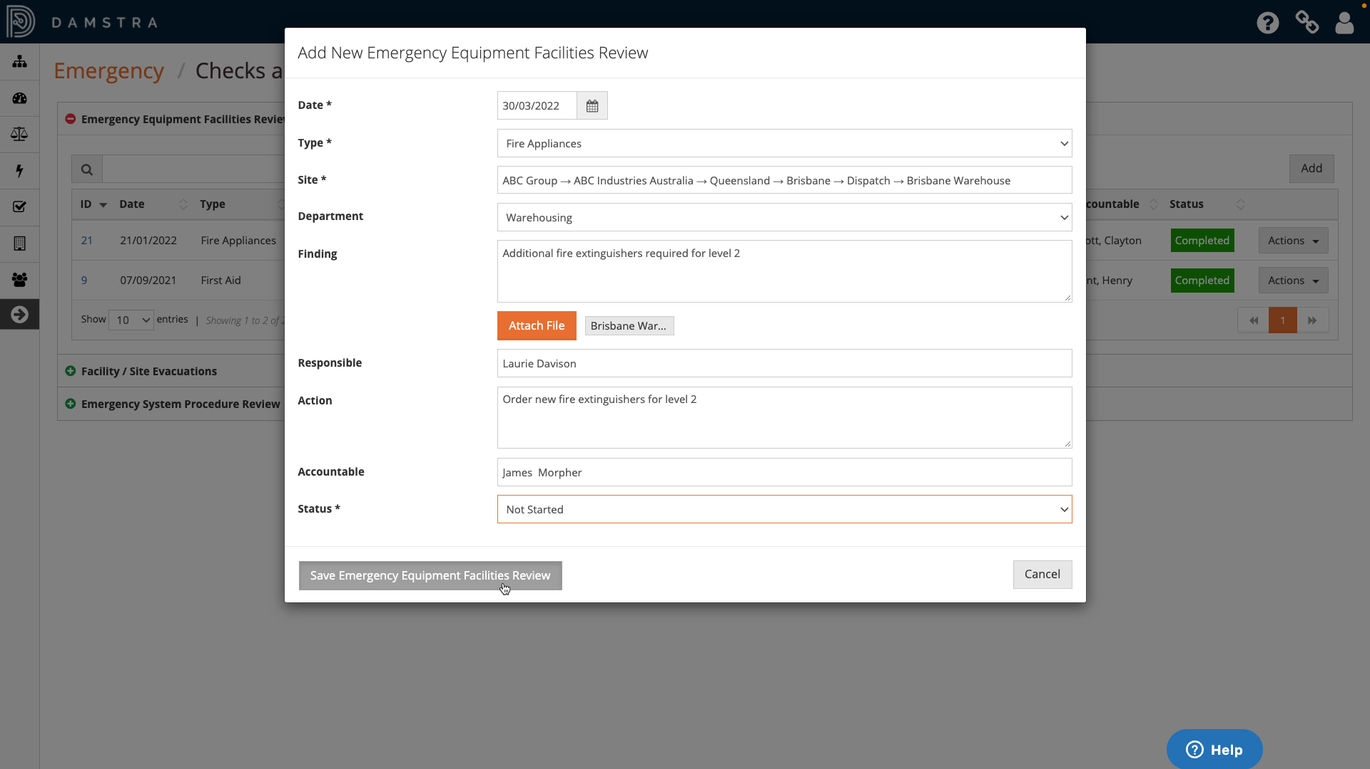
Emergency Checks and Registers
Add Emergency Equipment Facilities Review (cont)
Enter the findings of the review in the free-text field, and attach any related files.
If any actions are required as a result of the review select the person responsible for carrying it out, along with detail of the action required, and the person accountable for its completion.
Select the appropriate status for the action from Not Started, Underway and Completed. If no action is required, select ‘Completed’.
Once completed, click ‘Save Emergency Equipment Facilities Review’. The item will be visible in the register.

Slide 8
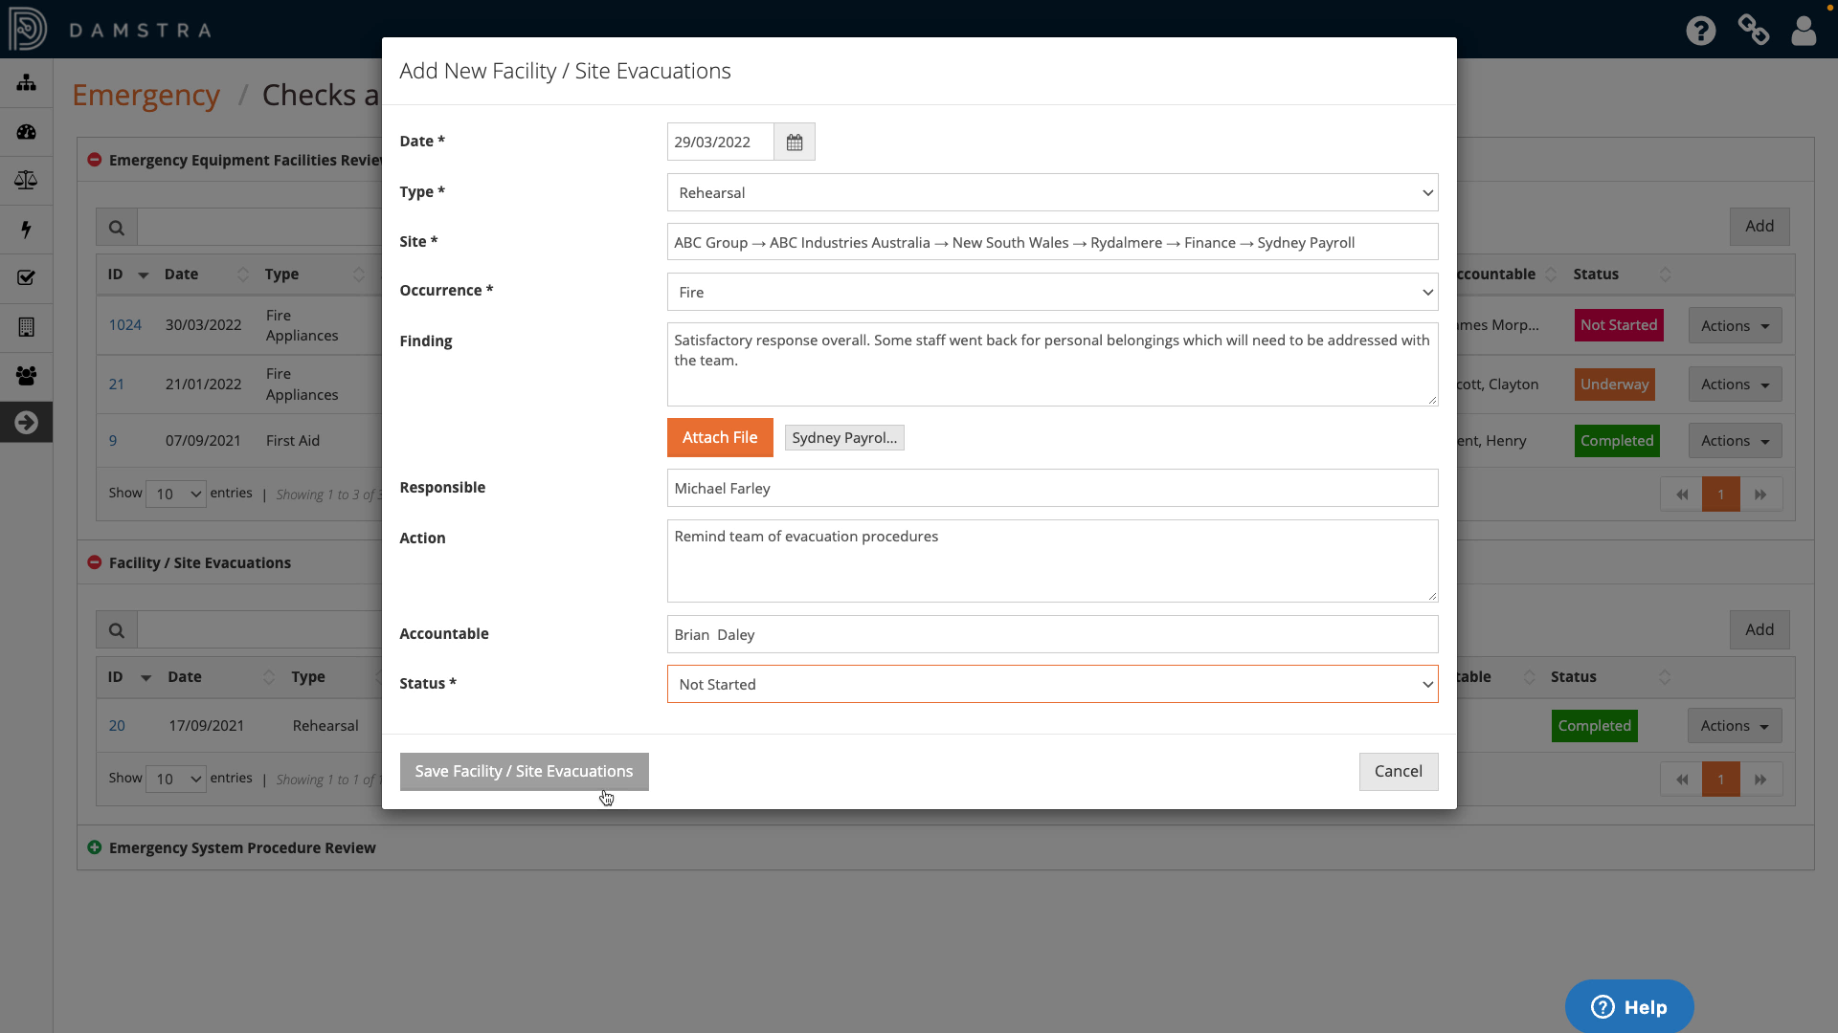
Emergency Checks and Registers
Add Facility / Site Evacuations Review
The next section is intended as a place for recording emergency evacuations and rehearsals such as fire drills. Note that it is not for reviewing the emergency procedures themselves, which are recorded in the next section, rather how a particular instance of a site evacuation was handled according to those procedures.
As with the Emergency Equipment Facilities Review section, add a new record by clicking ‘Add’ and filling in the form with details including the type of evacuation – actual or rehearsal – and the occurrence, for example fire or earthquake. Again, provide the details of any actions required as a result of the review, then save the record.

Slide 9
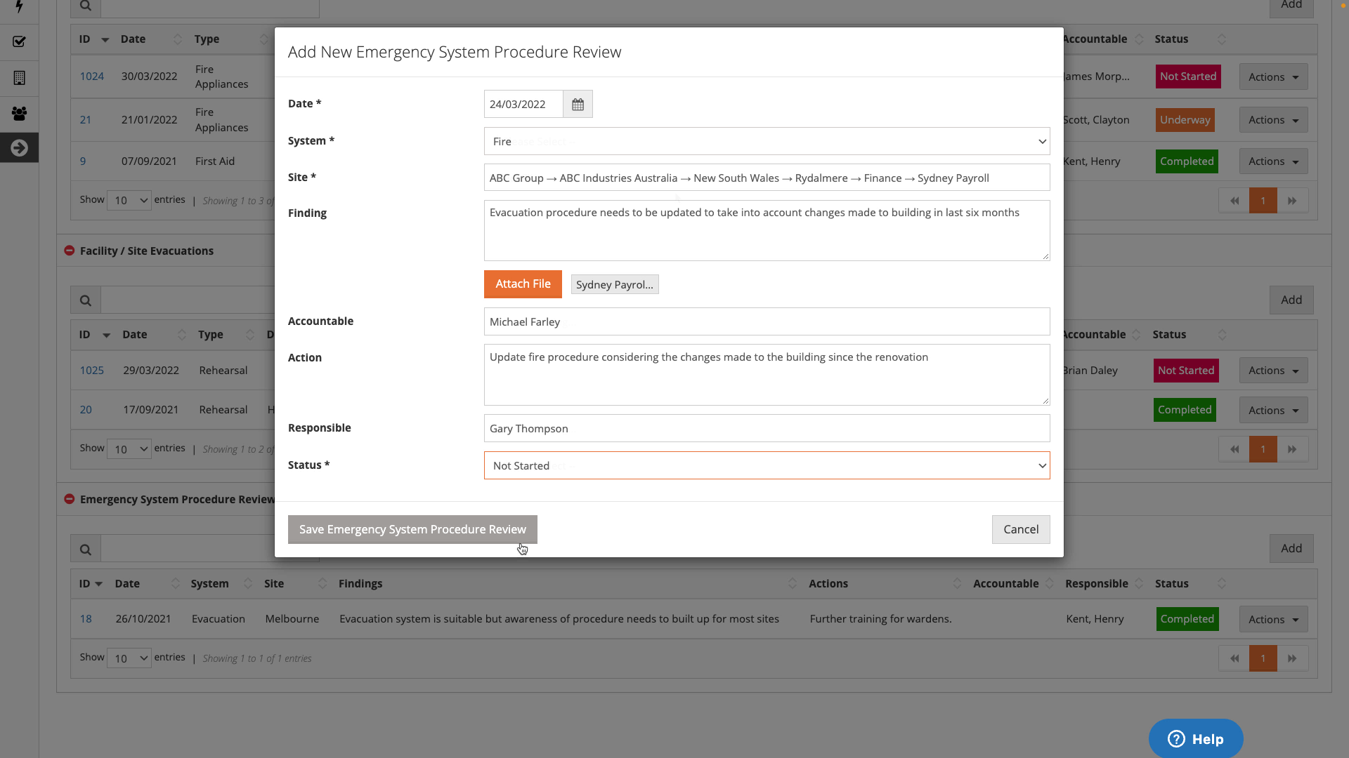
Emergency Checks and Registers
Add Emergency System Procedure Review
The last section is intended for reviews of emergency system procedures, for example the fire evacuation procedure for a particular site, which you might carry out on a regular, scheduled basis.
As with the other sections, to add a review, click the Add button and complete the form including the system being reviewed.

Slide 10
Emergency Checks and Registers
Add Emergency System Procedure Review
The last section is intended for reviews of emergency system procedures, for example the fire evacuation procedure for a particular site, which you might carry out on a regular, scheduled basis.
As with the other sections, to add a review, click the Add button and complete the form including the system being reviewed.

Slide 11
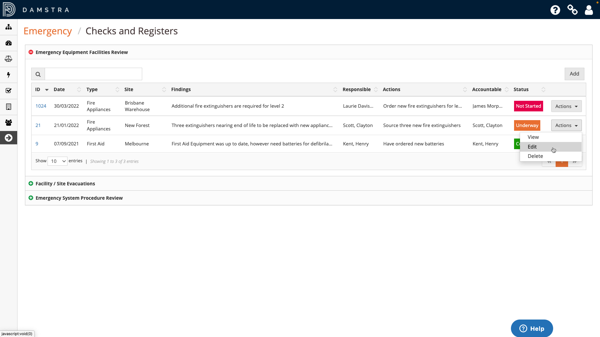
Emergency Checks and Registers
Updating and Deleting a Review
Note that for all three sections, the responsible and accountable parties for any recorded actions will not be automatically notified and you will need to manually communicate these assignments with the relevant people.
The responsible parties should provide status updates for the actions directly in the appropriate record.
To do this, locate the relevant record and select ‘Actions’, then ‘Edit’. Update the item and save.
To delete an item, select ‘Actions’, then ‘Delete’.

