Slide 1
Password Management
Safety

Slide 2

[DISCLAIMER]
This presentation document has been prepared by Damstra Technology Limited (“Damstra") and is intended for off line demonstration, presentation and educational purposes.
The information is not version controlled and as such is subject to change without notice.
Damstra does not accept any responsibility or obligation to inform users of this presentation of such changes.
This includes any copies of this presentation taken and modified outside of the Damstra domain.

Slide 3
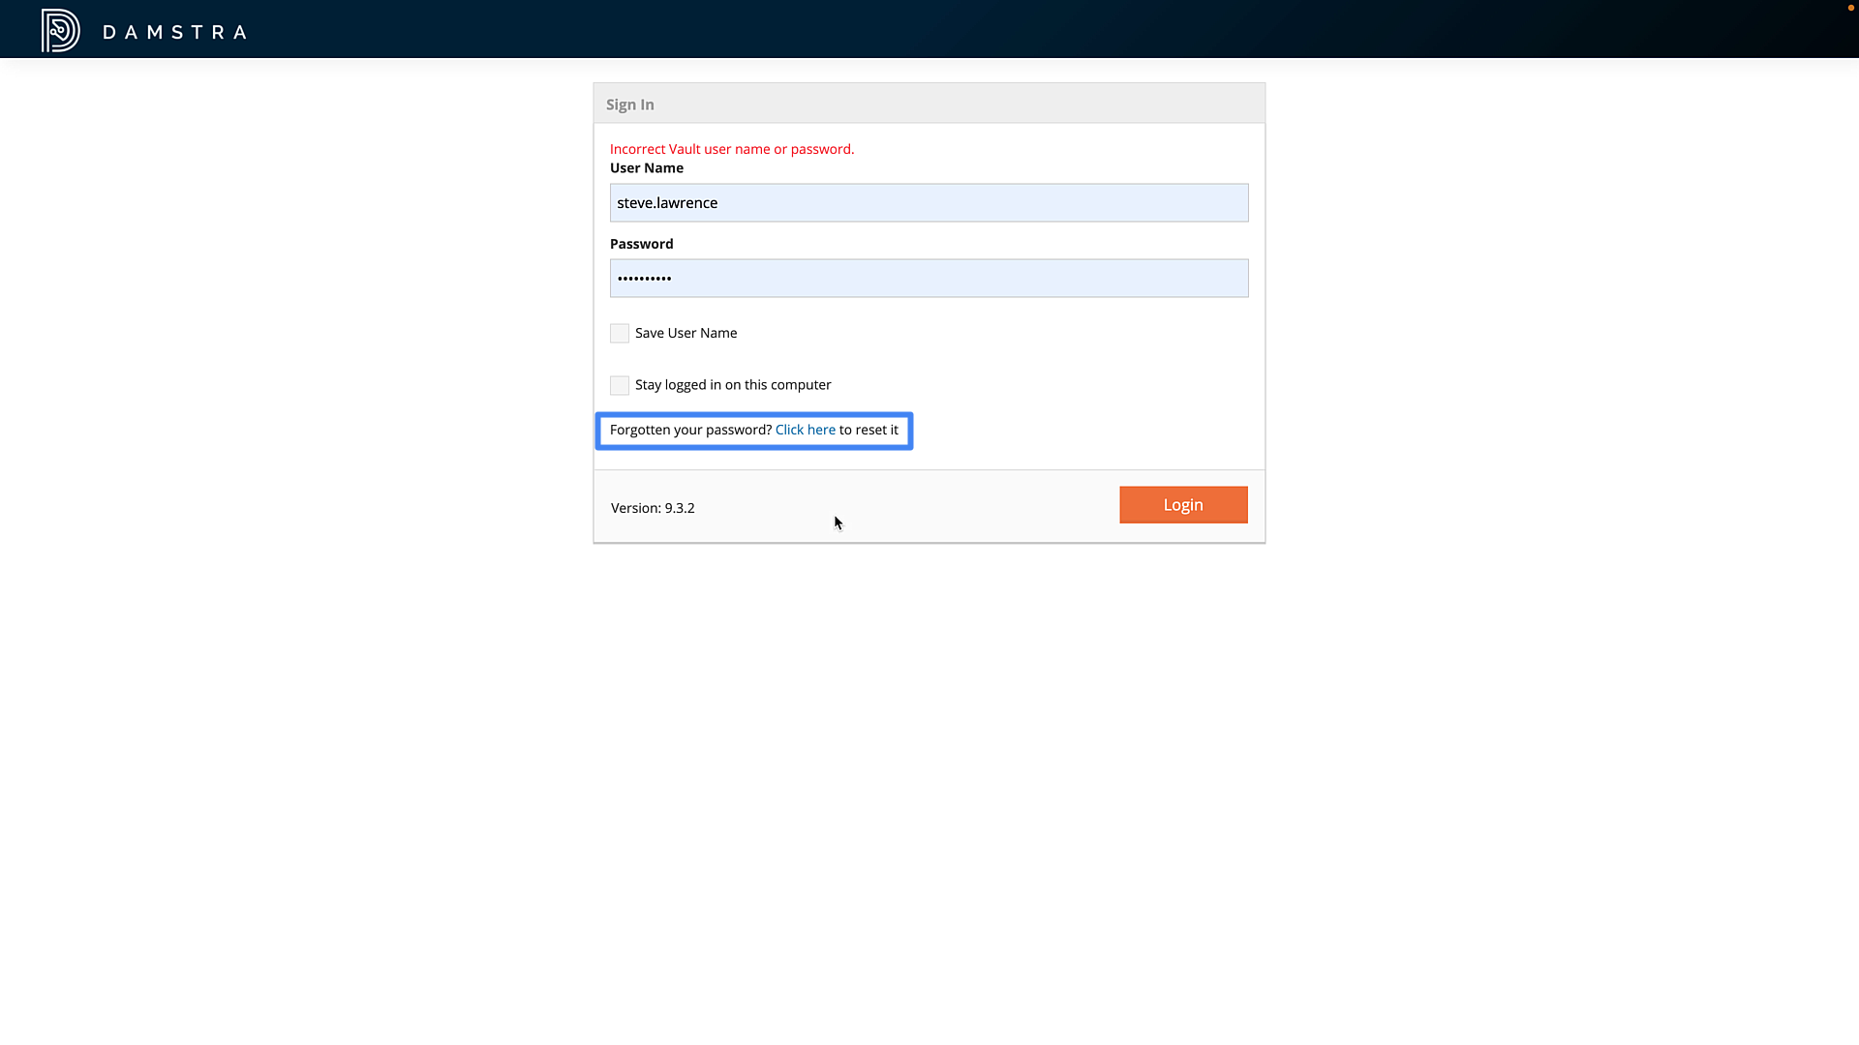
Password Management
Changing a Forgotten Password
Damstra Safety offers several different methods for managing login passwords.
Firstly, if you have forgotten your password and therefore cannot log in to Damstra Safety, you may click the ‘Forgotten your Password’ link at the login screen. You will be prompted to enter your email address, and a link will be emailed to you with further instructions.

Slide 4
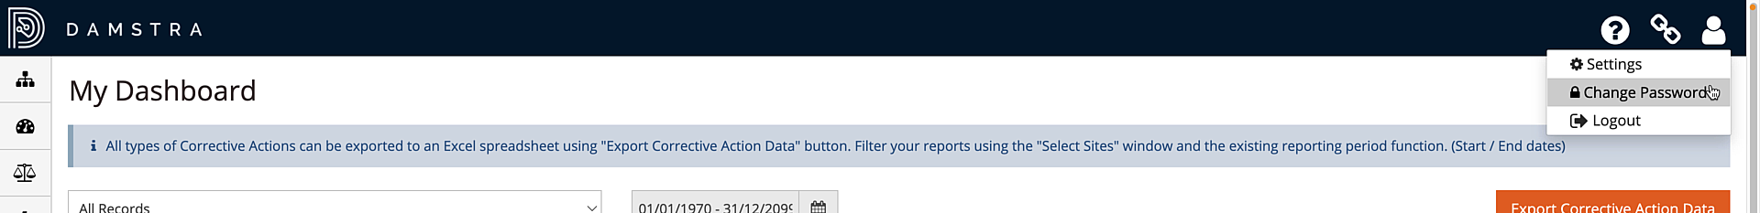
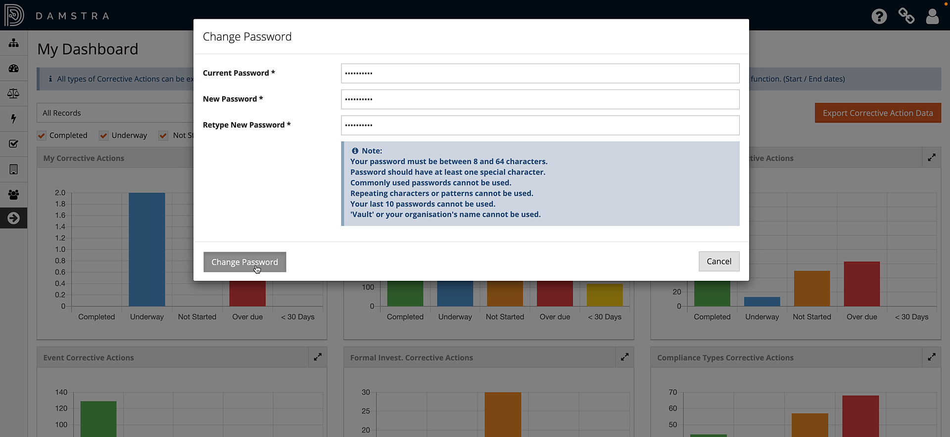
Password Management
Changing your own Password
In the second method, once logged-in to your Damstra Safety system, you may change your password by clicking the profile icon toward the top of the screen, then selecting ‘Change Password’.
Simply confirm your existing password before entering and confirming a new one, noting the password requirements displayed below.

Slide 5
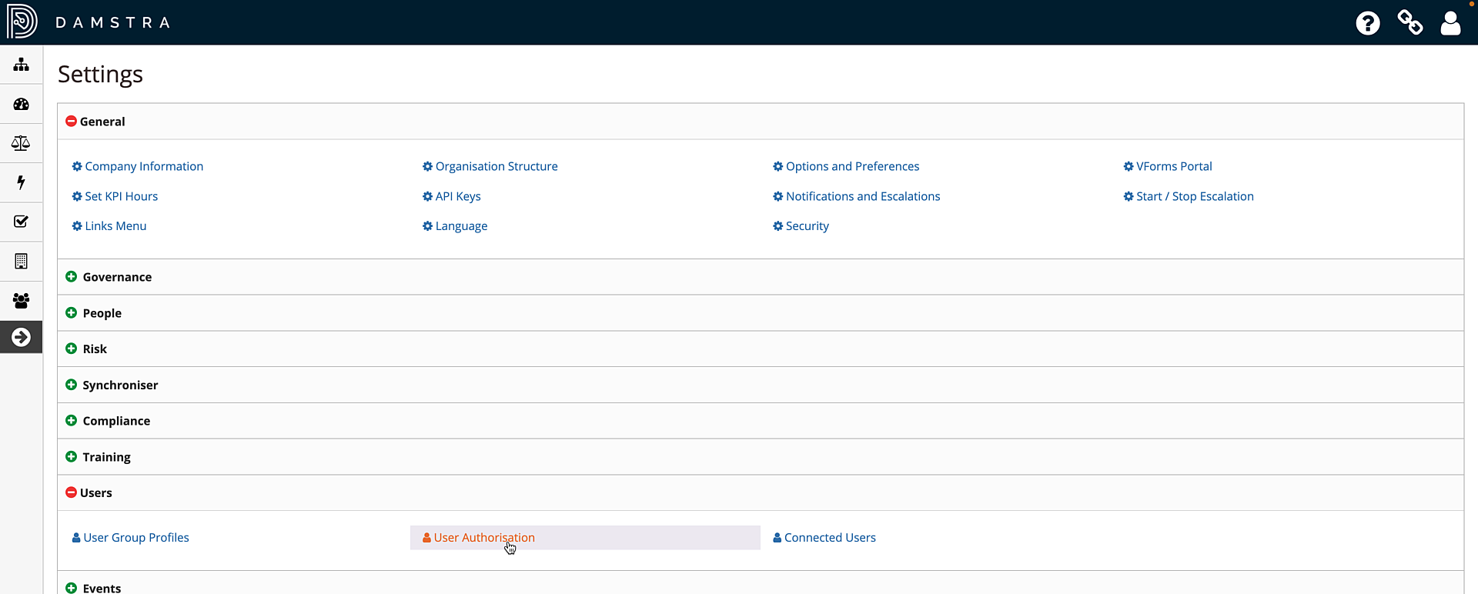
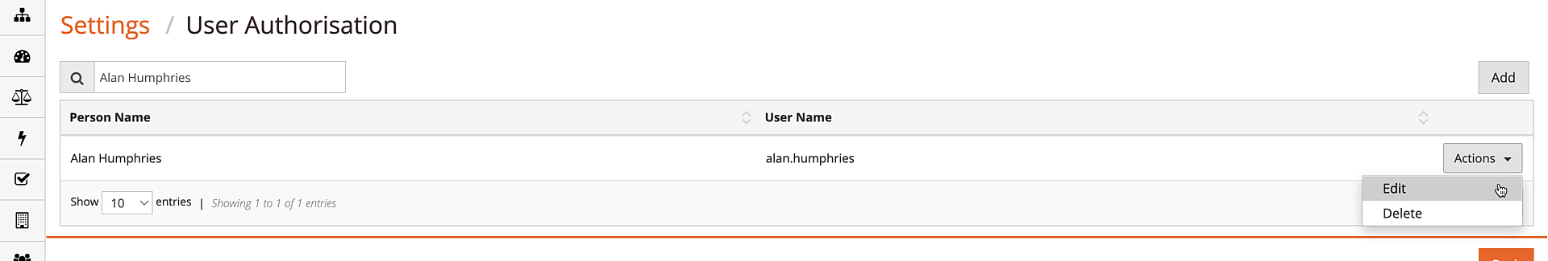
Password Management
Changing another User’s Password
In the third method, you may change the password on behalf of another Damstra Safety User, provided you have sufficient User permissions in your system.
To do this, go to Settings, then Users, then User Authorisation. Find the target User whose password you would like to change and select ‘Actions’, then ‘Edit’.
If you do not see these options in your system, you do not currently have sufficient permission to change another User’s password. Contact your systems administrator if you feel that this is an error.

Slide 6
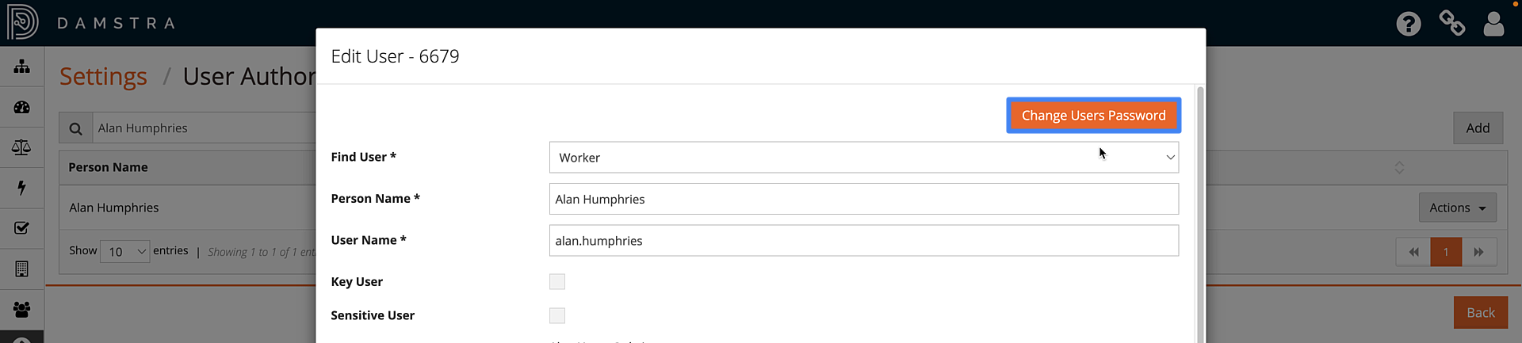
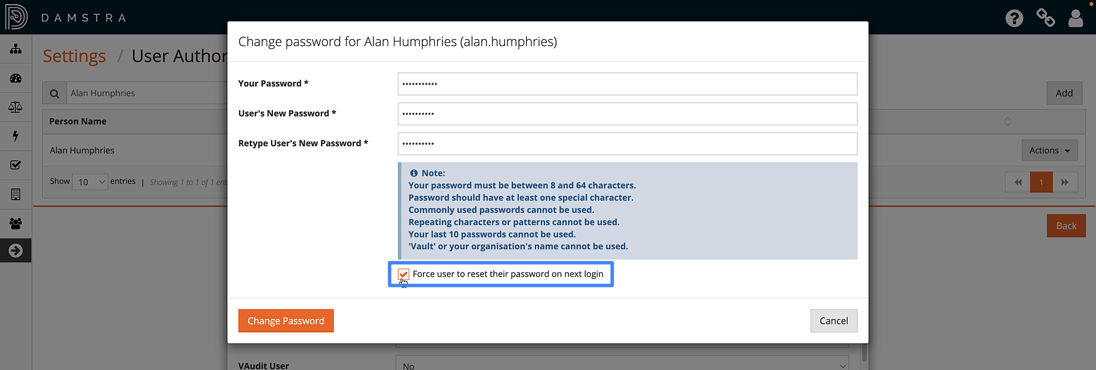
Password Management
Changing another User’s Password (cont)
Provided you do have adequate permission, in the pop-up form that appears, click the ‘Change Users Password’ button at the top of the form, and enter your current password, then the target User’s new password. Enter it once more to confirm.
Optionally, if you’d like to force the target User to reset their password to something known only to them the next time that they login, check the ‘Force User to reset their password on next login’ checkbox. The User will need to know the password you have temporarily set for them, and then they will be able to select a password of their own choosing.

Slide 7
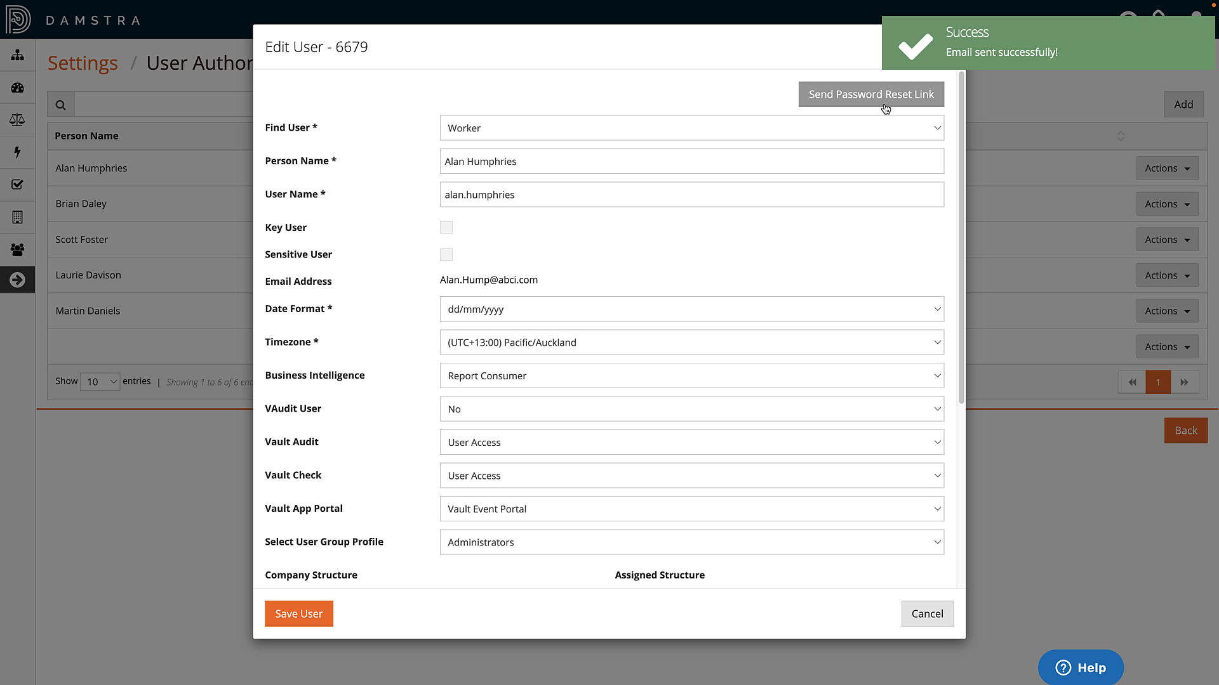
Password Management
Changing another User’s Password (cont)
In some instances, your Damstra Safety system may have been configured for Users to manage their own passwords.
In this case you will not be able to set the User’s password but will instead see a ‘Send Password Reset Link’ button at the top of the form.
Click the button to send reset instructions to the target User’s email address as recorded within their Worker record.

