Slide 1
Introduction to the Governance Module
Safety

Slide 2

[DISCLAIMER]
This presentation document has been prepared by Damstra Technology Limited (“Damstra") and is intended for off line demonstration, presentation and educational purposes.
The information is not version controlled and as such is subject to change without notice.
Damstra does not accept any responsibility or obligation to inform users of this presentation of such changes.
This includes any copies of this presentation taken and modified outside of the Damstra domain.

Slide 3
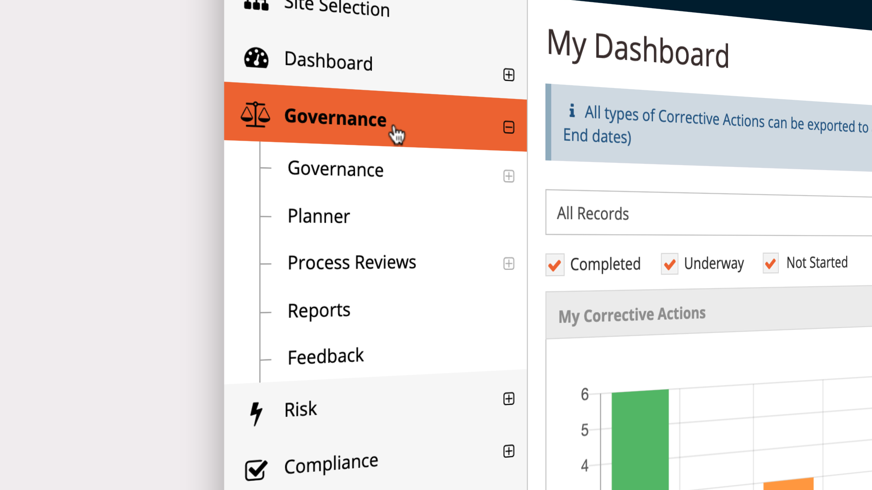
Introduction to the Governance Module
Introduction
Damstra Safety is your gateway to complete health and safety risk management. Understanding and knowing how to get the most out of each module across the system will help you achieve a full coverage view of the health and safety landscape across your Organisation.
If you haven’t already done so, we recommend that you first learn the fundamentals of getting around your system with our ‘Damstra Safety Essentials’ video which you can find separately in the Support Portal.
In this video we’ll take a high-level look at each section within the Governance module.

Slide 4
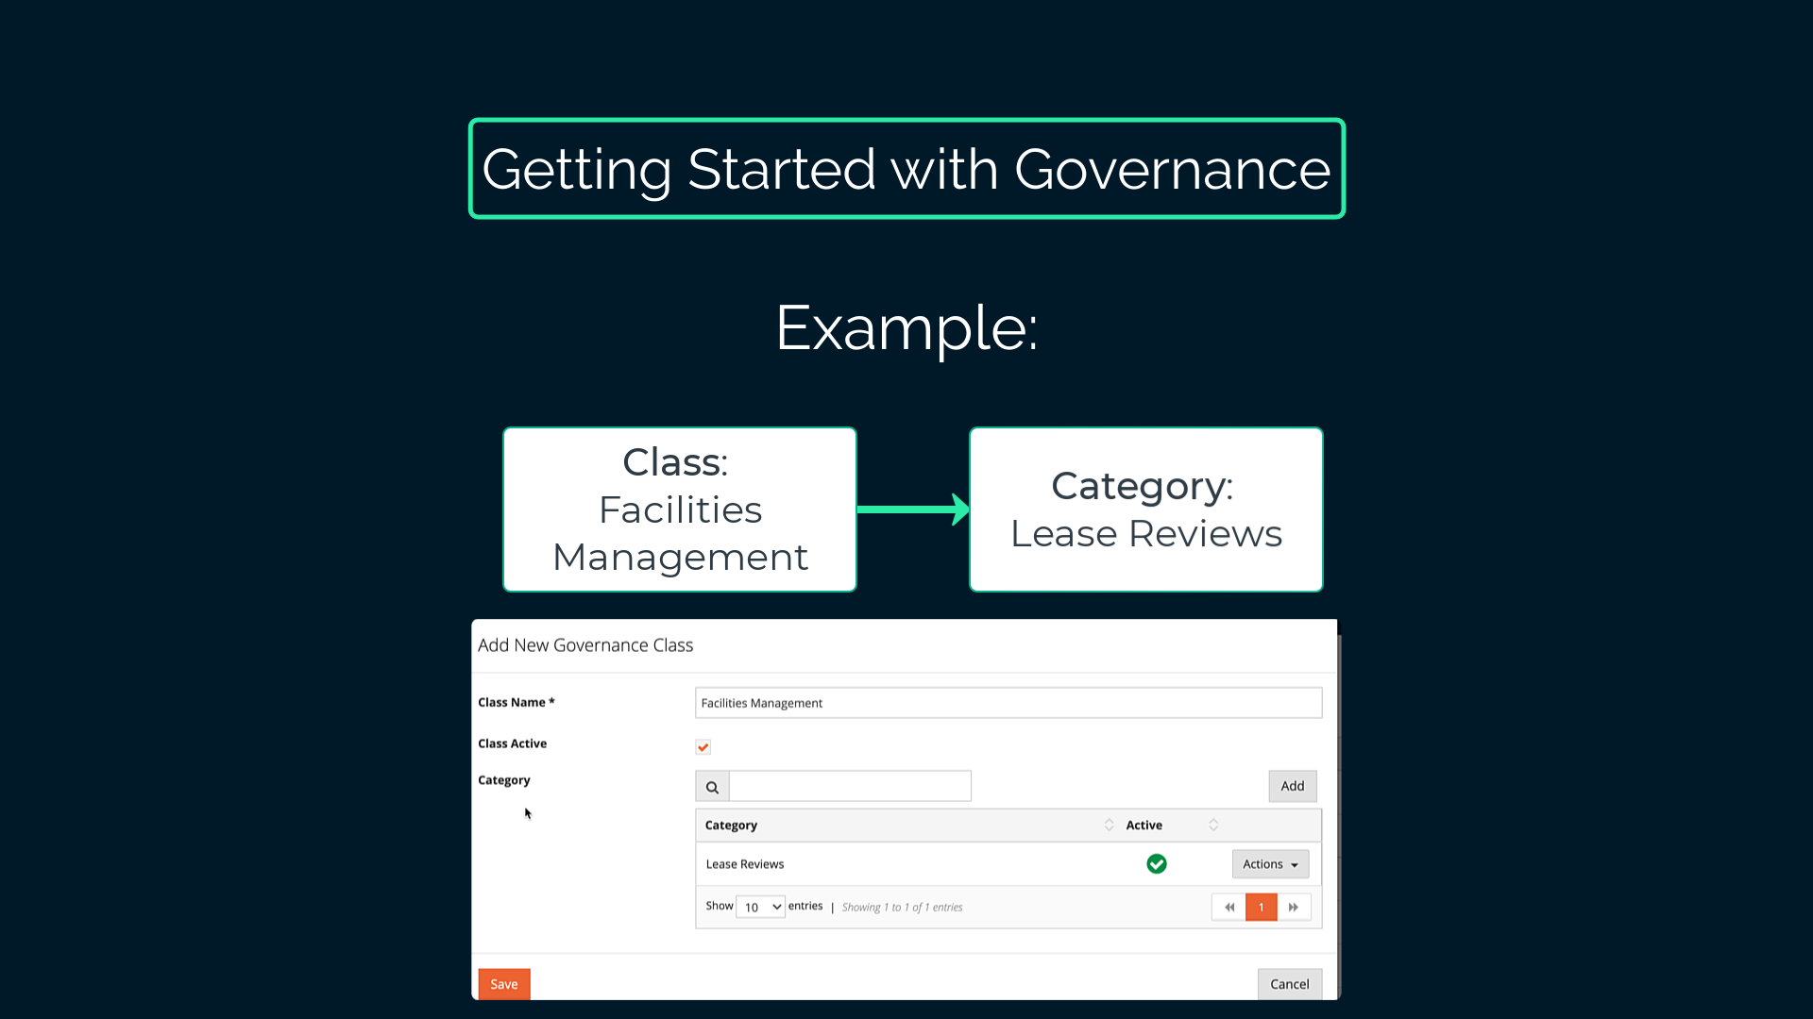
Introduction to the Governance Module
Getting Started with Governance
The Governance module offers tools to ensure that your business runs smoothly and compliantly by defining your governance objectives, providing visual progress tracking, and recording decisions and outcomes.
To get started, you’ll first need to define your Organisation’s high-level Governance objectives as a hierarchy of Categories and Classes via Settings. For example, if your Organisation manages facilities such as worksites or vehicles, you might need to review and manage leases for these items as time goes on. These governance objectives can be reflected into Damstra Safety by adding a ‘Facilities Management’ Class with a child Category of ‘Lease Reviews’.

Slide 5
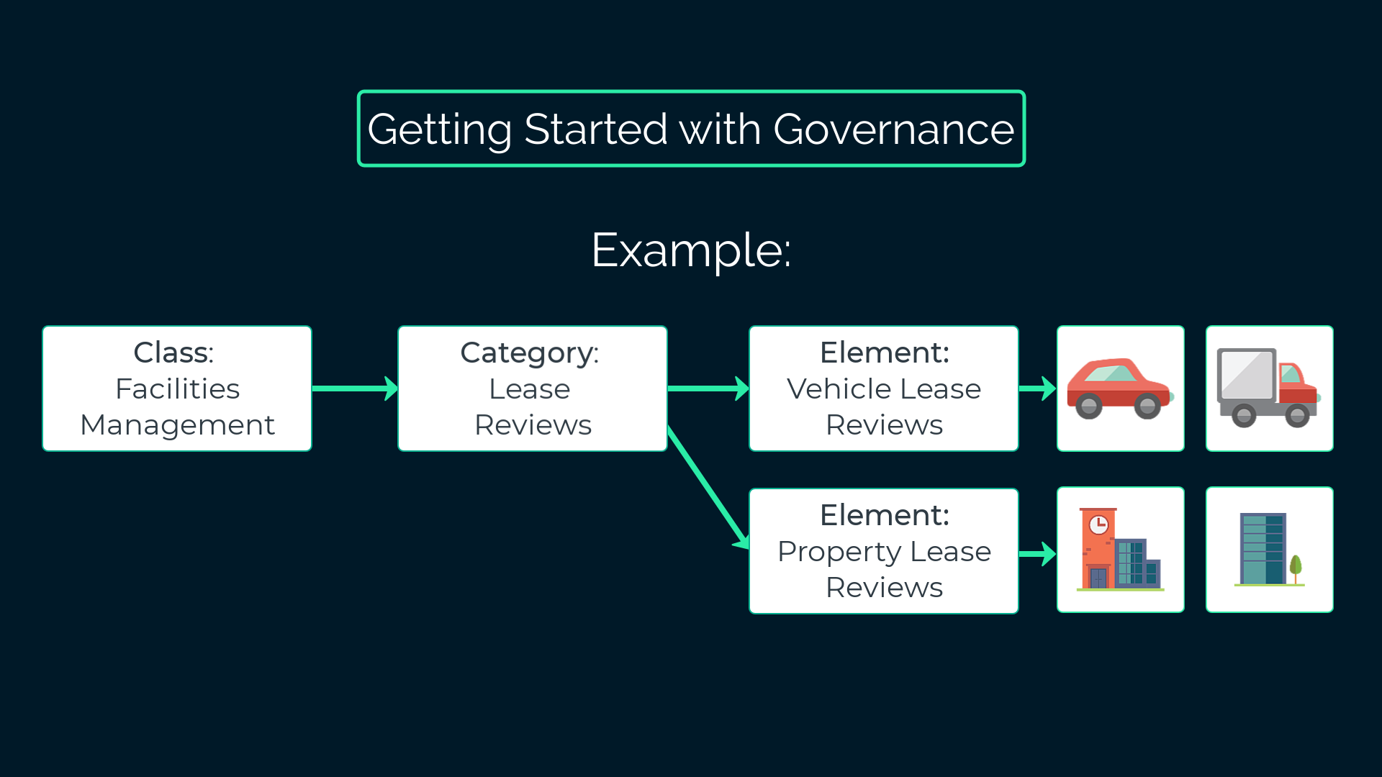
Introduction to the Governance Module
Getting Started with Governance (cont)
Now, you can break these high-level objectives down into more granular tasks – known in Damstra Safety as ‘Elements’ - via the Governance Elements section. Continuing the example of lease reviews, you might break this objective down into ‘Vehicle lease reviews’ and ‘Property lease reviews’.
Finally, in the ‘Elements Assigned’ section, link these tasks to the people, plant or asset items that will become the subject of those tasks. For example, assign the ‘Vehicle Lease Reviews’ Element to each leased vehicle in your fleet so that each vehicle is individually considered and select an accountable party. Do the same for ‘Property Lease Reviews’. Those accountable will be notified and will find the details in the ‘My Governance’ Dashboard.

Slide 6
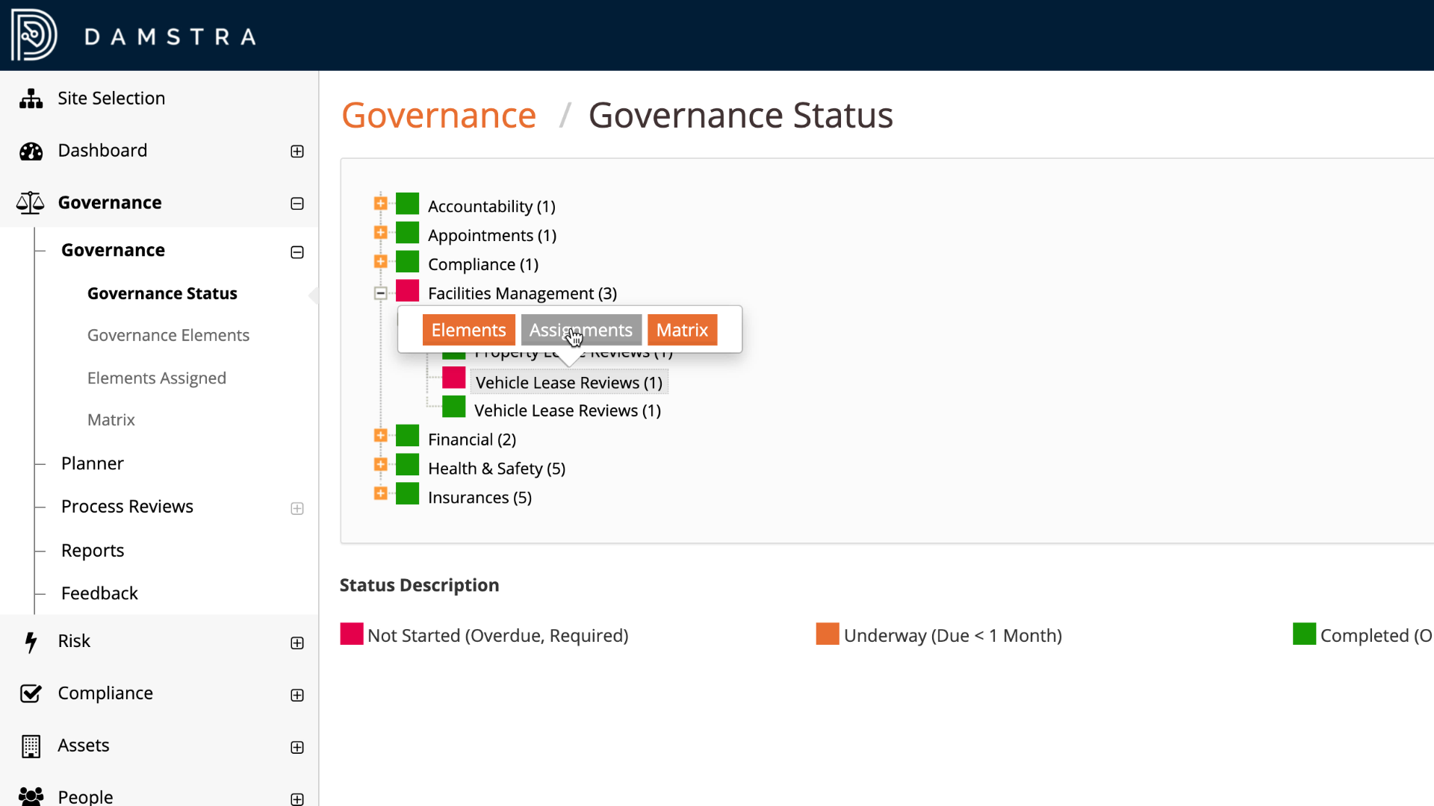
Introduction to the Governance Module
Governance Status
You can monitor the progress of these activities using the intuitive red-amber-green dashboard in the Governance Status section. For overdue or at-risk elements, drill-down for a concise view of what’s being held-up and who is accountable to keep things on-track.

Slide 7
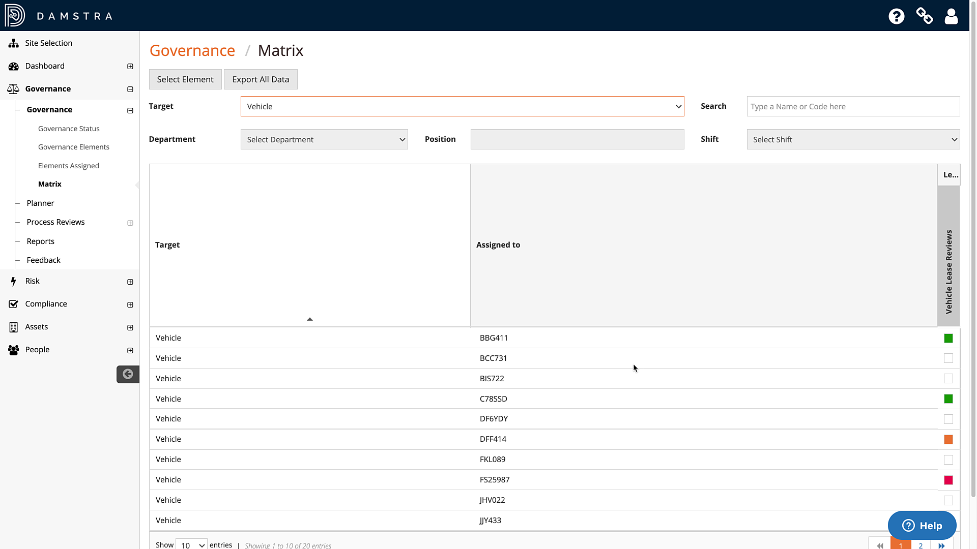
Introduction to the Governance Module
Governance Matrix
For additional filtered views of Governance progress across departments and teams, the Governance Matrix section provides a flexible crosstab view of the Governance landscape when required.

Slide 8
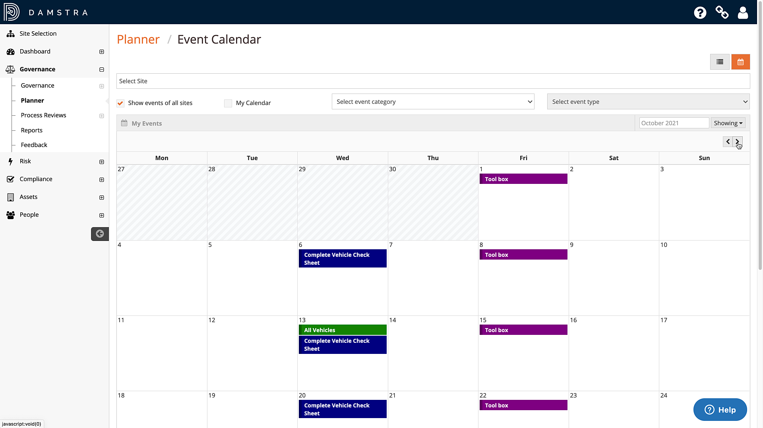
Introduction to the Governance Module
Planner
The Planner provides a consolidated calendar or register view of both upcoming and historical events that are recorded in the Compliance module of your Damstra Safety system but are relevant to Governance activities and are surfaced here so that you don’t need to search for them.
You can use the filters to find specific events or events of a particular type. You can even add new Events right from the planner.

Slide 9
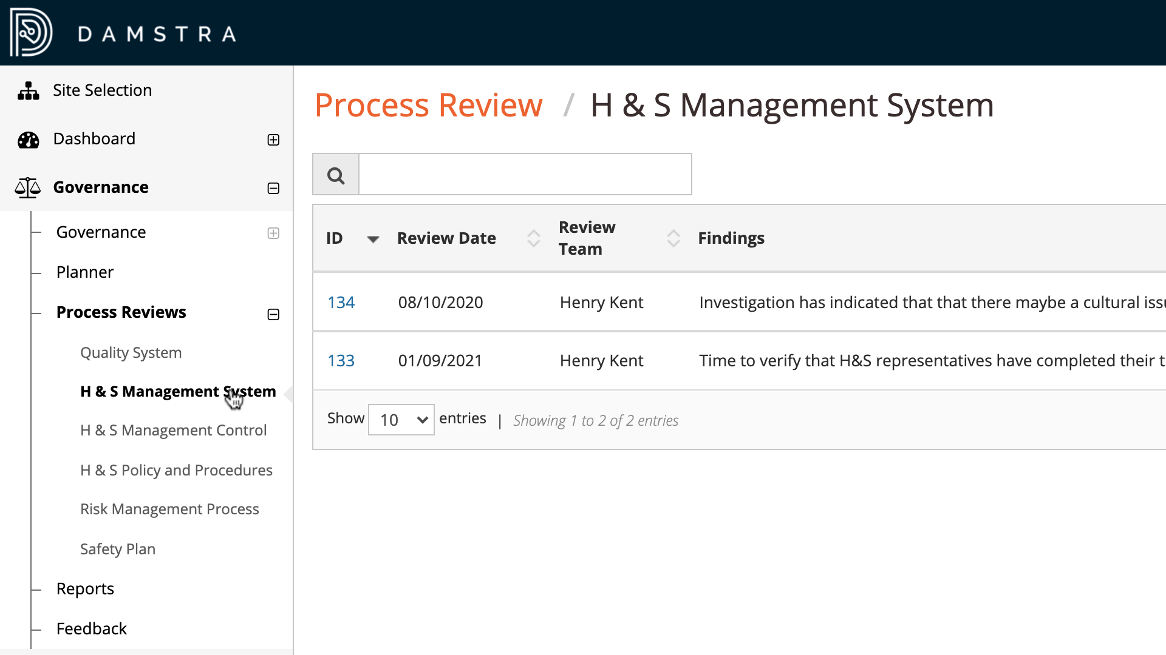
Introduction to the Governance Module
Process Reviews
As your business changes and grows over time, it’s important to ensure that the efficiency of your Safety Management System – of which Damstra Safety plays a key role – is periodically reviewed.
The Process Reviews section is built for this specific purpose, with registers for recording and tracking reviews of the various elements of your wider Safety Management System.
For each type of review, add detailed findings, actions and schedule the next review.

Slide 10
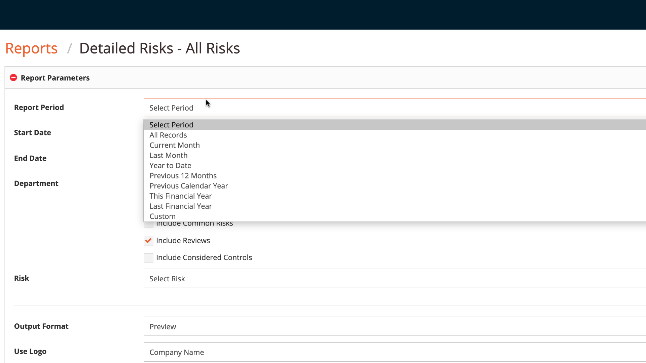
Introduction to the Governance Module
Reports
And to help with gaining insights from your data, the built-in Reporting suite provides basic reporting capability.
Search or browse for the data you’re interested in, select the parameters, then share the output with stakeholders.
Note that for those looking for even more power and flexibility to build complex, custom reports, talk to your account manager about our optional Business Intelligence module.

Slide 11
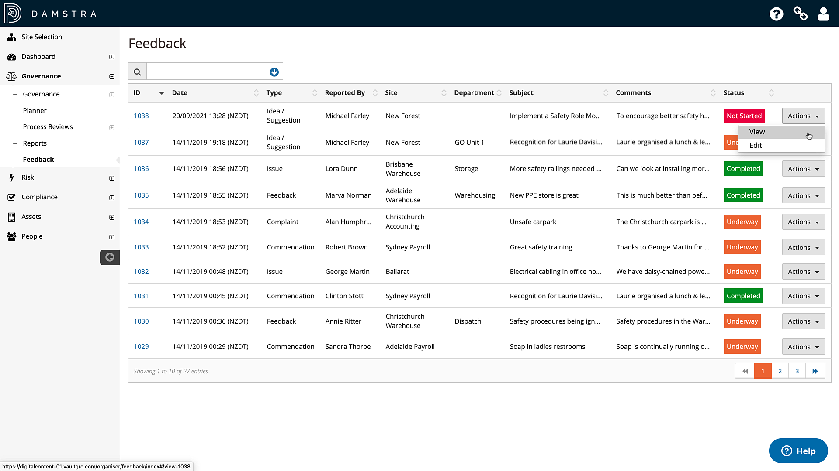
Introduction to the Governance Module
Feedback
And finally, hear what the wider business has to say about Health & Safety matters with the central Feedback register which anyone in your business can contribute to via simple, online Web Portals or the Notify mobile app.
Review each feedback item and create any Corrective Actions required to address issues and improve safety. Those responsible for the Corrective Actions are notified and they will also appear in that person’s Worker record.

Slide 12
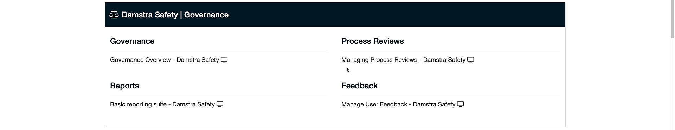
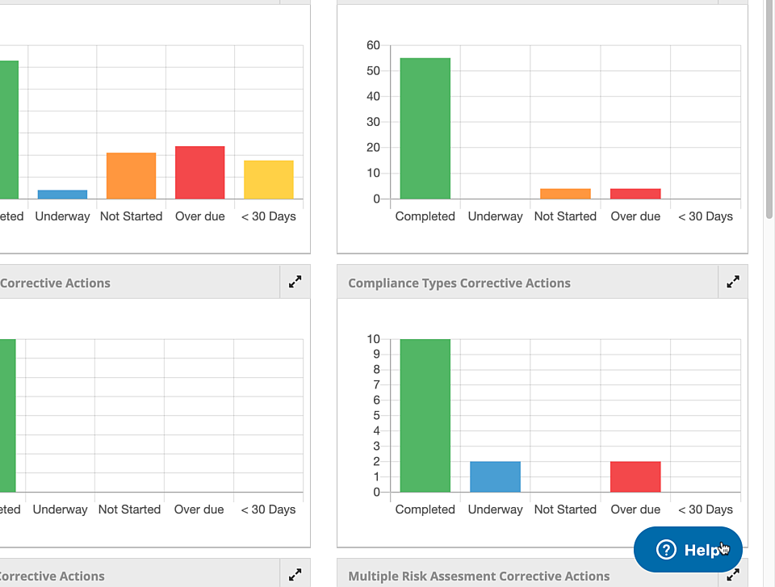
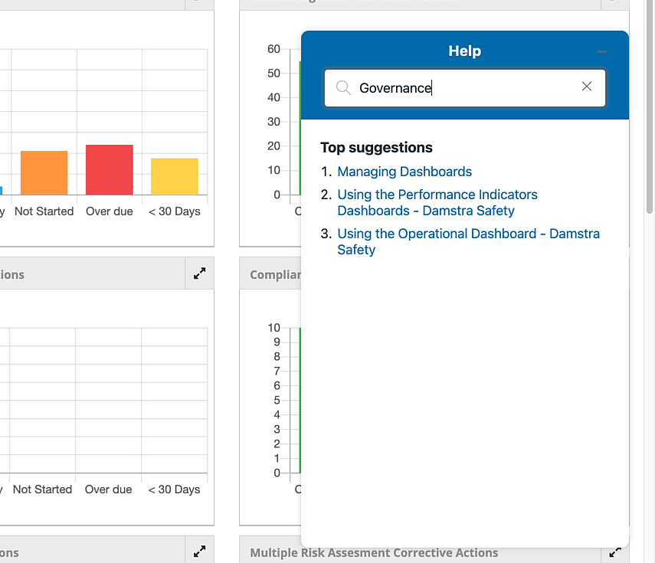
Introduction to the Governance Module
In-depth Help
For more in-depth help with any item in the Governance module, navigate to the Governance section of the Support Portal, or search using the built-in Help Widget.

